Slide 1
Common Course Numbering
CACCRAO Presentation, March 31, 2026

Slide 2
Presenters
Victor DeVore, Dean, Student Services
San Diego Community College District
Michelle Grimes-Hillman
Visiting Executive, Common Course Numbering
CCCCO

Slide 3
Common Course Numbering
California's move toward common course numbering is reshaping how colleges catalog, articulate, and communicate curriculum across the system. This general session explores the policy landscape driving the initiative, its implications for admissions and records operations, and what A&R professionals need to know to prepare their institutions for implementation.
From transcript evaluation and degree audit impacts to student-facing communication strategies, attendees will leave with a clearer picture of what's coming, and how to get ahead of it.

Slide 4
Why Common Course Numbering? Email Qs to ccn@cccco.edu
It is the law: Education Code 66275.5 amended by AB 1111 (2021, Berman)
“(a) (1) To streamline transfer from two- to four-year postsecondary educational institutions and reduce excess credit accumulation, on or before July 1, 2027, both of the following shall occur:
(A) The California Community Colleges shall adopt a common course numbering system for all general education requirement courses and transfer pathway courses.
(B) Each community college campus shall incorporate common course numbers from the adopted common course numbering system in its catalog.
(2) The common course numbering system shall be student facing…and ensure that comparable courses across all community colleges have the same course number.”
Why a law?
Current course numbering varies.
Transfer and articulation results vary by college and university.
Students deserve to have consistent information when choosing and articulating course work.
Improve credit mobility and equitable baccalaureate attainment.
Notes:
Education Code Sections 66725-66725.5 [via Assembly Bill No. 1111 (Berman)] require implementation of a student-facing common course numbering (CCN) system across the California Community Colleges on or before July 1, 2027. The CCN system assigns the same course number to comparable courses across all California community colleges in order to “streamline transfer from two- to four-year postsecondary educational institutions and reduce excess credit accumulation.” The CCN system establishes a structure that maximizes credit mobility for all students, strengthening equitable transfer and student success. More specifically, it supports students in areas such as building cohesive academic plans, understanding how required courses transfer and apply to completion, and making informed course selections that support degree completion. This effort requires the coordinated engagement of many stakeholders, including faculty, administrators, staff and system officials.

Slide 5
Why Common Course Numbering?
Students move between colleges and repeat courses, wasting time and money
Among recent associate degree completers, on average:
56% completed all coursework at 1 CCC
28% completed coursework at 2 CCCs
17% completed coursework at 3 or more CCCs
Inconsistent course numbering causes confusion
Complex transfer process can delay progress towards graduation
Academic Year | 1 College | 2 Colleges | 3 Colleges
2018-2019 | 77 | 83 | 92
2019-2020 | 76 | 82 | 90
2020-2021 | 74 | 81 | 88

Slide 6
Background and Vision
AB 111 Common Course Numbering Task Force (Sept. 2022 – Dec. 2023)
Intersegmental and cross-function membership
Report and recommendations (2023)
Common Course Numbering Project
Task: Implement recommendations from Task Force
Phased approach for template development and student-facing implementation
System-level Transferability and Articulation
From all California community colleges:
To four-year colleges/universities using CCN course templates
Common transferability
Consistent General Education applicability
Consistent course-to-course articulation
Potential for more consistent major prep articulation
Notes:
California Community Colleges Chancellor’s Office (Chancellor’s Office) formed the AB 1111 CCN Task Force (CCN Task Force) to make recommendations for a systemwide plan. The CCN Task Force published their final report and, in doing so, proposed a phased approach to meet the mandates of AB 1111. In Phase I, which was completed in summer 2024, faculty worked in collaboration with intersegmental leadership teams to developed CCN Templates for an initial set of high-enrollment courses to generate an initial set of CCN-aligned courses. Those courses went live for students in fall 2025. During Phase II, a second cluster of courses was used to evaluate and refine the development processes and templates, test technology-based implementation, test-drive convening practices and validate intersegmental collaboration. Phase IIA courses will be live in Fall 2026, and Phase IIB courses will be live in Fall 2027 (or earlier if the college chooses). Phase III templates have been developed but are yet to be released while the Chancellor’s Office works with UC and CSU to identify template-first transferability and articulation review processes.
The vision of CCN is to achieve intra- and inter segmental consistency for articulating commonly numbered courses within the California Community Colleges and between the University of California (UC), California State University (CSU), and the Association of Independent California Colleges and Universities (AICCU), while preserving institutional and faculty autonomy.

Slide 7
Implementation First Steps: Phase I Courses
Course | Enrollment Data (2022-23) | Cal-GETC Area
College Composition (ENGL 100) | 300K-330K | 1A
Argumentative Writing and Critical Thinking (ENGL 105) | 115K-140K | 1B
Public Speaking (COMM 110) | 150K-175K | 1C
Intro to Statistics (MATH 110) | 185K-225K | 2
Intro to American Government and Politics (POLS 110) | 125K-160K | 4
Intro to Psychology (PSY 110) | 145K-170K | 4
Notes:
As an immediate key priority, the CCN Steering Committee identified and recommended the selection of a cluster of courses for Phase I based on a set of high-enrollment data and in alignment with CalGETC as recommended by the CCN Task Force.

Slide 8

CCN Implementation Updates
Phases include 3 parts:
Template Development
CCC Course Revisions
UC/CSU Articulation Review
Phase I
Template Development
CCC Course Revisions
UC/CSU Articulation Review
Phase II
Template Development
CCC Course Revisions
UC/CSU Articulation Review
Phase III
Notes:
CCN is being rolled out in phases (ASCCC site here). Phase I CCN Templates have been successfully adopted, with 100% participation of CCCs, and are student-facing as of summer and fall 2025. The CCCCO is also exploring uses of AI to identify potential courses that should be commonly numbered.
Phase
Courses (Numbers indicated do not include Honors courses)
CCN Template Development Process
Expected Date for Public Implementation
Phase I
6 courses (6 high- enrollment courses were chosen for Phase I, representing over 1 million CCC enrollments)
Completed 2024 (articulation not yet established)
Student-facing at 115 California Community Colleges expected by fall 2025
Phase II student facing 23 courses over 2026/2027
Phase III student facing ~50 courses fall 2027
Significant legislative support, with substantial state investment ($10 million to CCCCO and $105 million to the CCCs), demonstrates California’s commitment to learner-centered transfer pathways.

Slide 9
CCN Course Templates
Course Outline of Record Element
Subject Code & Course Number | Identical
Course Title | Identical
Lecture & Lab Units | Adheres to an Established Minimum
Course Description | Part 1: Identical Part 2: Optional Expanded Details
Prerequisites, Corequisites | Identical
Course Content Lab Content | Part 1: Identical Part 2: Optional Expanded Details
Course Objectives/Outcomes | Part 1: Identical Part 2: Optional Expanded Details
Methods of Evaluation (Representative), Textbooks (Representative Samples) | Part 1: Identical Part 2: Optional Expanded Details
Notes:
Cheryl

Slide 10
Vision of Template-First Review and Determinations
Transferability
115 credit-granting CCCs submit individual CORs to ASSIST for:
UC transferability (UC only)
UC transfer eligibility (UC only)
Cal-GETC (UC and CSU)
Determinations vary by community colleges, impacting transfer students.
Confusion and adverse impacts on students will increase with CCN.
Students should reasonably assume commonly numbered courses will transfer the same; not currently the case.
Articulation: Course-to-Course and Major Prep
115 credit-granting CCCs submit individual CORs to ASSIST for course-to-course and major prep.
Determinations vary widely by community colleges; coursework is relatively consistent across the system.
Notes:
There is concern about the articulation of CCN courses. How are the CCN aligned courses from Phase I (student-facing fall 2025) and Phase II (student-facing for fall 2026 and fall 2027) recognized for transfer and degree credit at other institutions? While CCN aims to simplify and align course numbering and naming across colleges, it is critical that these shared course numbers are backed by formal transferability and articulation agreements that are consistent across the CCCs, no matter where a student takes a course. Without these agreements, students may assume a course like ENGL C1000: Academic Reading and Writing will automatically meet the same requirements at different colleges or universities, which may not be the case. The CCN Council continues to advocate for systemwide transferability and articulation agreements to accompany the development of CCN templates. Relying on individual colleges to negotiate separate agreements could result in inconsistencies that disadvantage students.

Slide 11
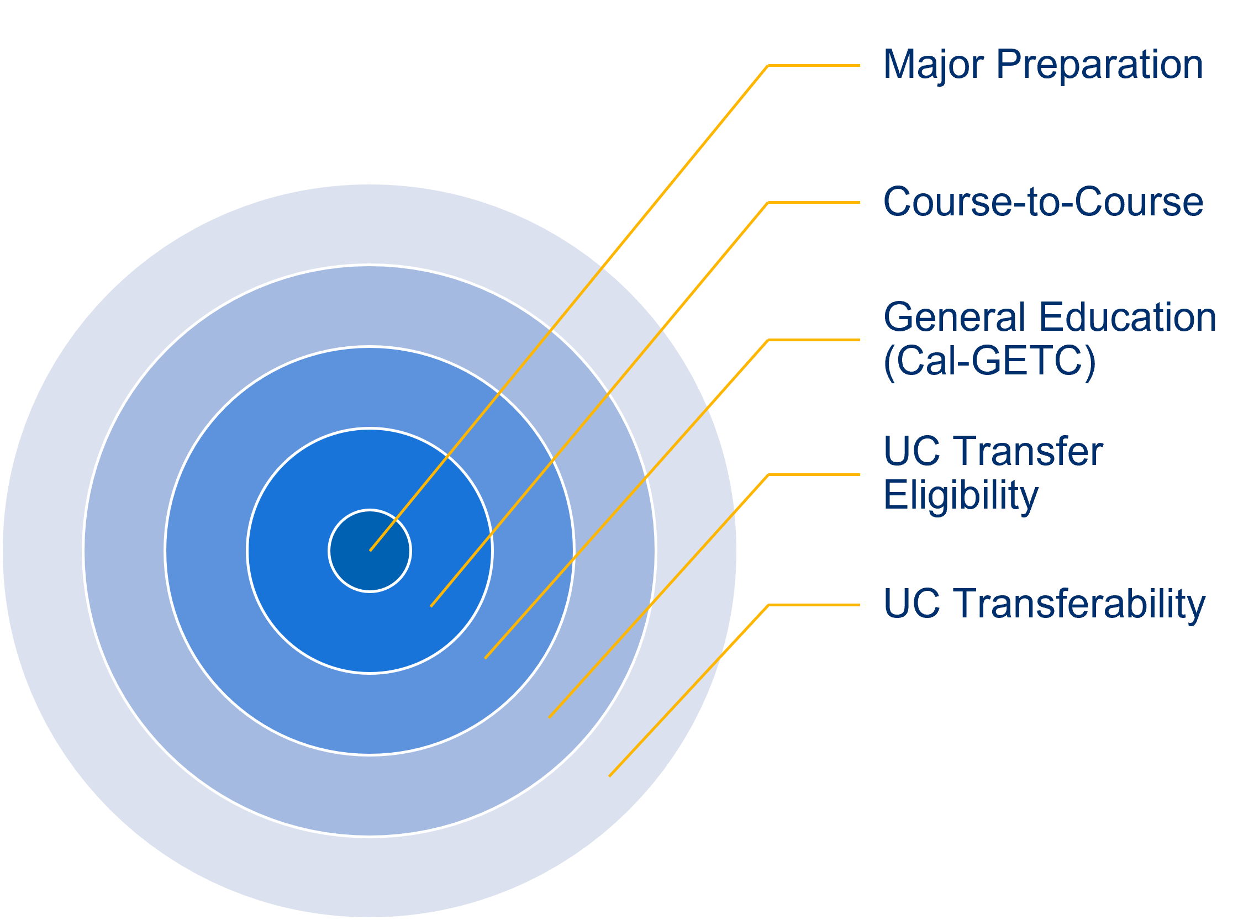
System-Level Transferability vs. Local Articulation
The vision is to utilize templates NOW for system-level review of UC transferability, UC transfer eligibility, and Cal-GETC.
Reviews for the outer three rings are done at UC and CSU system offices
Course-to-course and major preparation review and determinations are the responsibility of local university faculty efforts; templates can streamline workload for faculty and support credit mobility.
Notes:
More than 2,000 CCN-aligned course outlines have now been submitted by colleges across California. As more of these courses become student-facing in Fall 2026 and Fall 2027, they will serve thousands of transfer-bound students who deserve clarity, consistency, and confidence that their coursework will carry forward. This work is more than structural alignment: it is a statewide commitment to transparency, equity, and credit mobility consistent with the promise of AB 1111 (Berman, 2021). Initial template-first review efforts focus on the outer rings of the image above: transferability and Cal-GETC. Later efforts will focus on course-to-course and major preparation, which are conducted by faculty within college and university departments or programs.

Slide 12
Common Course Numbering (CCN)
Phase III template release delayed.
Colleges will be expected to have Phase III CCN-aligned courses student-facing no earlier than by fall 2028.
Colleges are expected to continue alignment and prepare to have Phase IIA and Phase IIB aligned courses student-facing and in their catalogs by Fall 2026 and Fall 2027 respectively.
Transfer and Articulation Update – Proposed legislation (AB2236, Berman)
TOP2CIP for ADTs and CCN (Collaborated with ASCCC to assign CIPs)
Used existing CIPs and made efforts to align and maintain CTE/Non-CTE structures
Will be published soon
Identifying the future CCN Courses (post Fall 2027) via
CCN Scope and Sequencing workgroup (using AI and intersegmental AOs input)
Template review process under discussion, but expect templates to be reviewed every 5-7 years
Notes:
The Phase III Templates will be considered for release pending the opportunity to utilize CCN Course Templates as a vehicle for transferability and articulation.
In a nutshell, AB 2236 moves California from campus-by-campus articulation to a mandatory, systemwide articulation model tied to common course numbering. The bill does not create new "common courses' But rather reinforces the existing faculty work currently completed by AB1111. The bill does not require the CSU or UC to adopt a common course number but rather requires the CSU to participate and to use templates to create articulation agreement so every community college that aligns itself with a template is granted the same articulation by any CSU (or UC) that accepts the template. Student reasonable expect that if they take a CCN course that it will lead to the same transfer outcome. We encourage the all CCC colleagues to learn about the proposed legislation. According to the CSU data dashboard, LAO, and PPIC research transfer students tend to graduate in less time and tend persist at great rates compared to the CSU first time freshmen. The CCC faculty prepare transfer students to be successful at 4-year universities, there is no need to scrutinize course outlines at levels that seem to not honor the academic freedom of the CCC faculty.
Currently, even when courses share a common course number, articulation between a community college and CSU or UC may still require individual campus review and approval. This bill requires the segments to replace that individualized review process with a streamlined, system-level agreement that uses common course numbering templates to determine equivalency. Currently, even when courses share a common course number, transferability and articulation between a community college and CSU or UC still require individual campus review and approval, which results in inconsistencies which are disruptive to student progress. AB2236 requires the segments to replace that individualized review process with a streamlined, system-level agreement that uses common course numbering templates to determine equivalency.
The Chancellor’s Office, in collaboration with the Academic Senate for California Community Colleges (ASCCC), has completed identification of the Classification of Instructional Programs (CIP) codes aligned to existing Transfer Model Curricula (TMCs) and corresponding CCN templates. This work was undertaken to promote consistency, reporting clarity, and alignment across associate degrees and commonly numbered courses. Identical CIP codes will apply to corresponding ADTs and CCN templates. These codes will be uploaded directly into COCI; no additional action is required by colleges.
CIP selection prioritized outcome alignment, the educational scope of an associate degree, and the presence or absence of existing specificity within Taxonomy of Programs (TOP) codes, rather than relying exclusively on within-discipline specificity. It is important to clarify that CIP codes are used for reporting and classification purposes. They do not determine Minimum Qualifications, local discipline assignment under title 5, or override guidance contained in the Program and Course Approval Handbook. The Chancellor’s Office will publish details of CIP assignments for the ADTs and CCN templates as they become available.
The Chancellor’s Office is currently surveying colleges to identify potential impacts associated with the TOP-to-CIP transition, including instances where CIP alignment may affect CTE or non-CTE designation. Feedback from the field is currently informing ongoing refinement (through the end of March) and targeted technical assistance to support colleges through implementation. Please see the TOP-to-CIP website for more information.
The CCN Council is also forming work groups to advance activities outlined in the sustainability plan, including testing an artificial intelligence (AI) tool to identify courses that may be commonly numbered in the future, as well as continuing to advocate for practical systemwide solutions for transferability and articulation.

Slide 13
Fall 2025 Student Impact by the numbers: Phase I CCN enrollment
CCN Taxonomy | Course Title | CCN 25 Fall Enrollment
ENGL C1000 | Academic Reading and Writing | 189,072
ENGL C1001 | Critical Thinking and Writing | 35,638
COMM C1000 | Introduction to Public Speaking | 89,540
STAT C1000 | Introduction to Statistics | 79,486
POLS C1000 | American Government and Politics | 55,445
PSYC C1000 | Introduction to Psychology | 80,283
ENGL C1000H | Academic Reading and Writing (Honors) | 1,288
ENGL C1001H | Critical Thinking and Writing (Honors) | 814
COMM C1000H | Introduction to Public Speaking (Honors) | 488
STAT C1000H | Introduction to Statistics (Honors) | 336
POLS C1000H | American Government and Politics (Honors) | 509
PSYC C1000H | Introduction to Psychology (Honors) | 583
ENGL C1000E | Academic Reading and Writing (Embedded Support) | 10,057
STAT C1000E | Introduction to Statistics (Embedded Support) | 6,974
Total |  | 550,513

Slide 14
Conservative Estimate of Potential Student Enrollments Phases I-III: Based on AY24-25 CID enrollments
Phase | Number of Standard Templates | CID 24/25 Enrollment
Phase I | 6 | 1,237,719
Phase IIA | 8 | 481,908
Phase IIB | 10 | 410,940
Phase III | 52 | 1,776,469
Totals | 76 | 3,907,036
Note:
Does not include potential enrollment from Honors and Embedded Support Courses
Does not include courses that were not available in MIS data based on CID

Slide 15
CCN Student Communication, Education Plans, and Transcripts
What is your college doing to educate students?
Icangotocollege.com includes CCN information and the project website has branding and social media materials for colleges to use.
Technology has been an ongoing issue for the colleges.
Student-facing information must reflect identical CCN elements.
Help us educate students and our campuses!
Review student education plans and transcripts for CCN taxonomy accuracy.
Is the student-facing information accurate and in alignment with the intended taxonomy? See the Taxonomy FAQ.
CCCs received funding for CCN implementation – your work matters.
Notes:
Check out the branding and marketing tools available for use. The CCCs have been very innovative in producing crosswalks and media information to share with students. What has your college done?
As you can imagine, technology can create unintended barriers when implementing a new initiative. There is concern that some CCCs may not be able to accurately display the CCN taxonomy and titles on students' ed plans and transcripts.
At the request of the CSU and UC systems, a survey was sent to CIOs and CSSOs to gather data on what information appears on student transcripts and what is transmitted to the system offices.
Please review your local education plans and student transcripts. This effort is important to ensure accurate transfer evaluations, as many students are currently applying to transfer.
Your assistance in reviewing student education plans and transcripts for CCN accuracy is greatly appreciated. The CCN title and taxonomy must be identical for this process to work both intra- and intersegmentally. The goal is to ensure that students receive full and appropriate credit for their coursework.
We will be talking about the transcripts at the breakout during CCCARO conference in Sacramento on March 31st at 3:15 to 4:05pm. Come bring your questions and ideas to this breakout.

Slide 16
CCN Stakeholders
Internal Stakeholders
Faculty (across all departments)
Classified Professionals
Academic Senate
Classified Senate
Student Services
Information Technology
Admissions and Records
Research
External Stakeholders
Current Students
New/Returning Students
High School Students
Noncredit Students
High School Partners
University Partners
Notes:
Check out the branding and marketing tools available for use. The CCCs have been very innovative in producing crosswalks and media information to share with students. What has your college done?
As you can imagine, technology can create unintended barriers when implementing a new initiative. There is concern that some CCCs may not be able to accurately display the CCN taxonomy and titles on students' ed plans and transcripts.
At the request of the CSU and UC systems, a survey was sent to CIOs and CSSOs to gather data on what information appears on student transcripts and what is transmitted to the system offices.
Please review your local education plans and student transcripts. This effort is important to ensure accurate transfer evaluations, as many students are currently applying to transfer.
Your assistance in reviewing student education plans and transcripts for CCN accuracy is greatly appreciated. The CCN title and taxonomy must be identical for this process to work both intra- and intersegmentally. The goal is to ensure that students receive full and appropriate credit for their coursework.
We will be talking about the transcripts at the breakout during CCCARO conference in Sacramento on March 31st at 3:15 to 4:05pm. Come bring your questions and ideas to this breakout.

Slide 17

CCN Marketing
Notes:
Check out the branding and marketing tools available for use. The CCCs have been very innovative in producing crosswalks and media information to share with students. What has your college done?
As you can imagine, technology can create unintended barriers when implementing a new initiative. There is concern that some CCCs may not be able to accurately display the CCN taxonomy and titles on students' ed plans and transcripts.
At the request of the CSU and UC systems, a survey was sent to CIOs and CSSOs to gather data on what information appears on student transcripts and what is transmitted to the system offices.
Please review your local education plans and student transcripts. This effort is important to ensure accurate transfer evaluations, as many students are currently applying to transfer.
Your assistance in reviewing student education plans and transcripts for CCN accuracy is greatly appreciated. The CCN title and taxonomy must be identical for this process to work both intra- and intersegmentally. The goal is to ensure that students receive full and appropriate credit for their coursework.
We will be talking about the transcripts at the breakout during CCCARO conference in Sacramento on March 31st at 3:15 to 4:05pm. Come bring your questions and ideas to this breakout.

Slide 18
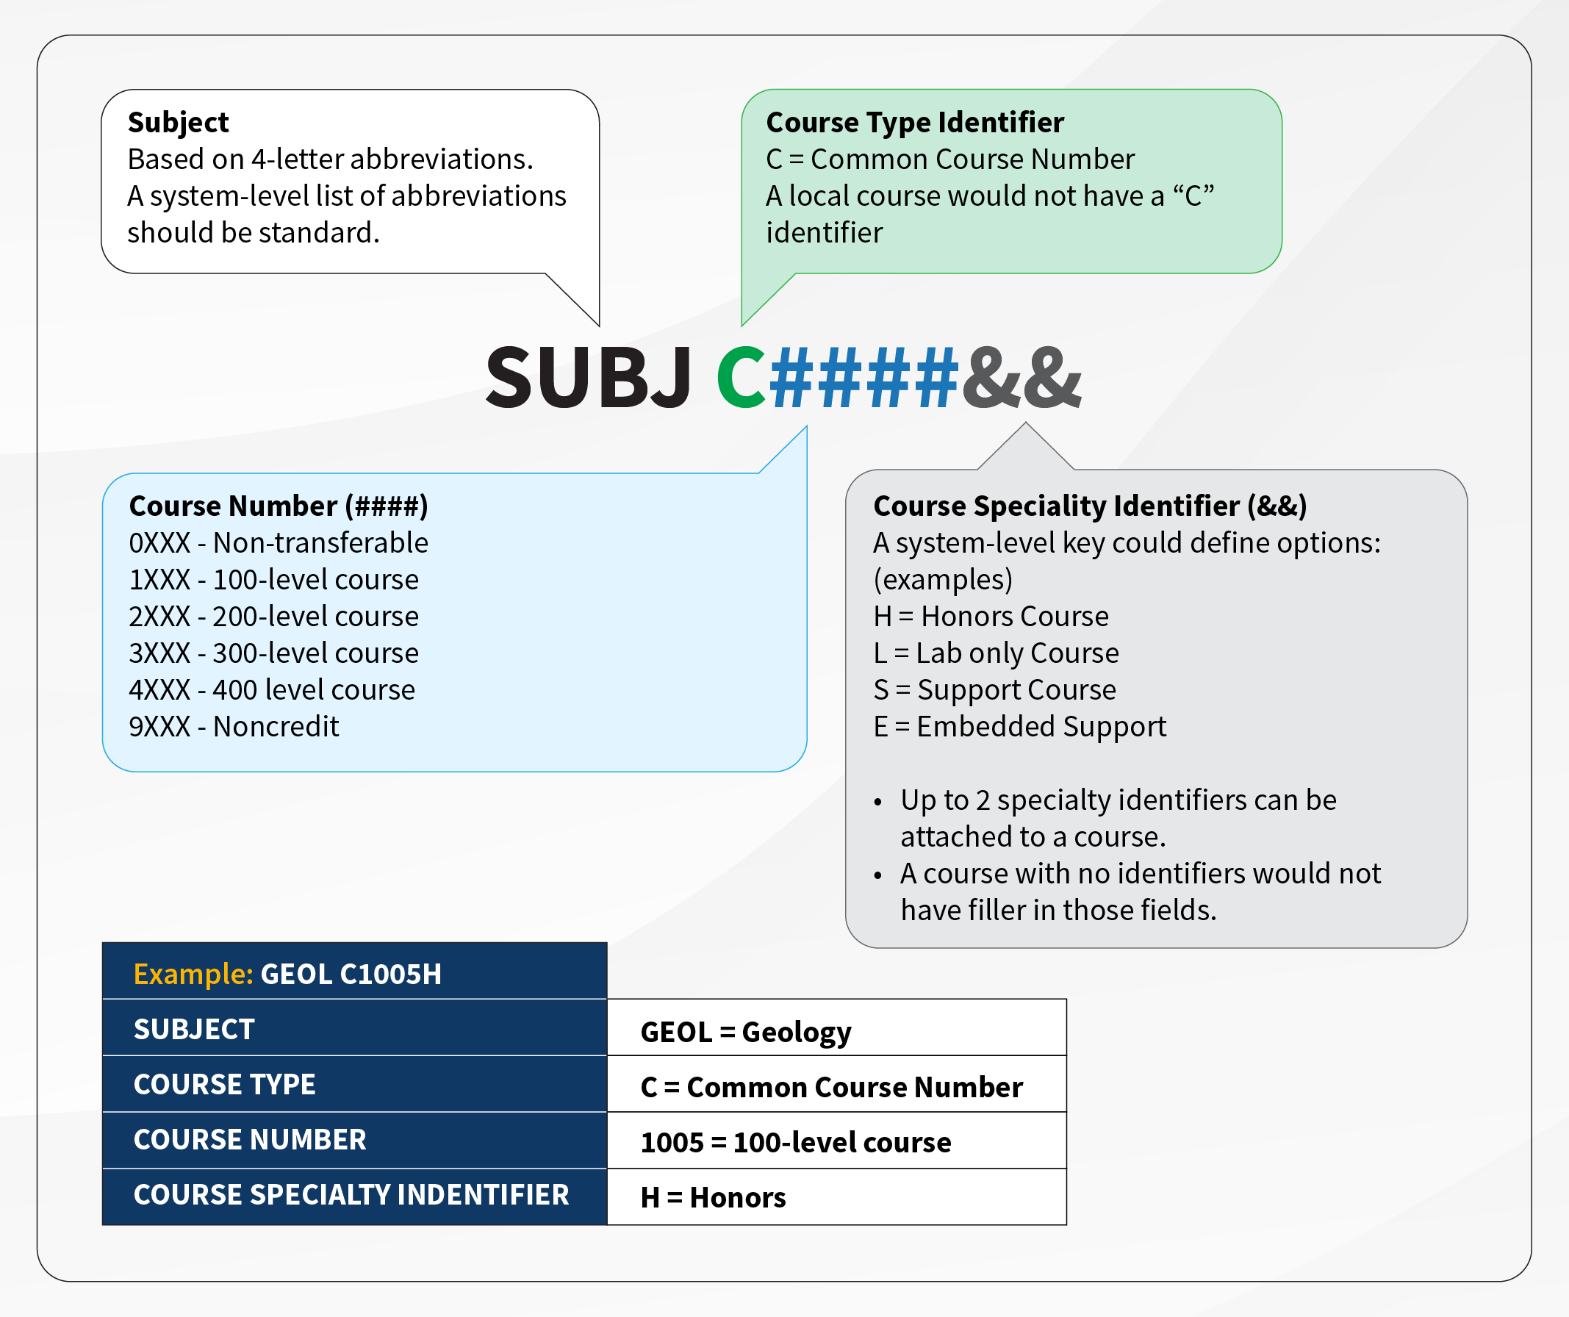
Taxonomy is 11 characters total: no extra hyphens, no extra spaces
Subject: 4 characters
CCN Identifier: C (1 character)
Course Number: 4 characters
Special Identifiers: Up to 2 characters: L, E, H, or LH
We currently do not have any CCN courses using an S

Slide 19
Examples of Student Transcript Data: ENGL C1000 Academic Reading and Writing
The addition of hyphens, spaces, and incorrect title and taxonomy - truncation happens!
College CORRECT: ENGL C1000 Academic Reading and Writing
College X: ENGL C1000 ACADEMIC READ & WRITE
College Y: ENGL-C1000 Academic Read & Writ
College Z: ENGL-C1000 Academic Reading and Writing
College H: ENGL-C1000 Academic Reading and Writin
College J: ENGL C1000 Academic Reading & Writing
College K: ENGL C1000 Academic Reading & Writing
College L: ENGL C1000 ACAD RDG AND WRIT
College M: ENGL 100 Reading and Composition
College N: ENG 101 Academic Reading and Writing (CCN: ENGL C1000)
College O: ENGL 1500 Composition and Reading

Slide 20
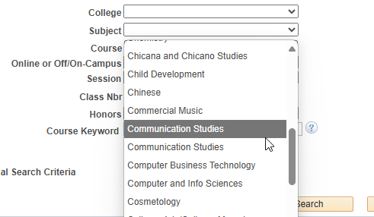
CCN Considerations
Check your SIS class search. Some are fairly restrictive in how it shows (e.g. PeopleSoft)
Make sure your feeder high schools have the updated curriculum to ensure that your articulation and CCAP agreements will not be affected.
Online Class Search will display both. So if students look up MATH they'll see both MATH and STAT
Notes:
Check out the branding and marketing tools available for use. The CCCs have been very innovative in producing crosswalks and media information to share with students. What has your college done?
As you can imagine, technology can create unintended barriers when implementing a new initiative. There is concern that some CCCs may not be able to accurately display the CCN taxonomy and titles on students' ed plans and transcripts.
At the request of the CSU and UC systems, a survey was sent to CIOs and CSSOs to gather data on what information appears on student transcripts and what is transmitted to the system offices.
Please review your local education plans and student transcripts. This effort is important to ensure accurate transfer evaluations, as many students are currently applying to transfer.
Your assistance in reviewing student education plans and transcripts for CCN accuracy is greatly appreciated. The CCN title and taxonomy must be identical for this process to work both intra- and intersegmentally. The goal is to ensure that students receive full and appropriate credit for their coursework.
We will be talking about the transcripts at the breakout during CCCARO conference in Sacramento on March 31st at 3:15 to 4:05pm. Come bring your questions and ideas to this breakout.

Slide 21
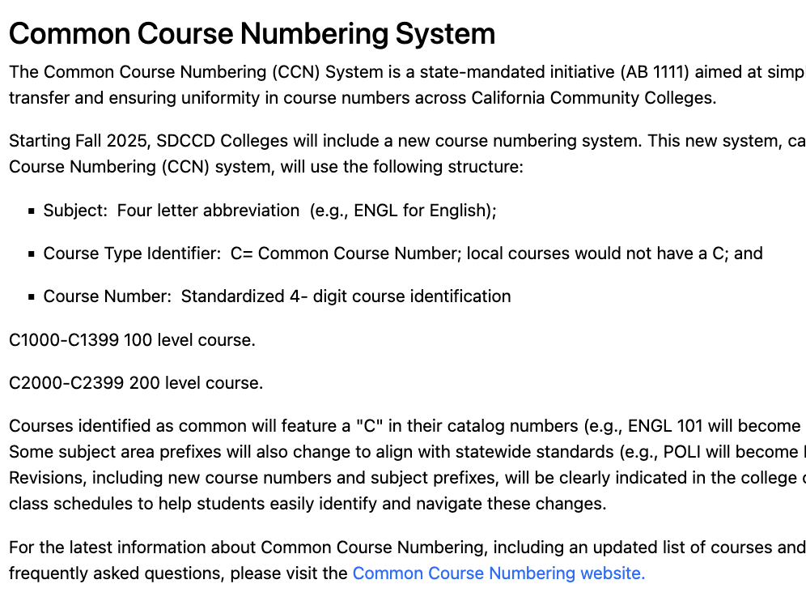
CCN Considerations
The college catalog clearly explains the common course numbering system
Notes:
Check out the branding and marketing tools available for use. The CCCs have been very innovative in producing crosswalks and media information to share with students. What has your college done?
As you can imagine, technology can create unintended barriers when implementing a new initiative. There is concern that some CCCs may not be able to accurately display the CCN taxonomy and titles on students' ed plans and transcripts.
At the request of the CSU and UC systems, a survey was sent to CIOs and CSSOs to gather data on what information appears on student transcripts and what is transmitted to the system offices.
Please review your local education plans and student transcripts. This effort is important to ensure accurate transfer evaluations, as many students are currently applying to transfer.
Your assistance in reviewing student education plans and transcripts for CCN accuracy is greatly appreciated. The CCN title and taxonomy must be identical for this process to work both intra- and intersegmentally. The goal is to ensure that students receive full and appropriate credit for their coursework.
We will be talking about the transcripts at the breakout during CCCARO conference in Sacramento on March 31st at 3:15 to 4:05pm. Come bring your questions and ideas to this breakout.

Slide 22
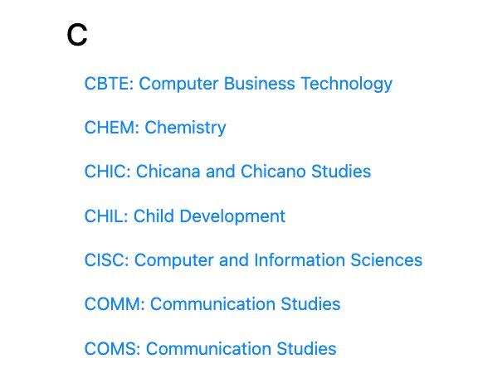


CCN Considerations
Help students navigate designator changes in the college catalog
Notes:
Check out the branding and marketing tools available for use. The CCCs have been very innovative in producing crosswalks and media information to share with students. What has your college done?
As you can imagine, technology can create unintended barriers when implementing a new initiative. There is concern that some CCCs may not be able to accurately display the CCN taxonomy and titles on students' ed plans and transcripts.
At the request of the CSU and UC systems, a survey was sent to CIOs and CSSOs to gather data on what information appears on student transcripts and what is transmitted to the system offices.
Please review your local education plans and student transcripts. This effort is important to ensure accurate transfer evaluations, as many students are currently applying to transfer.
Your assistance in reviewing student education plans and transcripts for CCN accuracy is greatly appreciated. The CCN title and taxonomy must be identical for this process to work both intra- and intersegmentally. The goal is to ensure that students receive full and appropriate credit for their coursework.
We will be talking about the transcripts at the breakout during CCCARO conference in Sacramento on March 31st at 3:15 to 4:05pm. Come bring your questions and ideas to this breakout.

Slide 23

Resources
CCCCO Project Website
Templates
Quarterly Updates
Talking Points
Branding/Digital Media
Slide Deck
Icangotocollege
ASCCC CCN Project Site
@TransferNationCA

Slide 24
Q&A
CCN@CCCCO.EDU
CCNSUPPORT@ASCCC.ORG

