Slide 1

Board Policies, Procedures and You
A Guide for Admissions and Records Professionals

Slide 2

CACCRAO Annual Conference
Victor DeVore, Dean, Student Services San Diego Community College District

Slide 3
Session Objectives
Examine how board policies interact with federal law, California Education Code, and Title 5
Identify BPs and APs that fall within the purview of Admissions and Records
Navigate the participatory governance process for policy approval
Understand the CCLC Board Policy and Administrative Procedure Service and how to use CCLC templates effectively
Determine when content belongs in board policy versus the college catalog

Slide 4

Taking a Pulse

Slide 5
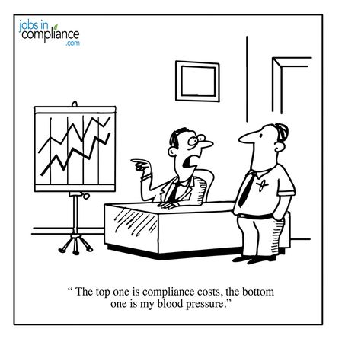
CACCRAO Annual Conference
The Regulatory Framework

Slide 6

The Regulatory Hierarchy
Federal Law (Top Tier): FERPA, Title IV (HEA), Title IX, ADA, Veterans’ Benefits
California Education Code (Second Tier): Ed Code §76000 (admissions), §68000 (residency), §76200 (records)
Title 5, CA Code of Regulations (Third Tier): Regulations by Board of Governors with force of law
Board Policies (Fourth Tier): Adopted by local governing board — broad direction and expectations
Administrative Procedures (Fifth Tier): Implement board policies with operational detail

Slide 7
When Do Regulations Take Effect?
Federal and State Regulations (e.g. Education Code) take effect once the bill is signed into law by the Governor, unless stated specifically in the legislation: This bill, commencing July 1, 2026, would require the above referenced schools and institutions
Title 5 regulations take effect 180 days after filed with the Secretary of State.

Slide 8
Education Code vs. Title 5
Education Code is restrictive, defines what districts must do.
Created/modified through the legislative process.
Title 5 is permissive, letting colleges know what the minimum requirements are to be in compliant with regulations.
Created/modified through the CCCCO

Slide 9
Key Federal Laws Impacting A&R
FERPA (20 U.S.C. §1232g): Student records privacy, directory information, release of records → BP/AP 5040, 5045
Title IV (Higher Education Act): Financial aid eligibility, enrollment verification, SAP → BP/AP 5010, 5030, 5055
Title IX: Nondiscrimination in admissions and enrollment → BP/AP 5010, BP 3410
Title II / ADA / Section 504: Accessible admissions processes, accommodations → BP/AP 5140
Veterans’ Benefits (38 U.S.C.): Enrollment certification, residency for veterans → BP/AP 5015, AP 5013

Slide 10
Key Education Code
Admissions Requirements and Regulations 76000
Fees 76300-76395 - Enrollment Fees & Waivers 76300
Nonresident Fees, Waivers, & Calculations 76140-76143
Other Permissible Fees (Health, Parking, Transportation, Materials, Audits, etc.) 76350-76395
Noncredit Courses 76380
Concurrent and Dual Enrollment 76001-76004 & 48800-48802
Residency 68000-68001
Removal, Suspension, or Expulsion 76030-76037
Records, Privacy, and Student Access 76200-76246
Flexible Calendar 84890

Slide 11
Key Title 5 Provisions
Open Courses – Chapter 2, Subchapter 1 §51006
Residency (including requirements, exemptions, and waivers) - Chapter 5, Subchapter 1 §54000-54072
Electronic Signatures by Students - Chapter 5, Subchapter 4.5 §54300
Student Records - Chapter 5, Subchapter 6 §54600-54662
Definition of a Credit Hour - Chapter 6, Subchapter 1, Article 1 §55002.5
Prerequisites, Co-requisites, and Recommended Preparation - Chapter 6, Subchapter 1, Article §55003
Multiple and Overlapping Enrollments (aka Enrolling in Courses With Time Conflicts) – Chapter 6, Subchapter 1, Article 1 §55007

Slide 12
Key Title 5 Provisions
Grades - Chapter 6, Subchapter 1, Article 2 §55021 & 55023
Pass/No-Pass Options - Chapter 6, Subchapter 1, Article 2 §55022
Withdrawal - Chapter 6, Subchapter 1, Article 2 §55024
Grade Changes - Chapter 6, Subchapter 1, Article 2 §55025
Probation and Dismissal - Chapter 6, Subchapter 1, Article 3 §55031-55034
Course Repetition and Academic Renewal - Chapter 6, Subchapter 1, Article 4 §55040-55046
Credit for Prior Learning - Chapter 6, Subchapter 1, Article 5 §55050

Slide 13
Key Title 5 Provisions
Articulation of High School Courses - Chapter 6, Subchapter 1, Article 5 §55051
Advance Placement Examinations - Chapter 6, Subchapter 1, Article 5 §55052
Minimum Requirements for the Associate Degree - Chapter 6, Subchapter 1, Article 6 §55063
Academic Calendar and Flex Calendar - Chapter 6, Subchapter 8 §55700-55765
Attendance Reporting Procedures (FTES) - Chapter 9, Subchapter 1, Article 2 §58003-58012
Attendance Reporting Documentation - Chapter 9, Subchapter 1, Article 4 §58030
Limitation on Enrollment for apportionment – Chapter 9, Subchapter 1, Article 1 §58106

Slide 14
Key Title 5 Provisions
Limitations on Apportionment – Chapter 9, Subchapter 2 §51802 - 58108
Course Repetition Chapter 9, Subchapter 2, Article 5 §58161
Registration and Enrollment Priorities – Chapter 9, Subchapter 2, Article 4 §51808
Loss of CCPG – Chapter 9, Subchapter 7 §58621
Retention and Destruction of Records – Chapter 10, Subchapter 2 §59020-59029
Instructional Materials – Chapter 10, Subchapter 7 §59400-59408
Student Financial Obligations (Outstanding Fees) – Chapter 10, Subchapter 7.5 §59410

Slide 15

BP/AP Development Process
CACCRAO Annual Conference

Slide 16
Understanding Participatory Governance
Education Code §70902(b)(7) requires boards to ensure faculty, staff, and students the opportunity to participate effectively in governance
All constituent groups have a right to have their voices heard and given fair consideration before a board acts
Key constituencies: Academic Senate, Classified Senate, Student Government, Bargaining Units
BP/AP 2510 – Participation in Local Decision-Making: The foundational policy defining how a district implements participatory governance
Defines which 10+1 matters use “rely primarily” vs. “mutual agreement”

Slide 17
The 10+1 Academic & Professional Matters
Title 5 §53200 establishes 11 areas where the board must consult collegially with the academic senate
Key areas impacting A&R:
Degree and certificate requirements (graduation evaluations, transcript notations)
Grading policies (grade symbols, academic standing, grade changes)
Standards regarding student preparation and success (matriculation, enrollment priorities)
Processes for program review and institutional planning
Two consultation models: “Rely Primarily” — board normally accepts senate recommendations; “Mutual Agreement” — both parties must agree

Slide 18
What Are Board Policies?
Board Policies (BP) are the voice for your Governing Board/Board of Trustees and define the goals and acceptable practices for the operation of the district.
Policies implement federal and state laws and regulations.
Governing Board, through policy, delegates authority to the President/Chancellor

Slide 19
What Are Administrative Procedures?
Administrative Procedures implement Board policies, laws, and regulations, and address how the goals of the District are achieved and define operations of the District.
They include details of policy implementation, responsibility, accountability, and standards of practice.
Although Procedures may be developed by the Chancellor, managers, faculty members, staff members, and students, it is the Chancellor who is held responsible for upholding the specific information delineated in the Administrative Procedures.
Procedures do not require Governing Board action.

Slide 20
Policy Development Workflow
1. Identify Need: CCLC update, law change, accreditation finding, or operational need
2. Draft: Responsible administrator drafts using CCLC template, adapts to local context
3. Constituent Review: Route through governance — academic senate for 10+1, classified staff, students
4. Governance Committee: College Council or District Governance Council reviews and recommends (Most Admissions and Records BP/AP should route through your Student Services Council)
5. Chancellor Approval (APs): APs completing governance review are signed by Chancellor/President
6. Board Action (BPs): First reading → second reading at Board of Trustees meeting
7. Publication: Post to district website, update BoardDocs, communicate to affected staff/students

Slide 21
Tips for A&R in the Governance Process
Be proactive: Review each CCLC biannual update yourself, don’t wait for it to reach you through the pipeline.
Build relationships: Establish working relationships with your policy coordinator, academic senate leadership, and governance chair
Provide subject matter expertise: You are the expert on enrollment, residency, FERPA, and student records, your input is essential

Slide 22
Tips for A&R in the Governance Process
Document everything: Maintain a log of policy reviews, proposed changes, and governance actions, invaluable for accreditation
Track the review cycle: Know which BPs/APs in your area are due for review and when the next CCLC update arrives
Know your templates: Check with your Board Coordinator (this is the person that helps organize board meeting agendas, etc.) on the proper format, template, fonts, etc.

Slide 23

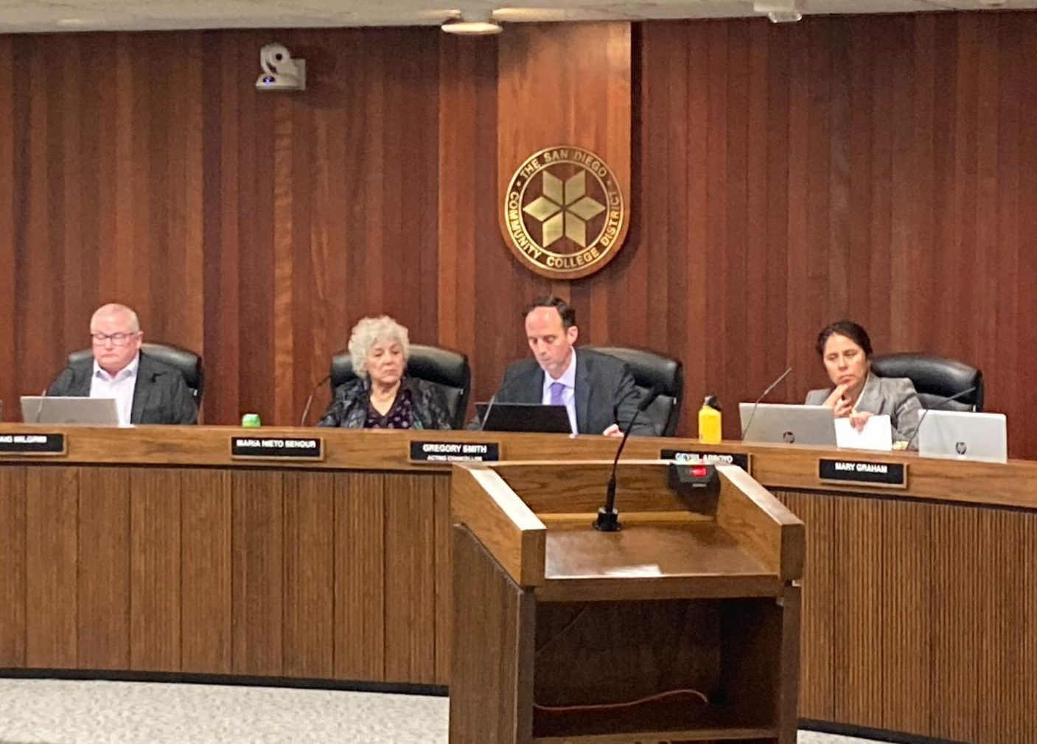
A&R Board Policies
CACCRAO Annual Conference

Slide 24
Chapter 5: A&R Core Policies (Part 1)
BP/AP 5010 – Admissions and Concurrent Enrollment: Eligibility, application process, open admission
BP/AP 5011 – HS and Young Students: K–12 concurrent enrollment, CCAP agreements
BP/AP 5012 – International Students: F-1 visa requirements, English proficiency, health insurance
BP/AP 5013 – Students in the Military: Priority registration, residency, credit for military service
BP/AP 5015 – Residence Determination: CA residency criteria, reclassification, AB 540, appeals
BP/AP 5017 – Immigration Status Inquiries: Limitations on collecting/disclosing status; CA Values Act
BP/AP 5020 – Nonresident Tuition: Annual calculation, exemptions
BP/AP 5030 – Fees: Enrollment fees, health fees, parking, student representation fees

Slide 25
Chapter 5: A&R Core Policies (Part 2)
BP/AP 5035 – Withholding of Student Records: Authority to withhold for unpaid obligations
BP/AP 5040 – Student Records & Privacy: FERPA compliance, directory info, consent, retention
BP/AP 5045 – Challenging Records & Access Log: Student challenges, access log requirements
BP/AP 5050 – Student Success and Support: Orientation, placement, counseling, ed plans
BP/AP 5052 – Open Enrollment: Open access requirements per Title 5
BP/AP 5055 – Enrollment Priorities: Priority groups, loss of priority, veterans
AP 5070 – Attendance: Attendance accounting, census procedures
BP/AP 5075 – Course Adds and Drops: Deadlines, withdrawal policies, “W” notation

Slide 26
Related Policies in Other Chapters
BP/AP 3310 – Records Retention: How long student records must be retained; secure destruction
BP/AP 3410 – Nondiscrimination: Nondiscrimination in all programs including admissions
BP/AP 4100 – Graduation Requirements: Drives transcript evaluation and degree audit
BP/AP 4220 – Standards of Scholarship: Academic standing, probation, dismissal
BP/AP 4225 – Course Repetition: Substandard grade alleviation, repetition limits
BP/AP 4230 – Grading and Academic Record Symbols: Grade symbols, incompletes, grade changes
BP/AP 4250 – Probation, Dismissal, Readmission: Academic/progress probation and readmission

Slide 27


CACCRAO Annual Conference
CCLC Templates

Slide 28
What Is the CCLC BP/AP Service?
CCLC provides a subscription-based Board Policy and Administrative Procedure Service in partnership with the law firm Liebert Cassidy Whitmore
Over 400 legally vetted BP and AP templates available to subscribing districts
67 of 73 California community college districts subscribe
Biannual legal updates (Fall and Spring) reflecting changes to federal/state statutes and regulations
Includes implementation handbook, subscriber website, and active listserv

Slide 29
CCLC Template Language Categories
Legally Required: Language that must be included to comply with federal law, state statute, or Title 5 regulations
Legally Advised: Strongly recommended based on legal best practices, even if not explicitly mandated
Suggested as Good Practice: Reflects sound institutional practices recommended by CCLC and its legal counsel
Templates reflect the minimum that is legally required or advised, districts adapt language to local conditions

Slide 30
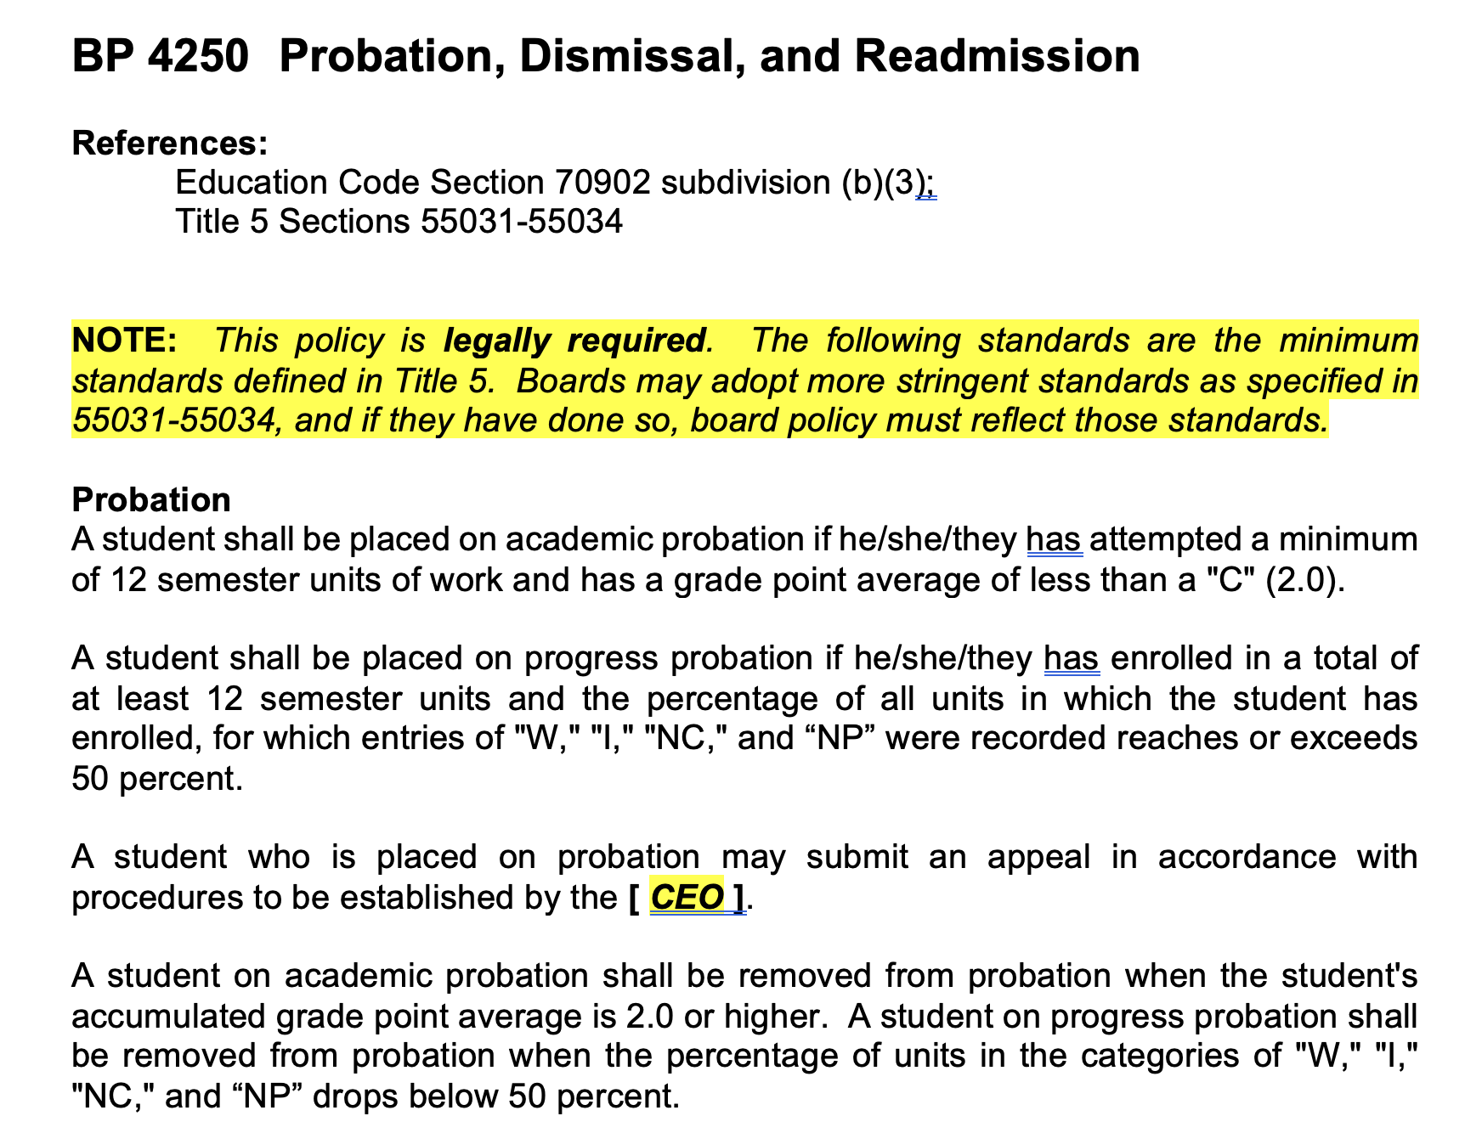
CCLC Template

Slide 31
The CCLC Seven-Chapter Structure
Chapter 1 – The District: Mission, organizational structure (Chancellor/Superintendent-President)
Chapter 2 – Board of Trustees: Meetings, delegation of authority, BP/AP 2510 Participation in Decision-Making
Chapter 3 – General Institution: Accreditation, planning, safety, nondiscrimination
Chapter 4 – Academic Affairs: Curriculum, grading, academic freedom, graduation requirements
Chapter 5 – Student Services: Admissions, enrollment, records, fees, matriculation (A&R focus)
Chapter 6 – Business and Fiscal Affairs: Budget, accounting, auxiliary services
Chapter 7 – Human Resources: Employment, salary, benefits, evaluations

Slide 32
Best Practices for CCLC Templates
Start with the template: CCLC templates represent legally reviewed baseline language — don’t reinvent the wheel
Adapt to local context: Districts have flexibility to adapt template language to reflect local conditions and culture
Adopt the CCLC numbering system: Standardized numbering makes cross-referencing, accreditation, and updates easier
Stay current with updates: Assign a responsible party to review each biannual update and route through governance promptly
Use BoardDocs or comparable system: Track revisions, manage the policy manual, and provide public access

Slide 33

CACCRAO Annual Conference
BP/APs and Your Catalog

Slide 34
The College Catalog
Student-facing policy summaries in plain language, degree/certificate requirements, academic calendar, fee schedules, student rights and responsibilities
The catalog is your “contract” with the student for that academic year.
The Cardinal Rule: The catalog must be consistent with adopted BPs and Aps: the catalog communicates policy, it does not create it

Slide 35
Common Pitfalls to Avoid
Operational details in Board Policy: Makes policy inflexible and requires Board action for routine updates — put details in the AP instead
Unadopted policy in the catalog: The catalog should reflect adopted policy, not create it, always adopt formally first
Failing to update the catalog: After a BP revision, reconcile catalog language during each catalog cycle
Legalistic catalog language: The catalog is a student communication tool, use plain language, save the legal references for the BP/AP (Use AI!)
Inconsistency between documents: Mismatches create compliance risks, accreditation findings, and confusion

Slide 36
Key Takeaways
Use CCLC templates as your foundation: Legally vetted, regularly updated, used by most CA districts
Know the legal hierarchy: Federal law → Ed Code → Title 5 → Board Policy → Admin Procedure
Own your chapter: Chapter 5 is A&R’s chapter; be proactive in reviews and updates
Understand the governance process: BPs go to the Board; APs are approved by the Chancellor/President
Keep policy and catalog in sync: Policy sets the rules; catalog communicates them; AP details implementation

Slide 37
Resources
Bills: https://legiscan.com/CA/legislation
CA Education Code: https://leginfo.legislature.ca.gov/faces/codesTOCSelected.xhtml?tocCode=EDC&tocTitle=+Education+Code+-+EDC
Title 5: https://govt.westlaw.com/calregs/Browse/Home/California/CaliforniaCodeofRegulations?guid=I5EDC84B04C6911EC93A8000D3A7C4BC3

Slide 38

Questions?
Victor DeVore
Dean of Student Services, SDCCD
CACCRAO Annual Conference

