Slide 1
Chancellor's Office Updates for Admissions and Records
2026 CACCRAO Conference
March 23, 2026
Notes:
Stacey to start presentation, give intros and V2030 background (5 min)

Slide 2
Agenda
Regulation and Program Updates
Reimagine CCCApply Updates
State and Federal Legislative Update
Resources for A&R Professionals
Notes:
Allison

Slide 3
Chancellor’s Office Speaker Introductions
Dr. Stacey Shears, Vice Chancellor of Student Affairs
Allison Beer, Dean, Educational Services and Support Division
Kati Kouklis, Analyst, Educational Services and Support Division
Dr. Linda Vazquez, Assistant Vice Chancellor for State and Federal Relations
priya Vasu, Legislative Analyst, Government Relations Division

Slide 4
Vision 2030 Framework
Vision 2030
3 Goals
Equity in Success
Equity in Access
Equity in Support
Vision 2030
3 Goals
Equity in Success
Equity in Access
Equity in Support
Vision 2030
6 Outcomes & Metrics
12 Actions within our Three Strategic Directions
Notes:
Vision 2030 outlines three central equity goals — Equity in Success, Equity in Access and Equity in Support — as the driving force behind the transformational change within the system. These goals aim by 2030 to reduce and ultimately eliminate equity gaps for students of color who are underrepresented, students of low income and students with disabilities.

Slide 5
How We Know We’re Getting There: Goals & Metrics
Increase with equity the number of California Community College students:
  Who complete a meaningful educational outcome.
  Who attain a baccalaureate degree.
  Who earn a living wage.
Equity in Success
Increase with equity the number of students attending a California community college, with particular emphasis on the number of underserved Californians.
Equity in Access
Increase with equity the number of California Community Colleges students receiving state and federal aid for which they are eligible to better support their educational journey.
Decrease the number of units in excess of 60 units for the Associate Degree for Transfer.
Equity in Support

Slide 6
Regulation and Program Updates
Presented by Dr. Stacey Shears
Notes:
Stacey (10 min)

Slide 7
Student Education Planning
Timely and comprehensive education plans are essential foundations for student success
Education planning is an institutional duty, not just a student-driven activity
Changes address inequities in completion and transfer by clarifying education plan delivery, timing, and methods
The Title 5 regulations effective February 13, 2026. Chancellor's Office memo ESS 26-11 provides more information and recommendations.

Slide 8
Title 5 Regulatory Updates
Clarified Student Education Plans
Section 55524 requires colleges to help students identify educational goals early and distinguishes abbreviated from comprehensive plans.
Mandatory Participation Requirements
Sections 55530 and 55531 make placement, counseling, and education planning mandatory for first-time non-exempt students to ensure engagement.
Accountability and Institutional Duties
Institutions must provide opportunities for comprehensive planning and may utilize registration holds for non-compliance.

Slide 9
Education Planning Framework
Colleges must provide Student Education Plans to all non-exempt students.
Two types of plans are permitted:
Abbreviated Education Plan
  1–2 terms in length
  Designed to meet immediate student needs
Comprehensive Education Plan
  Covers the student’s full course of study
  Supports completion of a degree, certificate, or transfer goal

Slide 10

Education Planning Implementation Webinar Series
Kickoff Webinar: April 15, 2026
Education planning regulatory updates
Campus implementation strategies
Technology approaches
Audience Q&A
Statewide Series Focus
Comprehensive education planning
Degree audit implementation
Auto-awarding processes
Register
Here
Notes:
First session includes Cuesta College + Feather River College Emphasize: “policy → practice” bridge
Encourage registration for full series (one registration = all sessions)
Future sessions:
Degree Audit (Shasta College – Sept 2026)
Auto Awarding (Nov 2026)
AI in student services (2027)
Position this as ongoing implementation support from the Chancellor’s Office

Slide 11
Education Planning Key Takeaways
Redesigning Student Intake Processes
Colleges should embed education planning into orientation, and first-term touchpoints for proactive student support.
Shifting Plan Responsibility to Institutions
Institutions take primary responsibility for creating and supporting education plans in alignment with Guided Pathways.
Cross-Functional Leadership and Collaboration
Effective implementation requires leadership and collaboration among student services, instruction, and technology teams.
Capacity-Building as Student Success Strategy
Viewing capacity-building as both compliance and a transformational opportunity enhances education delivery and student outcomes.

Slide 12
Academic Probation Regulation Updates
In November 2025, the Board of Governors approved amendments to: Title 5 Sections 55031–55034 with conforming updates across multiple sections.
These amendments revise terminology and standards related to:
Academic standing
Probation
Dismissal
Student support interventions
The revisions aim to:
Replace deficit-based terminology
Reduce stigma associated with academic standing
Reinforce access to counseling and support services
Align language across Title 5 provisions
The intent is to frame academic challenges as opportunities for improvement and student success.
Academic probation regulation changes will be effective April 17, 2026. The Chancellor's Office will provide a memo with guidance for implementation.

Slide 13
Key Terminology Changes
The regulations replace punitive language with supportive terminology.
Previous Language:
Academic Probation
Progress Probation
Academic Dismissal
Progress Dismissal
New Language:
Academic Notice
Progress Notice
Academic Pause
Progress Pause

Slide 14
Proposed Academic Renewal Regulatory Changes
In March 2026, the Chancellor's Office presented to the Board of Governors proposed amendments to Title 5 §55046 seeking to:
Standardize academic renewal eligibility across the California Community Colleges system
Promote equitable access to academic renewal
Reduce variation in local district policies
Support student persistence and re-engagement after early academic challenges
The Chancellor's Office is currently reviewing public comment.

Slide 15
What is Academic Renewal?
Academic Renewal allows colleges to:
Omit previously recorded substandard academic work in GPA calculations
  Substandard academic work includes D, F, FW, NP, and NC grades
Recognize a student’s improved academic performance over time
Academic renewal does not remove coursework from the transcript.
Challenges under current regulations:
Districts have broad discretion to determine eligibility
Policies vary significantly across colleges
Students encounter different thresholds depending on the institution
That variation creates equity and access concerns, particularly for:
  Part-time students
  Students attending multiple colleges

Slide 16
Proposed Changes Establish Minimum Eligibility Standards
The proposed Title 5 revisions:
Establish minimum statewide eligibility standards, notably that following the substandard coursework students must complete 6 semester units (or 9 quarter units) with a 2.0 GPA
Allow multiple renewal requests without unit caps
Clarify transcript requirements and eligible coursework
Promote equitable access for students across colleges

Slide 17
How These Policies Work Together
Student academic progress is supported through multiple mechanisms:
Academic Notice & Pause
Early identification of academic challenges
Access to counseling and support services
Structured pathway for academic recovery
Academic Renewal
Opportunity to address past academic performance
GPA recalculation when coursework no longer reflects students' ability
Supports long-term academic success

Slide 18
Common Course Numbering (CCN): Phase III
More than 2,000 CCN-aligned course outlines have now been submitted by colleges across California. Chancellor's Office memo ESS 26-25 includes progress and next steps.
Phase III template release delayed:
  Colleges will be expected to have Phase III CCN-aligned courses student-facing no earlier than by Fall 2028.
  Colleges are expected to continue alignment and prepare to have Phase IIA and Phase IIB aligned courses student-facing and in their catalogs by Fall 2026 and Fall 2027 respectively.
Identifying the future CCN Courses (post Fall 2027) via:
  CCN Scope and Sequencing workgroup (using AI and intersegmental AOs input)
  Template review process under discussion, but expect templates to be reviewed every 5-7 years
Notes:
The Phase III Templates will be considered for release pending the opportunity to utilize CCN Course Templates as a vehicle for transferability and articulation.
In a nutshell, AB 2236 moves California from campus-by-campus articulation to a mandatory, systemwide articulation model tied to common course numbering. The bill does not create new "common courses' But rather reinforces the existing faculty work currently completed by AB1111. The bill does not require the CSU or UC to adopt a common course number but rather requires the CSU to participate and to use templates to create articulation agreement so every community college that aligns itself with a template is granted the same articulation by any CSU (or UC) that accepts the template. Student reasonable expect that if they take a CCN course that it will lead to the same transfer outcome. We encourage the all CCC colleagues to learn about the proposed legislation. According to the CSU data dashboard, LAO, and PPIC research transfer students tend to graduate in less time and tend persist at great rates compared to the CSU first time freshmen. The CCC faculty prepare transfer students to be successful at 4-year universities, there is no need to scrutinize course outlines at levels that seem to not honor the academic freedom of the CCC faculty.
Currently, even when courses share a common course number, articulation between a community college and CSU or UC may still require individual campus review and approval. This bill requires the segments to replace that individualized review process with a streamlined, system-level agreement that uses common course numbering templates to determine equivalency. Currently, even when courses share a common course number, transferability and articulation between a community college and CSU or UC still require individual campus review and approval, which results in inconsistencies which are disruptive to student progress. AB2236 requires the segments to replace that individualized review process with a streamlined, system-level agreement that uses common course numbering templates to determine equivalency.
The Chancellor’s Office, in collaboration with the Academic Senate for California Community Colleges (ASCCC), has completed identification of the Classification of Instructional Programs (CIP) codes aligned to existing Transfer Model Curricula (TMCs) and corresponding CCN templates. This work was undertaken to promote consistency, reporting clarity, and alignment across associate degrees and commonly numbered courses. Identical CIP codes will apply to corresponding ADTs and CCN templates. These codes will be uploaded directly into COCI; no additional action is required by colleges.
CIP selection prioritized outcome alignment, the educational scope of an associate degree, and the presence or absence of existing specificity within Taxonomy of Programs (TOP) codes, rather than relying exclusively on within-discipline specificity. It is important to clarify that CIP codes are used for reporting and classification purposes. They do not determine Minimum Qualifications, local discipline assignment under title 5, or override guidance contained in the Program and Course Approval Handbook. The Chancellor’s Office will publish details of CIP assignments for the ADTs and CCN templates as they become available.
The Chancellor’s Office is currently surveying colleges to identify potential impacts associated with the TOP-to-CIP transition, including instances where CIP alignment may affect CTE or non-CTE designation. Feedback from the field is currently informing ongoing refinement (through the end of March) and targeted technical assistance to support colleges through implementation. Please see the TOP-to-CIP website for more information.
The CCN Council is also forming work groups to advance activities outlined in the sustainability plan, including testing an artificial intelligence (AI) tool to identify courses that may be commonly numbered in the future, as well as continuing to advocate for practical systemwide solutions for transferability and articulation.

Slide 19
CCN Student Communication
Recommendations and resources to communicate changes with students:
  Review student education plans and transcripts for CCN taxonomy accuracy.
  Ensure student-facing information is accurate and in alignment with the intended taxonomy. See the Taxonomy FAQ.
  Leverage CCN implementation funding
  Icangotocollege.com includes CCN information and the project website has branding and social media materials for colleges to use.
CACCRAO CCN Breakout session, March 31st 3:15pm
Notes:
Check out the branding and marketing tools available for use. The CCCs have been very innovative in producing crosswalks and media information to share with students. What has your college done?
As you can imagine, technology can create unintended barriers when implementing a new initiative. There is concern that some CCCs may not be able to accurately display the CCN taxonomy and titles on students' ed plans and transcripts.
At the request of the CSU and UC systems, a survey was sent to CIOs and CSSOs to gather data on what information appears on student transcripts and what is transmitted to the system offices.
Please review your local education plans and student transcripts. This effort is important to ensure accurate transfer evaluations, as many students are currently applying to transfer.
Your assistance in reviewing student education plans and transcripts for CCN accuracy is greatly appreciated. The CCN title and taxonomy must be identical for this process to work both intra- and intersegmentally. The goal is to ensure that students receive full and appropriate credit for their coursework.
We will be talking about the transcripts at the breakout during CCCARO conference in Sacramento on March 31st at 3:15 to 4:05pm. Come bring your questions and ideas to this breakout.

Slide 20




Credit for Prior Learning (CPL)
The 2025-26 CA state budget includes one-time funds to support colleges with CPL implementation
  $50,000 for all colleges that certified commitment to driving CPL outcomes
  Funds dispersed to district office February 2026
CPL Collection and Verification Pilot
  The Chancellor's Office, in partnership with CACCROA, is launching a new pilot to improve the collection of CPL documentation
  3 selected community college districts will be testing workflows to collect high-value CPL documentation through a verification platform and new workflows to allow self-service requests and document collection from students
CACCRO CPL Breakout Session, March 30th 2:30pm
Upcoming Events:
  CPL Regional Convening, Sacramento, April 20, 2026
  CPL Workshop, virtual, April 29, 2026

Slide 21

Reimagine Apply
Project Update
Spring 2026
Presented by Allison Beer
Notes:
Allison (10 min)

Slide 22
The Mission
Improve the user experience
The California Community Colleges Chancellor’s Office initiated the reimagining and development of a new student-centered application process and supporting system architecture for our prospective and returning students to:
Improve the user experience
Streamline the application process
Streamline the application process
Better support equitable access
Better support equitable access
Increase data accuracy
Increase data accuracy
Protect against and mitigate fraud
Protect against and mitigate fraud

Slide 23
The Progress to Date
Consolidate to a single, logic driven application
Streamline logic while preserving reporting integrity
Reduce overall number of questions to improve student experience
First round of UAT complete
  Development proceeding based on testing results
Expand use of Lightleap.AI for end-to-end fraud detection
Integration architecture finalized

Slide 24
Between Now and June 1, 2026
Student/community testing scheduled for April/May
  Follows branding/naming testing in March
End-to-end testing to the local ERP level
College/district staff training
  Fraud detection/prevention
  App Review CRM for communication & automation
Wave 1 district rollout plans under development
  Readiness checklist
General Availability remains June 1, 2026

Slide 25
Wave 1 Ripple Schedule
May 1st
Decision Point
Confirm district’s Ripple 1 window by May 1, aligning with strategic priorities and readiness.
June 1st
Platform Launch & Ripple 1
June 1st Liaison launches. Ripple 1 districts go live in June, supported by the Chancellor’s Office and project partners to ensure smooth transition and best practices.
July–Aug.
Ripple 2 Launch
July-August: Ripple 2 districts launch. Benefit from Ripple 1 insights for streamlined implementation.
Sept.
Ripple 3 & Scaling
September: Ripple 3 districts go live. A refined implementation playbook ensures successful scaling and mutual success.

Slide 26

Wave 2 Recruiting
Complete form to share data (SIS, CRM, etc.)
Provide key inputs from Wave 2 districts
  Term dates
  Majors
  College page materials – banner, brief text
Use resources developed during Wave 1
  Readiness checklist
  App Review starter kit
  PIO toolkit
CACCRAO Reimaging CCCApply General Session, March 31st 9am

Slide 27

CALIFORNIA COMMUNITY COLLEGES
Reimagine CCCApply Branding Research
Here's what we learned along the way.
Research conducted by Foundation for California Community Colleges' Student Centered Design Lab

Slide 28

WHAT WE DID
We asked students what makes the path feel clear.
We conducted name testing to better understand what helps students know where to begin.
Our efforts focused what language feels clear to them, and how naming can reduce uncertainty in the first step.
What we heard shaped the direction of the new naming structure and the broader entry experience.
This work was designed to identify not just which names performed well, but what students actually need at the starting point.
Photo: Pasadena City College

Slide 29
WHAT STUDENTS ACTUALLY WANT TO KNOW
“
Where do I start?
WHAT STUDENTS TOLD US
Students don't need a better name.
They need to know where to start.
process
“Apply” isn't how students think about beginning college.
Across 1,401 respondents, students described getting started
in terms of actions, people, and steps, not brand names.
counselor
start
How students describe starting college, in their own words
Photo: Sacramento City College

Slide 30
THE UNEXPECTED FINDING
No single name emerged -
because students need more than a name
What the data actually shows
90%
No single “perfect” name emerged for all groups
Names without ‘CCC’ score higher on usability,
but CCC signals legitimacy
Students consistently respond to names that clearly signal how to begin
A two-layer naming structure is the optimal solution that combines system identity with clear entry language
of students need more than a name
to know how to begin
Source: Name Testing Survey — 1,401 respondents, 90 colleges, 60 districts

Slide 31

WHAT WE HEARD
Students respond to
language the helps them begin
WHAT
MATTERS
MOST
Clarity
Direction
Confidence
Using natural language does more than identify the service. It helps students take the first step at a California community college.
In testing, “Start Here” outperformed “Apply” and “Enroll”

Slide 32
THE FRAMEWORK
Two layers — not one name.
The testing made one thing clear: students need both trust and clarity at the starting point.
LAYER 1
LAYER 2
Official Platform Identity
Student Entry Language
System Trust
Clear Start
Official statewide system identity.
Builds trust. Signals legitimacy.
Maintains the CCC brand.
Clear, natural directions
that invite students to begin.
No jargon. No friction. No ambiguity.
The system retains official identity and credibility. Students encounter simple human language.

Slide 33

WHAT'S COMING NEXT
The research is complete.
The direction is clear.
What comes next is finalizing the naming structure, aligning rollout materials, and preparing colleges for transition.
More will be shared as implementation moves forward.

Slide 34
State Legislative Updates
Presented by: Dr. Linda Vazquez and priya Vasu
Notes:
Linda and priya (10 min)

Slide 35
2025 Chaptered Legislation
Basic Needs/Resources
AB 42 (Bryan): Exempts any grant, award, scholarship, loan, or fellowship benefit (other than cash payments made directly by friends or relatives) from consideration as income for purposes of determining CalWORKs and CalFresh eligibility or grant amounts.
SB 271 (Reyes):
  Requires financial aid offices to provide students with dependent children:
    Information on campus childcare options and development centers
    Referrals to the campus Basic Needs Center for help accessing childcare subsidies, programs, and local providers
    Information on supplemental awards available to students with dependents
  Requires campus child development centers and preschools to provide students with dependent children:
    Referrals to the campus Basic Needs Center for childcare subsidy and provider assistance
    Referrals to the financial aid office, including information on awards for students with dependents
  Expands the definition of basic needs at CCC, CSU, and UC campuses to include childcare services and resources, including potential direct financial or service support.
Notes:
Linda

Slide 36
2025 Chaptered Legislation
Basic Needs/Resources
AB 79 (Arambula): Requires California Department of Social Services (CDSS) to develop training for basic needs staff at educational institutions, in consultation with relevant professionals from local public higher education. Training must cover local employability programs, DHCS and CDSS policy updates and topics specific to college students.
Additionally, CDSS must convene a quarterly workgroup to share best practices, address challenges, and identify statewide issues. Membership must include:
At least 12 county staff liaisons
At least four campus basic needs staff, representing multiple regions and campuses
At least one representative from each higher education segment, including the CSU and CCC Chancellor's Offices
Notes:
Linda
AB 79:
Develop training for basic needs directors and other designated staff and worker at educational institutions in consultation with staff liaisons, basic needs directors, basic needs coordinators, or other designated professional staff from institutions of public higher education within the county
The training must include information related to Local Programs that Increase Employability Department of Health Care Services and CDSS policy updates, including review of the CalFresh Student Eligibility Handbook; the training should also include other training related to the needs specific to college students including financial aid, scholarships, dependent status, and eligibility criteria for public social services programs.
Convene a workgroup that meets quarterly to share best practices, address challenges, and identify statewide issues, comprised of members of all of the following:
At least 12 county staff liaisons, comprised of at least two county staff liaisons from each of the six regions of the California Statewide Automated Welfare System (CalSAWS) consortium.
At least four college campus basic needs directors, basic needs coordinators, or other designated campus staff from multiple regions and campuses.
At least one staff member from each higher education segment including but not limited to the office of the Chancellor of the California State University, the Office of the Chancellor of the California Community Colleges.

Slide 37
2025 Chaptered Legislation
Financial Aid
SB 744 (Cabaldon): Accrediting agencies recognized by the U.S. Department of Education as of January 1, 2025 retain that recognition through July 1, 2029, as long as they continue operating in substantially the same way.
Transfer
SB 640 (Cabaldon): This bill establishes the CSU Direct Admission Program for the purpose of making direct admissions offers to eligible high school students. Requires California Community Colleges to promote program by:
  Covering it at new student orientation
  Sending an annual email to incoming fall students
  Posting information on the campus website in an accessible format
  Displaying information in counseling offices and transfer centers
Holidays
AB 268 (Kalra): Makes Diwali an optional holiday.
Notes:
Linda

Slide 38

Current Tier 1 Legislation
Sponsored Bills
AB 1920 (Gonzalez): Would expand eligibility for the California Promise (AB 19) fee waiver by clarifying that first-time, full-time students who earned a credential are not ineligible for AB 19.
AB 1829 (Fong): Would expand the allowable usage of CalWORKs REP funds to include direct aid for basic needs and services and allows institutions to waive the employer match requirement.
Notes:
Linda

Slide 39
Current Tier 1 Legislation
Common Course Numbering (CCN)/Articulation
AB 2236 (Berman): Would require the usage of CCN templates and require ICAS to develop a streamlined system-level articulation agreement.
AB 1769 (Ramos): Would require the CCC, CSU (and request the UC) to develop and implement transfer agreements and articulation programs to support and enhance the transfer of students attending California tribal colleges.
AB 1728 (Alanis): Would require the inclusion of firefighting and law enforcement education courses in the CCN process.
Notes:
priya

Slide 40
Current Tier 1 Legislation
Priority Enrollment
AB 2766 (Ahrens): Would expand priority enrollment eligibility and student housing priority for foster youth.
AB 2203 (Tangipa): Would give priority registration to students who receive the CalVet fee waiver and Federal GI Bill Benefits.
SB 892 (Grove): Would remove the 15-year time limit on when eligible military members and former members/veterans can use priority enrollment benefits.
Notes:
priya

Slide 41

Legislation Shapes Our System
If a bill causes you concern, raise those concerns early on
Seek input from the constituencies you engage with (CSSOs, CBOs, CEOs) before a bill is signed
Help us understand what we don’t know
Notes:
Linda

Slide 42
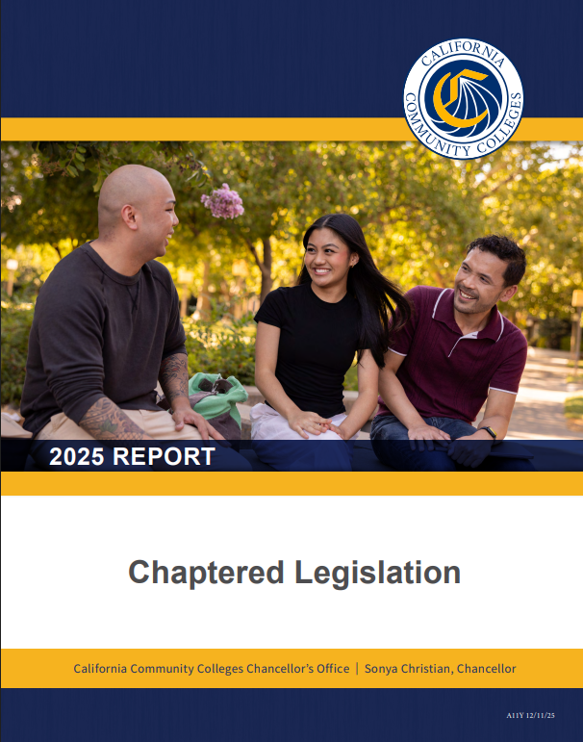
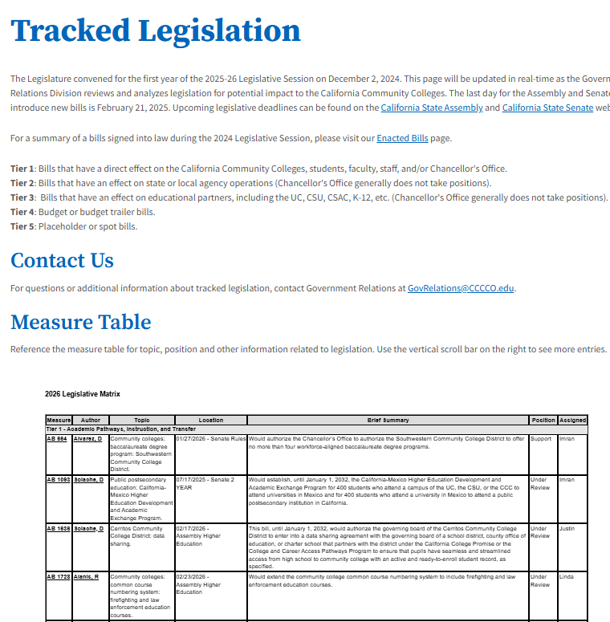
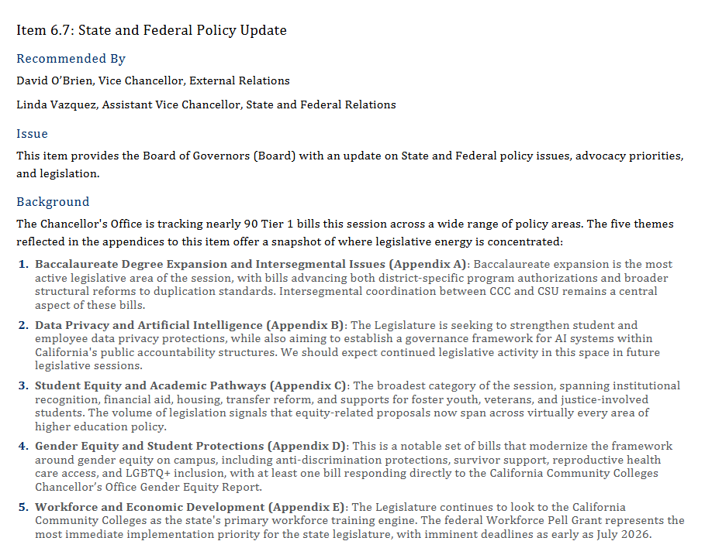
How We Keep You Informed

Slide 43

Contact Government Relations
Government Relations Staff Policy Issues
Dr. Linda Vazquez lvazquez@cccco.edu – All State Relations
Justin C. Salenik jsalenik@cccco.edu – Admissions and Records, Financial Aid and Basic Needs, Mental Health
Imran Majid imajid@cccco.edu – Budget, Faculty, Curriculum, Transfer, Baccalaureate Programs
priya v. pvasu@cccco.edu – Climate, AI, CCN, Priority Enrollment, Law Enforcement
Theresa Brown tbrown@cccco.edu – Labor, Facilites, Workforce, Legal
Cody Peters cpeters@cccco.edu – Scheduling support
Subscribe to the GR Listserv

Slide 44
Resources for A&R Professionals
Presented by: Kati Kouklis
Notes:
Kati (5 min)

Slide 45
New Resource for Admissions & Records Professionals
The CCC | Admissions and Records Professionals Learning Community
is now live on the Vision Resource Center (VRC).
This community was created to serve as a centralized, systemwide space for:
Foundational guidance
Training materials
Key regulatory resources
Supporting:
Student access
Equity
Compliance
Institutional integrity across the California Community Colleges
Notes:
Purpose of the Learning Community
The community functions as a centralized document repository for core Admissions & Records resources.
Resources are:
Organized by topic
Easily searchable
Updated as new guidance and materials become available
This space is intended to support consistent access to foundational guidance across the system.

Slide 46
Resources Available in the Community
Within the community, you will find:
Admissions & Records Handbook
Official guidance issued by the Chancellor’s Office
Covers regulatory compliance, admissions processes, and records management
New Directors Training Presentations
Remediated presentations from the 2025 New Directors Training
Designed for leaders in Admissions & Records, Financial Aid, and EOPS
Training Modules
5 asynchronous and self-paced Admissions & Records training modules
Current modules include Residency, Dual Enrollment, Credit Course Repetition, Interacting with Financial Aid, and Reporting and Audits
Notes:
Resources will continue to evolve and expand over time.
The Admissions and Records Handbook and the New Directors Training Presentations are available and can be downloaded.
The online training modules are available and once you complete the modules you can take an evaluation and receive a certificate of completion.

Slide 47

How to Access the Community
1. Log in to the VRC
2. Click the Connect Communities icon
3. Select CCC | Admissions and Records Professionals
4. Click Join

Slide 48
Q & A
Notes:
10 min or remaining time

