Slide 1
Reimagine CCCApply Project Update CACCRAO 2025
Rena Martinez Stluka, John Hetts, Erica Harrold

Slide 2
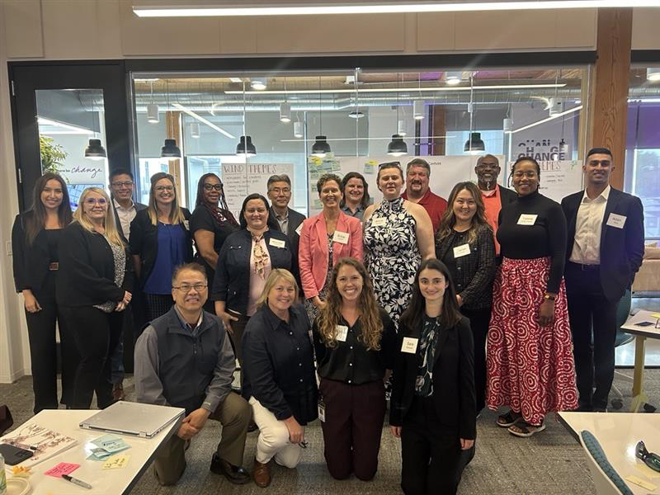
Background
Feb ‘23 - Apr ‘23
Oct ‘23 - Jan ‘24
Feb ‘24 – Jan ‘25
Short-term Working Group (Consultation Council Members) Workshops
Context Setting, Task Force Guiding Principles , Current State Review, Communication and Engagement, Roadmap
Interviews, Analysis & Working Sessions
Education Goals and History, Revised Content and Design Preview, Target State, Ideal Data Journey, Challenges
Task Force Sessions & RFP Development
Target State Application, Solution Requirements, RFP Process, Wave 1 Implementation
Questions Analysis
5 application types reviewed
2,483 questions & fields evaluated
Technical Analysis
11 years of documentation reviewed
20+ stakeholder interviews
Design Approach
13 institution peer reviews
80+ application screens designed
Student Input:
20 students interviewed for usability & feedback
Stakeholder Input
141 surveyed
73 interviewed
224 participants in working sessions
Task Force Meeting in September 2024
Notes:
John/ Erica: The CCCApply Task Force's initial development, including its structure, governance model, and stakeholder mobilization plan, established a foundation to honor the Chancellor’s commitment to participatory governance, supported by an extensive technical and functional analysis to design a best-in-class application. A Short-Term Working Group was established, comprised of Consultation Council members, that reviewed the current state of CCCApply, identified ‘short-term’ and ‘long-term’ improvement opportunities, developed a shared direction with guiding principles for the statewide Task Force, and identified key activities and milestones. The participating leaders acknowledged the shared responsibility to accomplish this complex transformation and collectively agreed on the need to improve our system’s front door experience for our students.
An extensive technical and functional analysis was conducted to inform the design of a best-in-class application. A review of the legal and organizational requirements for the 2,483 questions and fields was conducted as well as a peer review comparison with 14 institutions (including large community college systems and colleges, for-profit institutions, and public and private four-year systems both in California and nationally). In addition, 141 stakeholders across 62 colleges and 45 districts were surveyed for their input. Students were integral in the design and usability testing for the new application. Working with the Student Centered Design Lab, first-generation, returning, adult learners, and ESL students tested prototypes and a mock application process to validate the target state approach.

Slide 3
Background
Reimagine Apply
Task Force Vision
Task Force Members
A new student-centered application process and supporting system architecture for our prospective and returning students to:
The Reimagine Apply Task Force was formed to provide statewide perspective and expertise in the development of the new application. They crafted the following vision:
To guarantee a comprehensive and multi-faceted perspective, the Task Force was comprised of members from:
Improve the user experience
To make the application process quick and easy, ensuring accessibility and equity when applying to California Community Colleges, ultimately opening doors for career advancement and a brighter future for all students.
Academic Senate
Admissions & Records
Chief Executive Officers
Chief Information Systems Officers Association
Chief Instructional Office
Chief Student Services Officers
Financial Aid
Institutional Research
Public Information Officer
Student Senate
Technology Center
“
Reduce the pressure of the application process on students
Better support equitable access
Increase data accuracy
”
Protect against and mitigate fraud
Notes:
Rena: The Reimagine Apply Task Force was then formed to provide statewide perspective and expertise in the development of the new application. The group ensured the application improves the user experience, balances equity concerns, and protects against and mitigates fraud. To guarantee a comprehensive and statewide perspective, the Task Force was comprised of members from the Student Senate, Chief Information Systems Officers Association, Institutional Research, Technology Center, Financial Aid, Chief Instructional Office, Public Information Officer, Academic Senate, Admissions & Records, Chief Executive Officers, and Chief Student Services Officers.
Over the nine sessions, the Task Force’s vision - “to make the application process quick and easy, ensuring accessibility and equity when applying to California Community Colleges, ultimately opening doors for career advancement and a brighter future for all students”- informed their work. The group focused on the following key areas: the target state application design and governance, application tooling requirements, the RFP process, and support for implementation of the application.

Slide 4
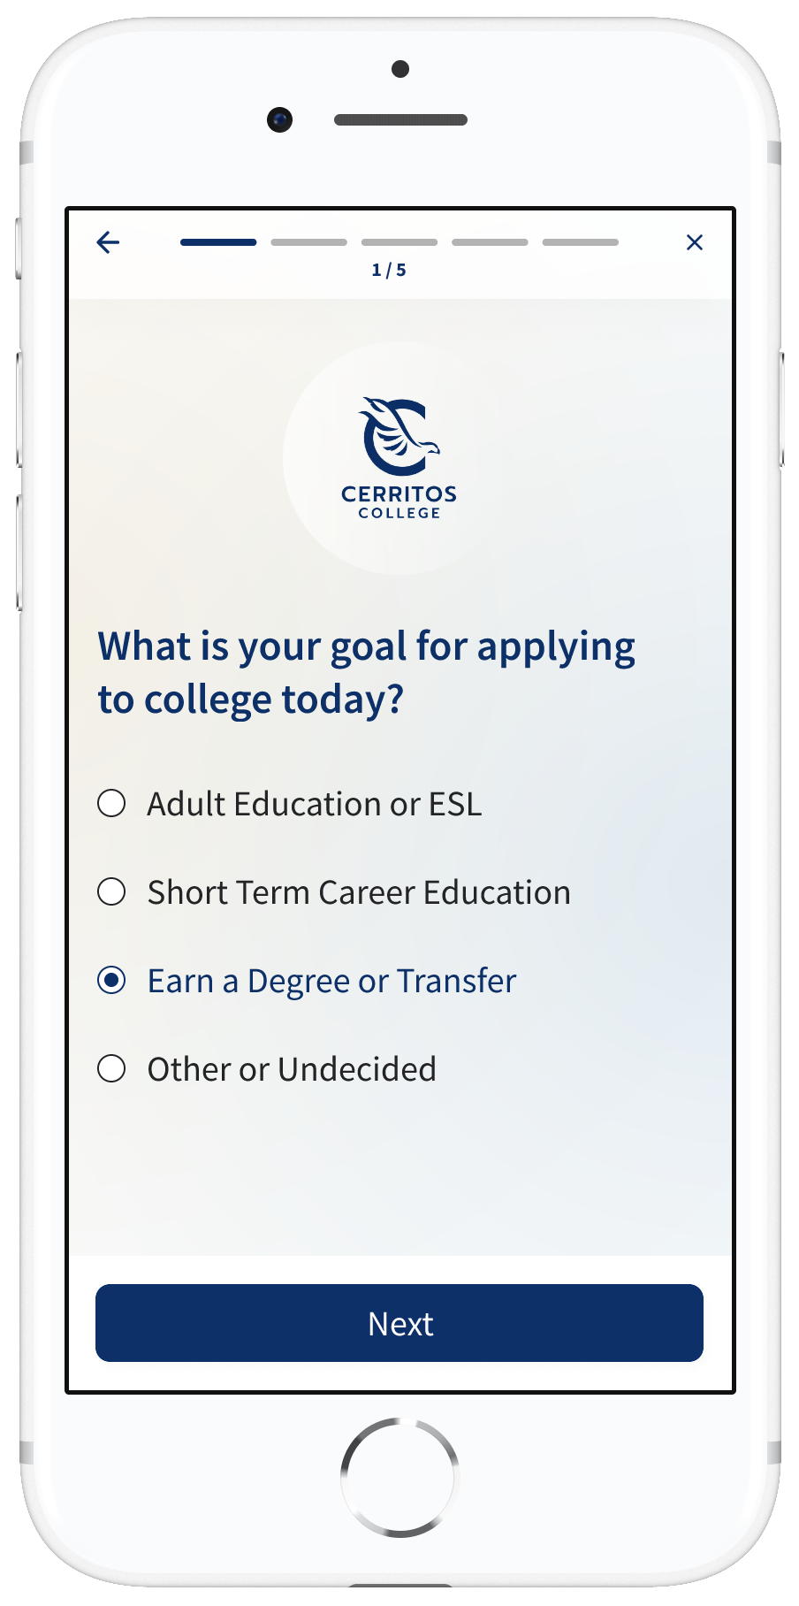
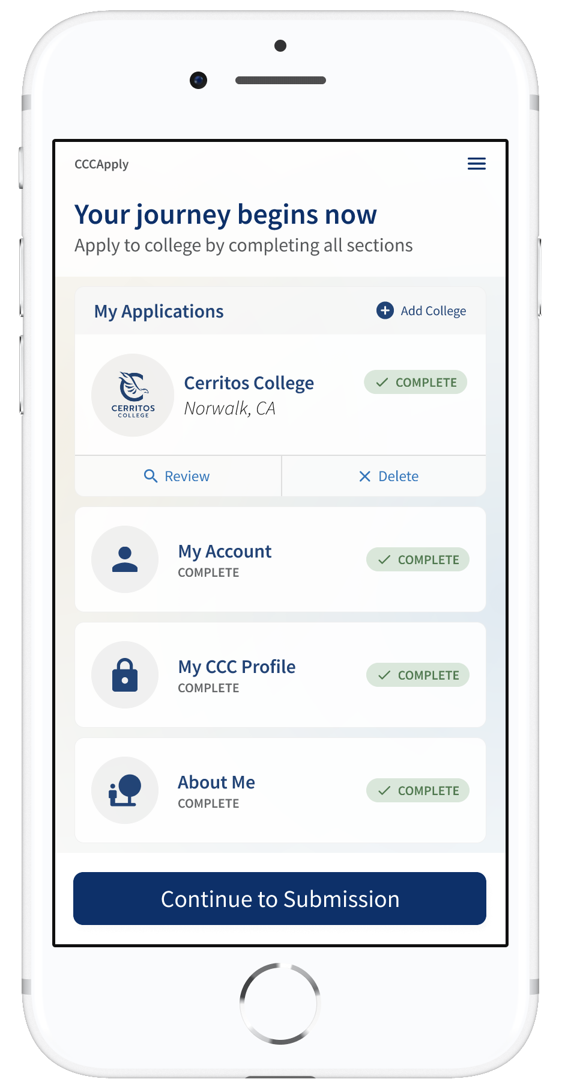
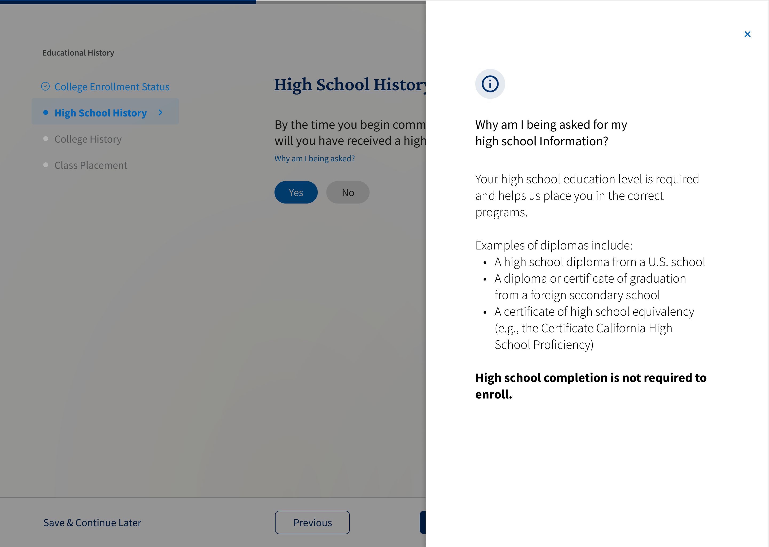
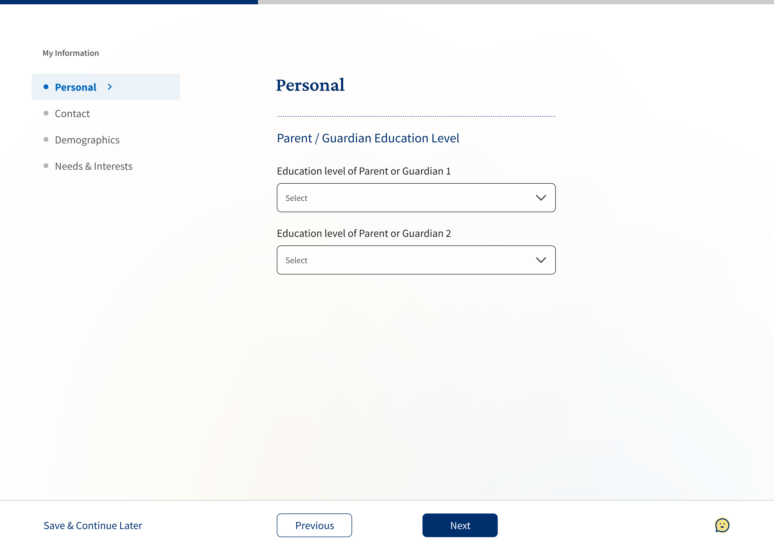
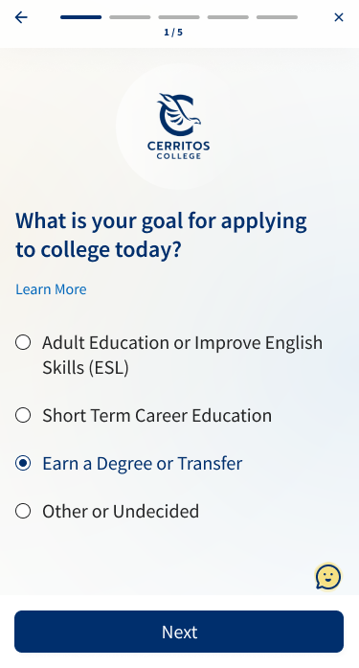
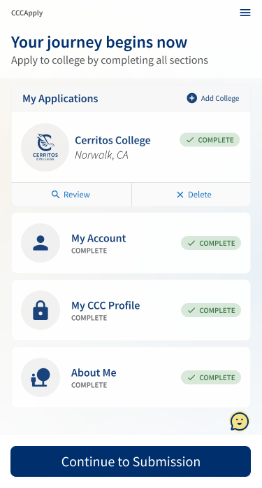
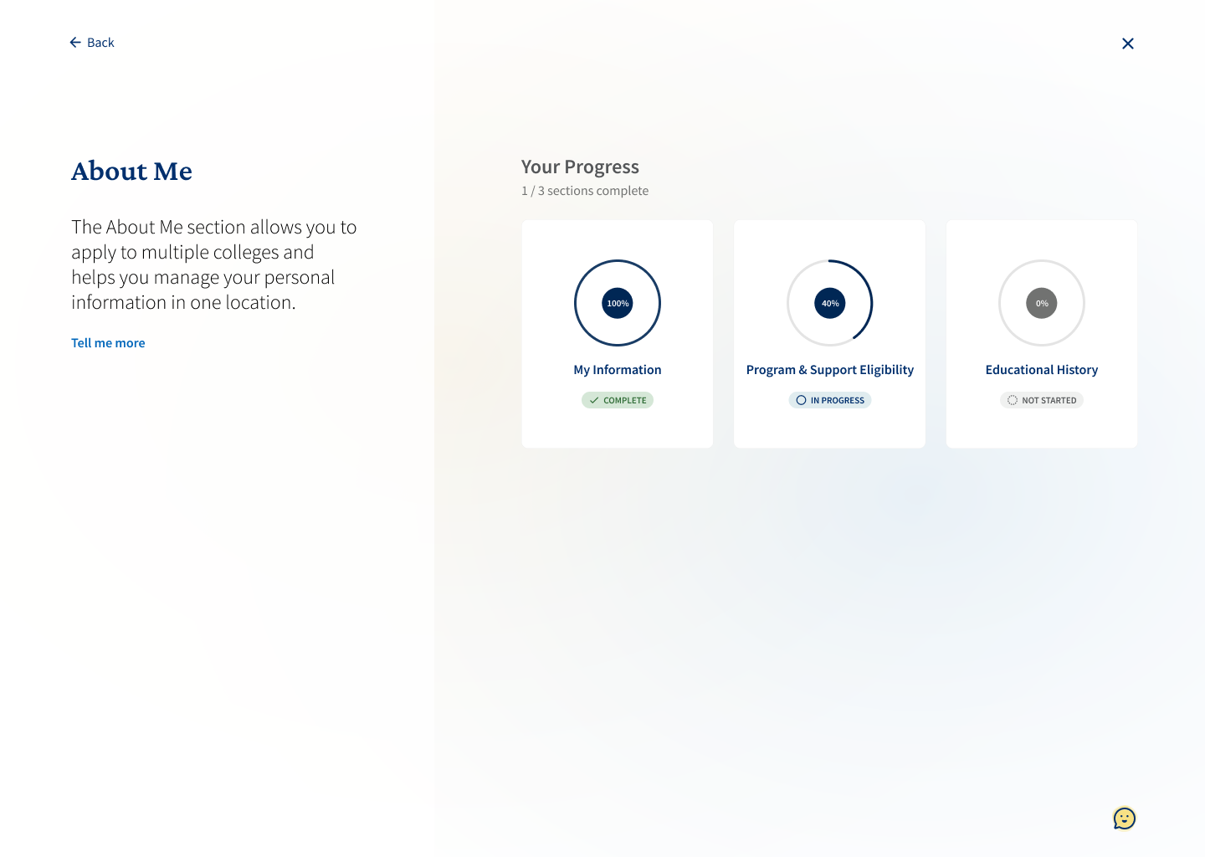
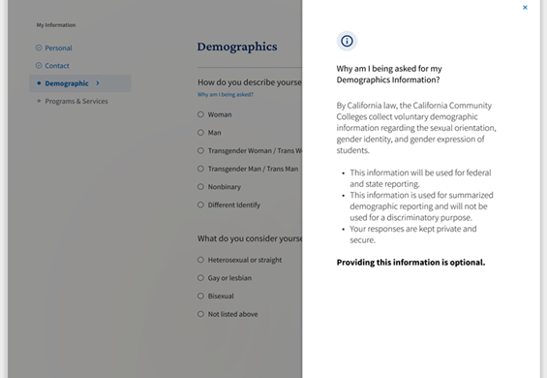
Target State Application
Target State Design
Target State Elements
The Task Force aligned on a modern, minimalist, and mobile-first design.
Applicant Focus: The Task Force streamlined and standardized application questions, balancing college process needs with a student-first experience through pre-submission requirements and guided post-submission prompts.
Fraud & Residency: The Task Force tackled fraud and residency challenges by refining fraud mitigation tools and enhancing residency processes to reduce barriers and improve accuracy for students and staff.
Governance: A governance structure was put in place to maintain integrity of the new application.
Structure: Branch logic was revised to streamline the application into one secure, welcoming ‘doorway’, asking only questions relevant to the applicant. The Task Force reviewed and aligned on how seven use cases experience the application uniquely:
Mobile Friendly
Purpose of Requirements
Section Labels
Progress Tracking
Scannable Text
Veteran
Adult/Older
Concurrent/ Dual Enrollment
Unhoused/
Homeless
Undocumented
Foster Youth
Justice Impacted
Notes:
Erica/ Rena: The Task Force aligned on a modern, minimalist, and mobile-first design focused on simplifying the college application experience through intuitive navigation, gamified progress, and content aligned with the student journey. Based on 141 survey responses and interviews with 73 colleagues across the state and more than 200 people giving input during the working sessions. The design approach sought to reduce the cognitive load for an applicant, gamifying progress through guided paths, navigation, wayfinding and contextual help for the student. The Task Force recognized the challenge of balancing simplification and data collection without creating new barriers. Ultimately, the Task Force aligned on a mobile-first application with simplified questions and reorganized content in a structure that better aligns with a student’s mental model for applying to college.
The group not only improved the standard application questions and its flow but also worked to improve the supplemental questions. The Task Force agreed on the need to standardize redundant questions, establish governance, and ensure the solution effectively supports college processes in addition to streamlining the experience for students. The group aligned on the target state approach of asking only questions relevant to an applicant type (i.e., credit, non-credit, international, dual/concurrent enrollment) prior to submission, followed by an evocative prompt which would then guide students into post-submission questions. The Task Force also reviewed and aligned on how various use cases (veteran, unhoused/ homeless, foster youth, undocumented, justice impacted, adult/older applicants, and concurrent/dual enrollment) should experience the application uniquely.
The Task Force also addressed two key areas: fraud and residency. A fraud working group was created to identify key friction points, discuss current fraud mitigation tools and systems, and explore potential solutions for enhanced fraud mitigation. The team used the resulting solutions to inform and refine the fraud-related application tooling requirements. A residency working group was also formed to propose short-term enhancements, improve the residency algorithm to prevent false flags that act as barriers for applicants and explore long-term potential solutions to make residency determination easier for both students and staff.

Slide 5
From Target State to RFP Solution Requirements
Solution Requirements
California Community Colleges Application Process and Requirements
Data Management and Formats
Data Integration
Technical Infrastructure and Technical Requirements
Software Development and Change Control Request
Security and Fraud Prevention and Detection
User Experience
Support
Accessibility
5
Notes:
John/Erica: We shared the target state functional and technical requirements with the Task Force and after careful consideration and in consultation with statewide stakeholders, it was decided that the system should pursue an RFP for a commercial solution, prioritizing ‘futureproofing’ the technology that could more easily adapt to evolving needs and challenges.
205 total questions/135 were solution requirements
California Community Colleges Application Process and Requirements
Features supporting the student application workflow, submission process, algorithm support, and solution configurability.
Data Management and Formats
Handling of data storage, question formats, understanding what data quality controls and data governance will be followed, approach to data integration, and reporting/ analytics capabilities.
Data Integration
Capabilities to connect with district SISs, trusted external systems (CalPassPlus), and data repositories
Technical Infrastructure and Technical Requirements
System hosting, performance, scalability, and uptime.
Software Development and Change Control Request
Processes for system updates, version controlling, and knowledge management repositories.
Security and Fraud Prevention and Detection
Measures for authentication, access controls, data privacy and protection, and fraud detection and mitigation capabilities.
User Experience
Interface design, ease of navigation, mobile responsiveness, and overall usability for users.
Support
Availability of assistance, training resources, SLAs, and user support channels, both for the platform and for the end user (staff and students)
Accessibility
Compliance with WCAG standards and support for assistive technologies.
Examples of Questions
California Community Colleges Application Process and Requirements
Does your solution support logical application branching and skip logic to provide an optimized path through the application based on the answers to previous questions? If yes, describe how this functionality works and how it ensures applicants only receive questions and information relevant to their matriculation pathway.
Does your solution allow automated outreach to student applicants at different points of the process (including, but not limited to, incomplete, submitted, and additional information needed)? If yes, describe how. Can application administrators add information to these communications to provide a more customized and tailored experience to students? If yes, describe how.
Data Management and Formats
Can your solution provide users access to reporting tools and the ability to generate, analyze, and distribute real-time custom reports related to applicants and application data at the campus and systemwide levels? If yes, describe how.
Does your solution support various question formats for processing user inputs (e.g., text, radio buttons, checkboxes, dropdowns, and file uploads)? If yes, describe the formats supported.
Data Integration
Does your solution support integration/API capabilities with other systems and applications across the current student application ecosystem including districts’ SISs? SISs include, but are not limited to: Anthology, Banner, Colleague, Oracle, PeopleSoft Campus Solutions, and Workday. If yes, describe how.
Does your solution have the ability to ingest, aggregate and manage data from trusted external systems (e.g., CaliforniaColleges.edu operated by CCGI, CDE, district student information systems, and other approved third-party systems) to enhance and accelerate the application process for applicants? If yes, describe. Please specify the methods of data transmission available (e.g., APIs).
Technical Infrastructure and Technical Requirements
Does your solution support fault tolerance capabilities that would provide uninterrupted system services that are capable of withstanding failures and disruptions? If yes, describe the capabilities.
Does your solution support both vertical and horizontal scaling to handle increasing loads, using load balancing and distributed computing? If yes, describe. California Community Colleges have received more than 300,000 applications in a single month.
Software Development and Change Control Request
Does your company record change logs and proactively communicate restrictions or upcoming changes (e.g., system updates or maintenance) to both end-users and technical teams? If yes, describe these practices and specify how far in advance these communications are typically issued.
Does your company provide knowledge management repositories which include technical documentation guides and manuals (e.g., desktop guides, user manuals, system architecture guides, etc.)? If yes, describe what you provide.
Security and Fraud Prevention and Detection
Can your solution enable single sign-on (SSO) through third-party systems that will have access to CCC applications? If yes, describe how.
Does your solution provide fraud detection capabilities? If no, how does your solution address fraud detection, including integration with third-party solutions. Fraud detection capabilities may include identity verification, device profiling, device screening, network analysis, geo-blocking, monitoring user interactions (bot detection), embedding fraud detection scripts, risk-scoring, anomaly detection, etc.
User Experience
Does your solution incorporate user-centric design principles to ensure the system is intuitive for students, faculty, and administrative staff? If yes, describe how these principles are applied.
Does your solution provide the ability to implement custom styling for student application forms to maintain branding consistency? If yes, describe how.
Support
Does your company offer user support methods such as email, chatbot, live chat, telephone, in-person support, or other options? If yes, please specify which methods are available.
Does your solution provide 24/7 SaaS customer support for students and colleges? If yes, describe the types of support offered.
Accessibility
Does your product meet the WCAG 2.2 AA accessibility standard? If yes, upload supporting documentation such as a third-party audit and/or quality control processes you use to maintain compliance with the standard.
Do you test with specific assistive technologies on the Windows OS, macOS, and iOS platforms to evaluate access for blind and visually impaired individuals? If yes, describe and provide supporting evidence of your assistive technology testing process.

Slide 6
RFP Process
The Task Force helped solidify the RFP process, including the composition of the committees, scorecards, and timeline.
RFP Review Committee
Extended Committee
Vendor Demonstrations
Finalize Scoring & Decision
The RFP Review Committee will be the core making a formal vendor recommendation to the Chancellor’s Office.
The Extended Committee will share their input once vendor finalists are selected.
The down-selected vendors demonstrated their solutions on February 26-28.
The groups will finalize scoring after the vendor demos.
Key Dates
Composition:
Vendor Demo Scenarios
March 21: Extended Committee RFP scoring deadline
March 28: Send scores/ feedback to RFP Review Committee to review
April 18: RFP Review Committee recommends vendor
May 21: Butte-Glenn Community College District (BGCCD) Board of Trustees (BOT) meeting – vendor selection results
August 13: BGCCD BOT meeting – contract negotiations/ Board approval
Composition:
36 stakeholders across:
Accessibility Compliance​
Application Submission Process​
Data Management​
Integrations​
Fraud Prevention and Security​
Reporting & Analytics​
Scalability​
Support​
System Health/Updates​
User Experience​
CEO
CISO
A&R
RP Group
Student Sente
CSSO
Tech Center
A&R
Information Security
IT System Integrators
Educational Support Services
Institutional Research
Financial Aid
Instructional VPs
User Experience
Accessibility
Key Responsibilities
Review requirements
Evaluate and score vendors
Select vendor finalists
Provide recommendation to Chancellor’s Office
10 students with:
Unique Experience
Location
Campus size
Campus setting
Key Responsibilities
Participate in split vendor scoring
Review materials (e.g., vendor submissions)
Notes:
John/ Rena: The Task Force helped solidify the RFP Review Committee – a group of 11 experts representing CEOs, CISOs, Admissions & Records, the Student Senate, the RP Group and CSSOs, tasked with evaluating vendors and providing a recommendation to the Chancellor’s Office for a commercial technology vendor to power the new online student application. This group reviewed vendor submissions and determined finalists who were then be reviewed by the Extended Committee, an additional group of 45 stakeholders with functional and technical expertise and 10 students. All from a diverse subsection of districts, the group is equally represented between campus setting (e.g., urban, suburban, and rural), college size and district type.
The RFP Review Committee took the input from the Extended Committee and included that in their final recommendation to the Chancellor’s Office. The recommendation will now go to the Butte-Glenn Board of Trustees meeting to be approved to begin the contracting negotiations.

Slide 7
Wave 1 Implementation & Next Steps
Wave 1 Composition
Implementation Advisory Group Composition
Wave 1 will be comprised of 12 districts and 32 colleges of varying campus size, campus setting, location, and Student Information System (SIS).
1. Steering Committee: Make key decisions and ensure districts are providing appropriate support.
Academic Senate
Admissions & Records
Board of Trustees
CEOs
CISO
CIO
CSSO
Financial Aid
IR Group
Student Senate
District leads + alternates (12)
2. Full Group: Participate in the design, build, testing, and training of the new app. Sharing info with the field and getting feedback
Functional (4 functional representative/district):
1 Admissions and Records
1 Financial Aid
1 Institutional Research
1 Student Services and Support
Technical:
1 technical representative (CISO, IT, programmers, etc.)
Next Steps
Finalize IAG Steering Committee Representatives
IAG Steering Committee Kickoff
Wave 1 Working Group Kickoff
Vendor Selection
IAG Working Session 1: Target State Application Branching
Notes:
John/ Erica: The Task Force helped develop the criteria for the Wave 1 group. They will be early adopters of the new application system with an initial go-live for February 2026. Steering Comm = 21 people Full Group = 80 The Task Force members identified key attributes for prioritizing the selection of ‘Wave 1’ districts that will be early adopters of the new application system, with an initial go-live for Spring Semester 2026. This included location, size, campus setting, multi-district vs. single district, and SIS. As of today, there are 12 districts and 32 colleges that are interested in participating in Wave 1. In the Task Force sessions, the group emphasized the importance of developing a Wave 1 Readiness Checklist to identify eligible districts and establish clear expectations. These requirements included the availability of functional and technical stakeholders to help with implementation and system requirements.
To support the successful implementation and adoption of the new online application, the Implementation Advisory Group (IAG) Steering Committee was created. IAG will be compromised of representation from the Academic Senate, Admissions & Records, the Board of Trustees, CEOs, CISO, CIO, CSSO, Financial Aid, the RP Group, the Student Senate, and Wave 1 district leads. IAG will support the seamless adoption and deployment of the new student application by collaborating with statewide associations, respective early-adopter districts, and the chosen vendor to incorporate stakeholder voices in the design, build, test, and implementation process, refining the approach where needed to meet the diverse needs of all stakeholders.

Slide 8
Reimagine Apply Timeline: Wave 1
Updated – 4/21/2025
2024 |  |  | 2025 |  |  |  |  |  |  |  |  |  |  |  | 2026
Oct | Nov | Dec | Jan | Feb | March | April | May | June | July | Aug | Sept | Oct | Nov | Dec | Jan | Feb | March | April | May | June | July | Aug
RFP Process
RFP Review Committee
Vendor Selected
Contract Finalized
Extended Committee
Recruitment of Wave 1
Wave 1
Wave 1 Group Finalized
Task Force
Reimagine Apply Steering Committee & Implementation Advisory Group
Wave 1 Retro
SteerCo Kickoff
Working Sessions
Wave 1 Launch
Wave 1: Design, Build, Test, Iterate, Train
Prep for Go-Live
Hypercare
Notes:
John/ Erica

Slide 9
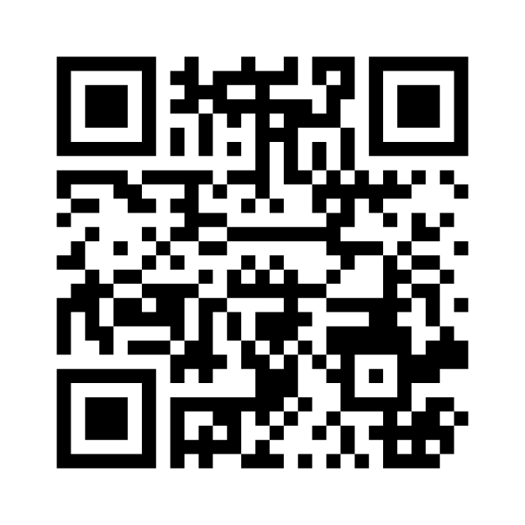
We want to hear from you
Use the QR code or go to menti.com and input #8537 0039
What's the best way to communicate about the roll-out of the new system?
What do we need to get right to support a successful adoption of the new application system?
Notes:
Erica

