Slide 1
2025 CACCRAO Conference
Navigating Change: Steering A&R Towards New Horizons
Dr. Pedro Avila
Superintendent/President
Gavilan College

Slide 2
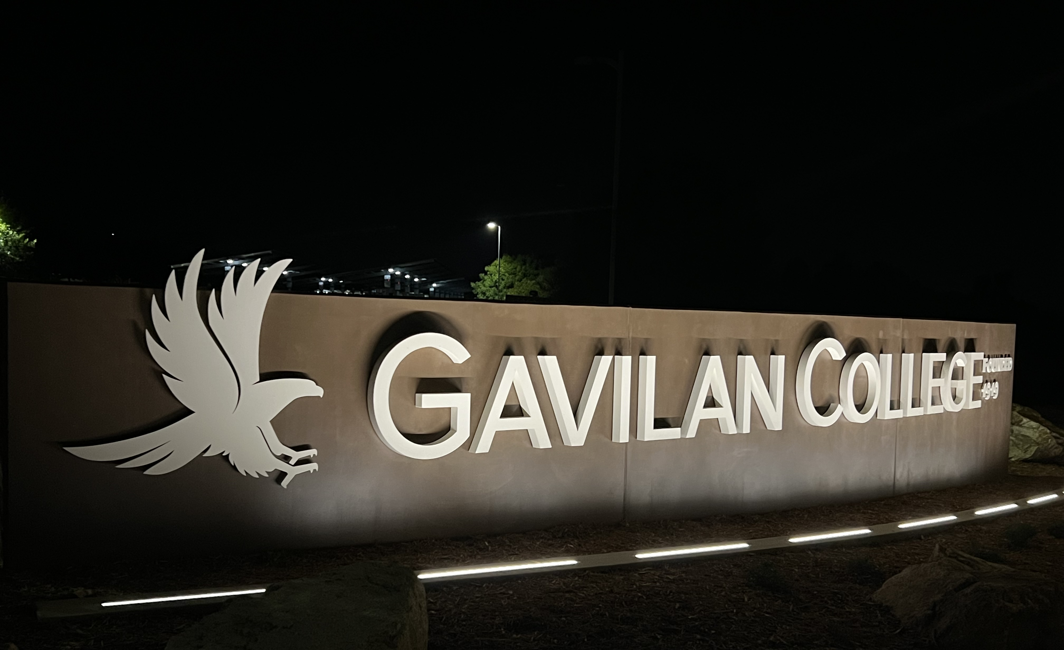
Measure X - Monument Signs
A picture is worth a
THOUSAND
WORDS

Slide 3
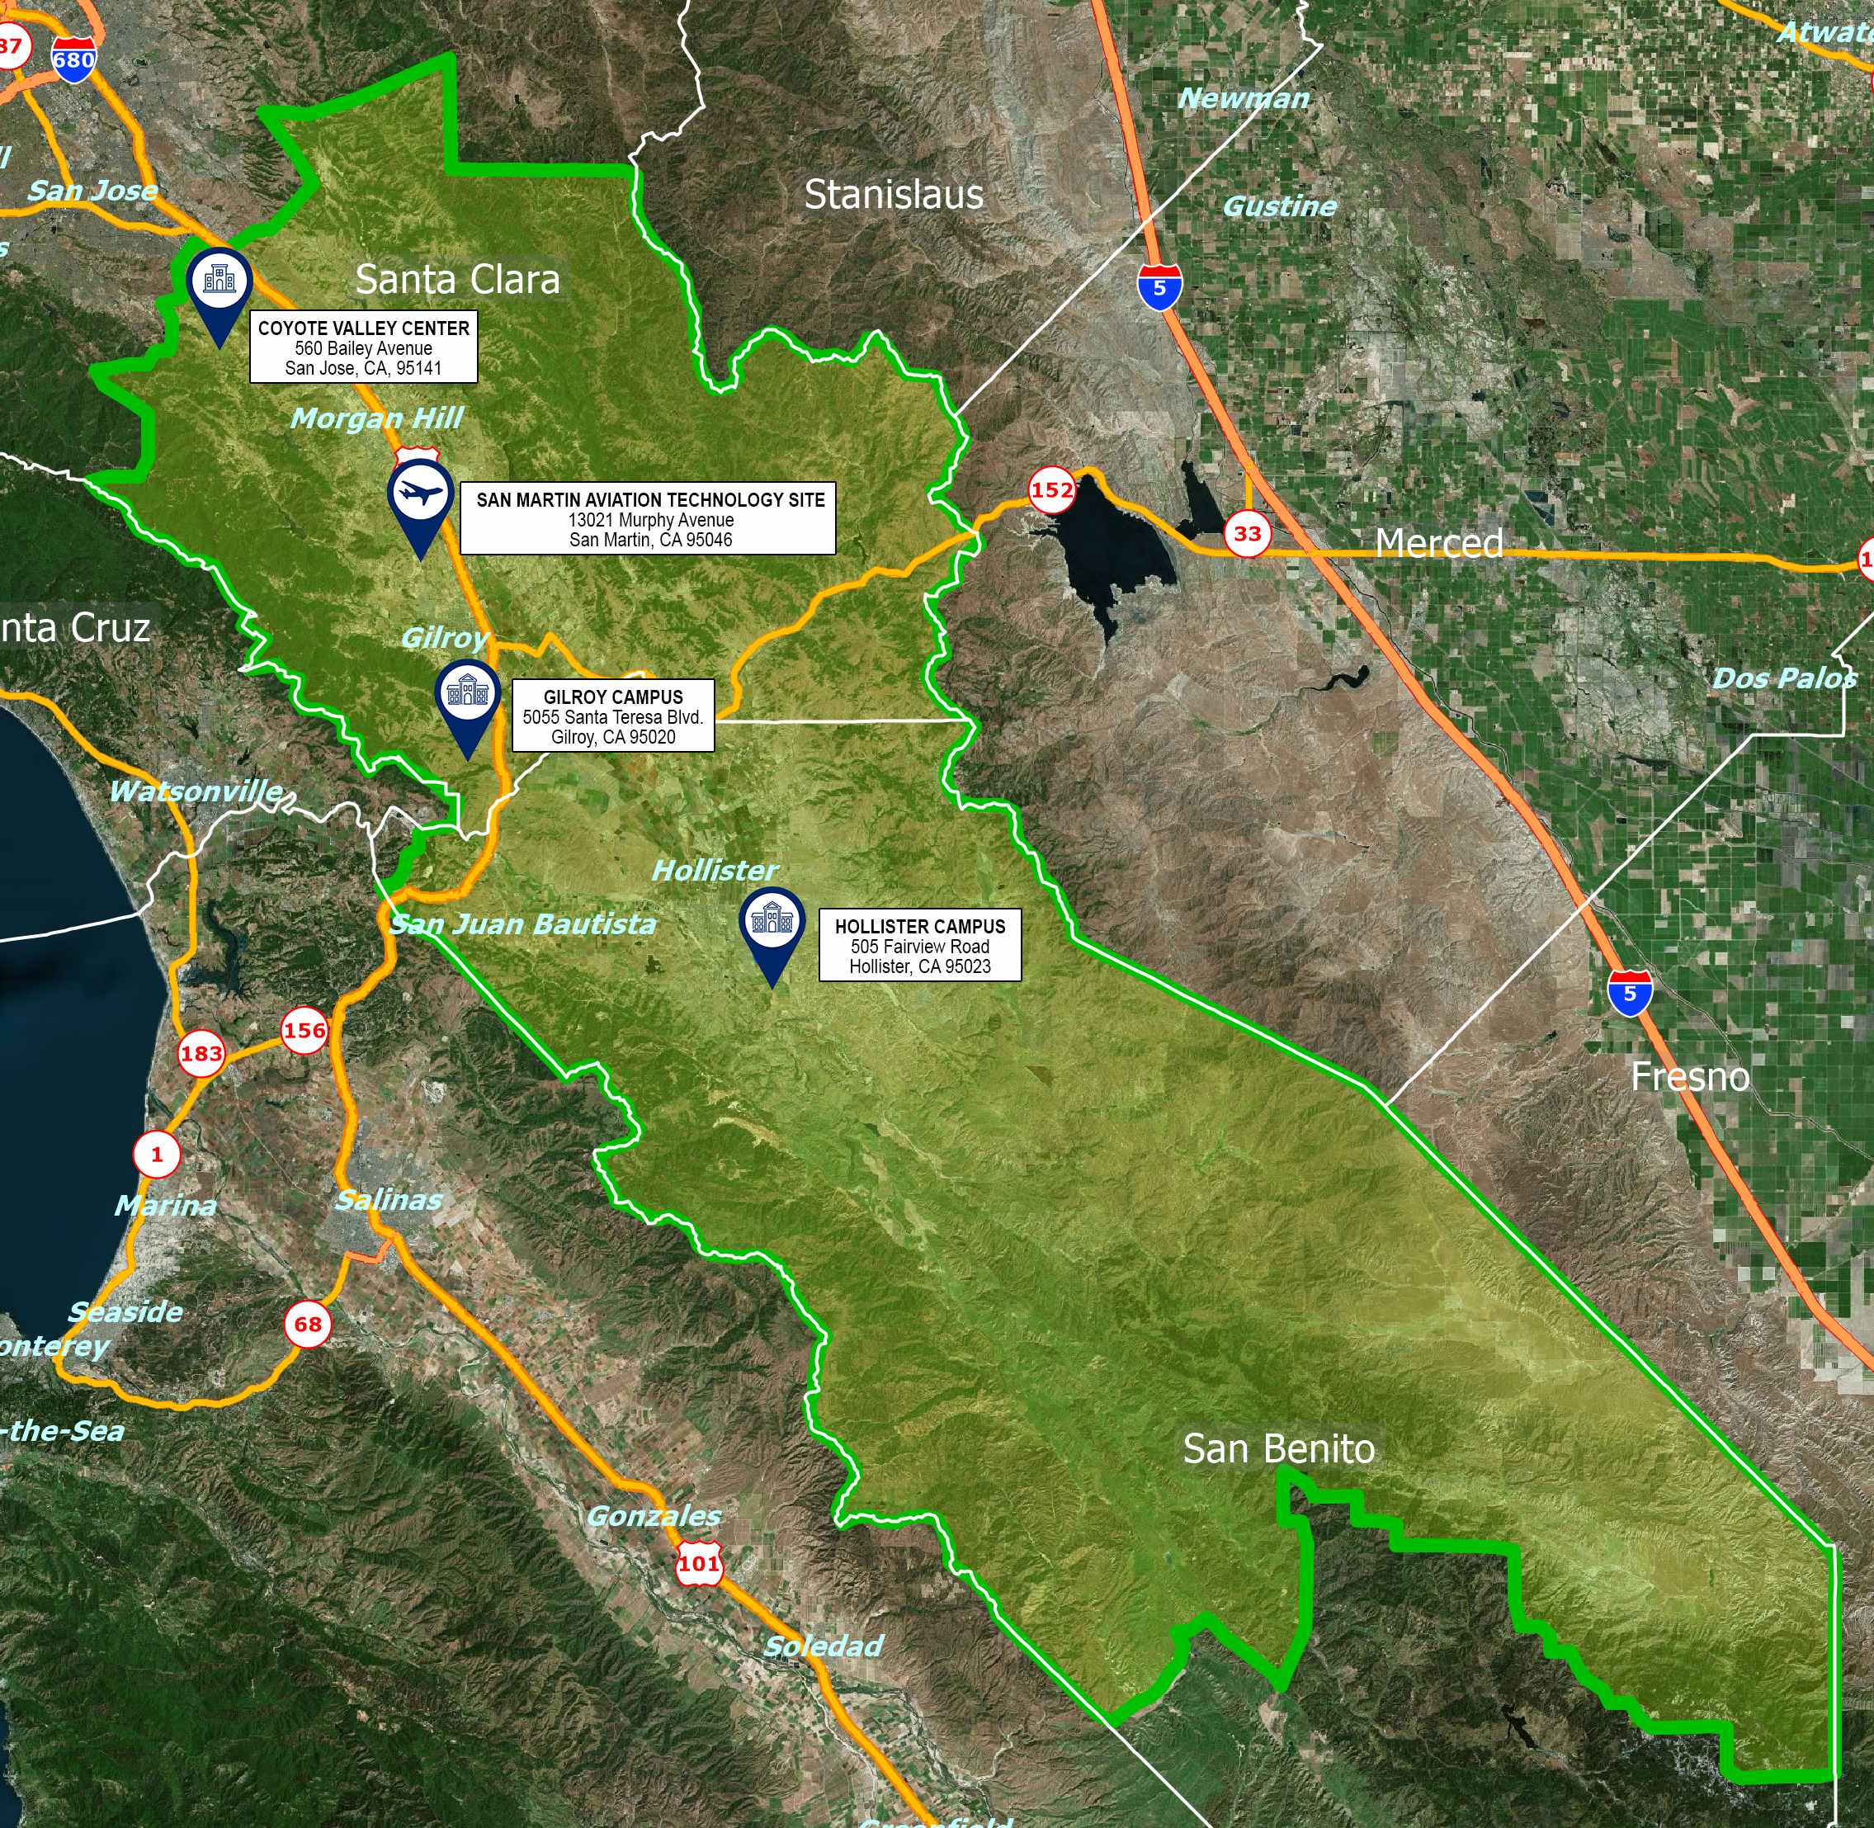
About Gavilan College
Gavilan College was established in 1919 as San Benito County Junior College, with instruction offered at Hollister High School.
It operated under this title until 1963 when the district expanded to include south Santa Clara County and was renamed Gavilan College Joint Community College District.
The College moved from Hollister to the Gilroy campus in 1968.
The district boundaries cover 2,700 square miles of land in the southern portion of Santa Clara County and most of San Benito County.
Castroville

Slide 4
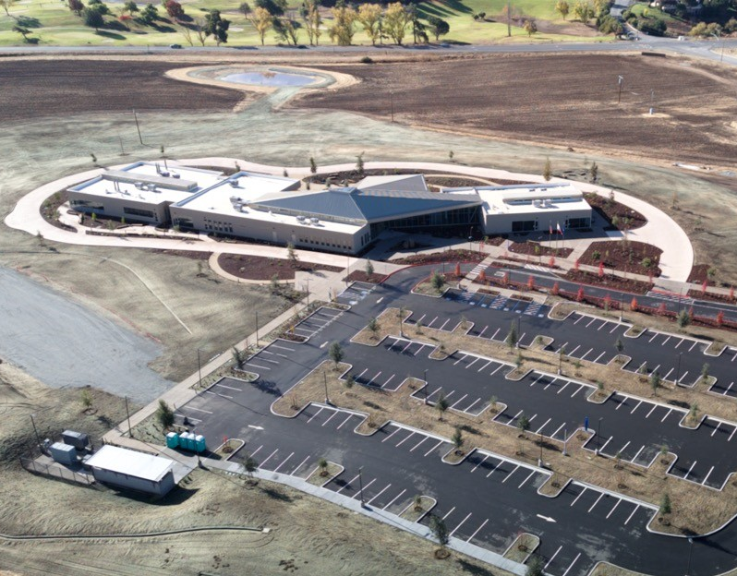

Hollister Campus

Slide 5
Student Headcount
+25%
COVID
+11%

Slide 6
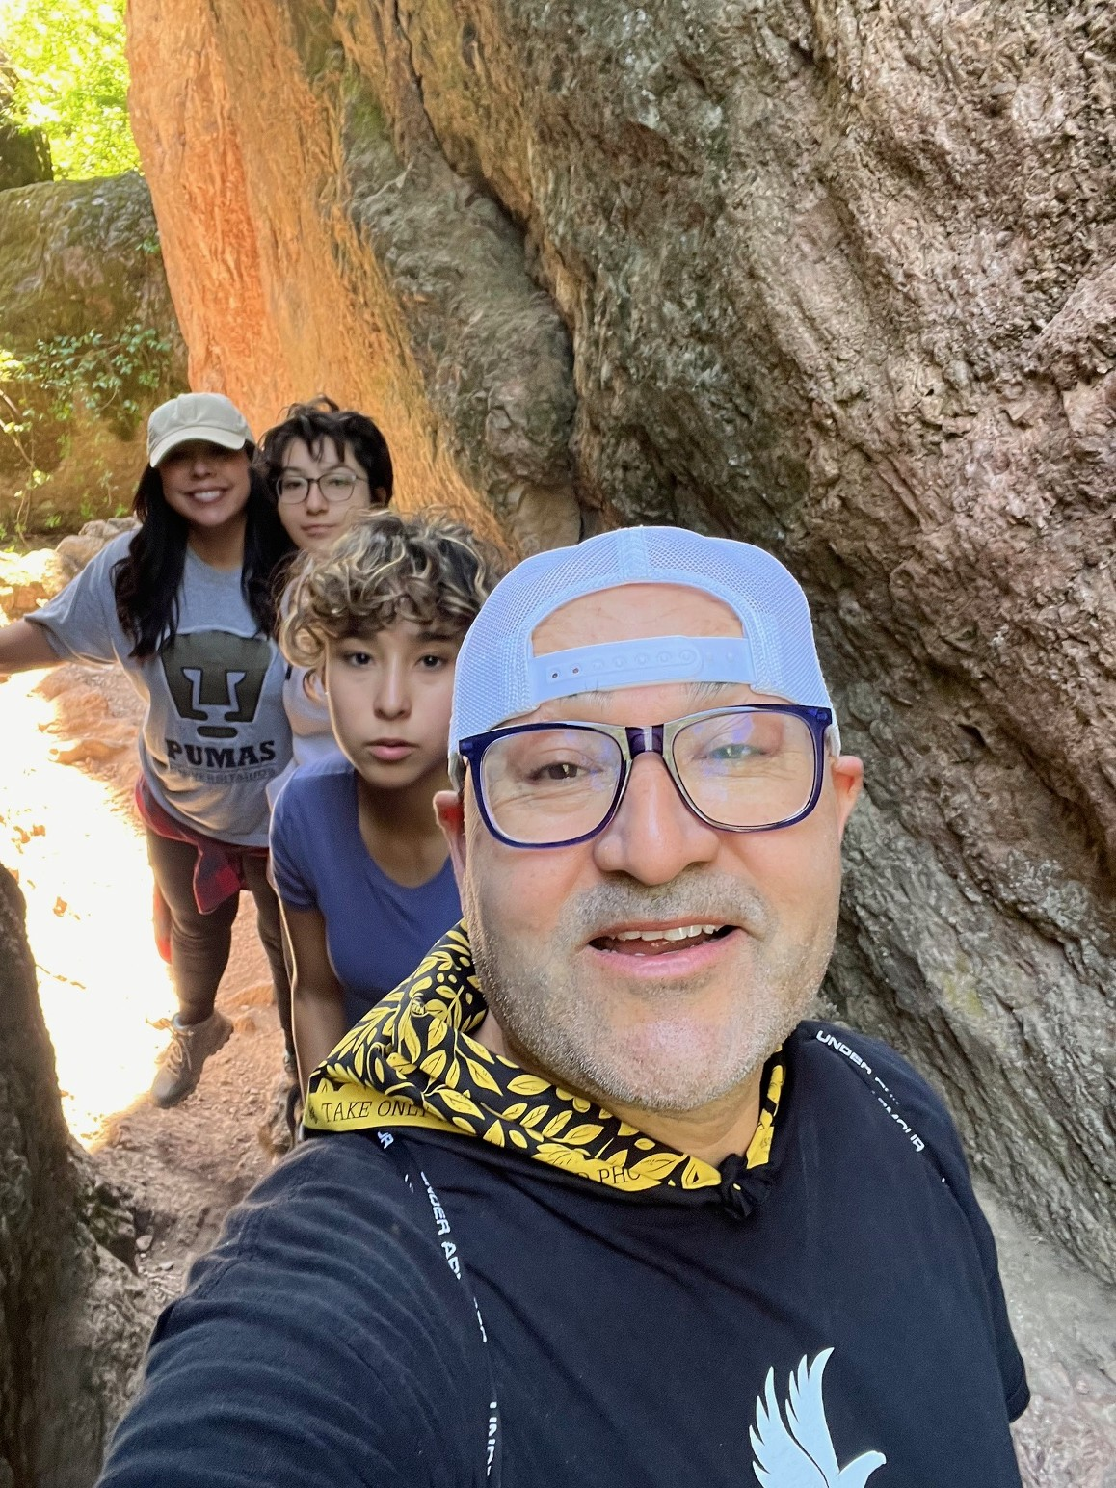

Slide 7


Slide 8
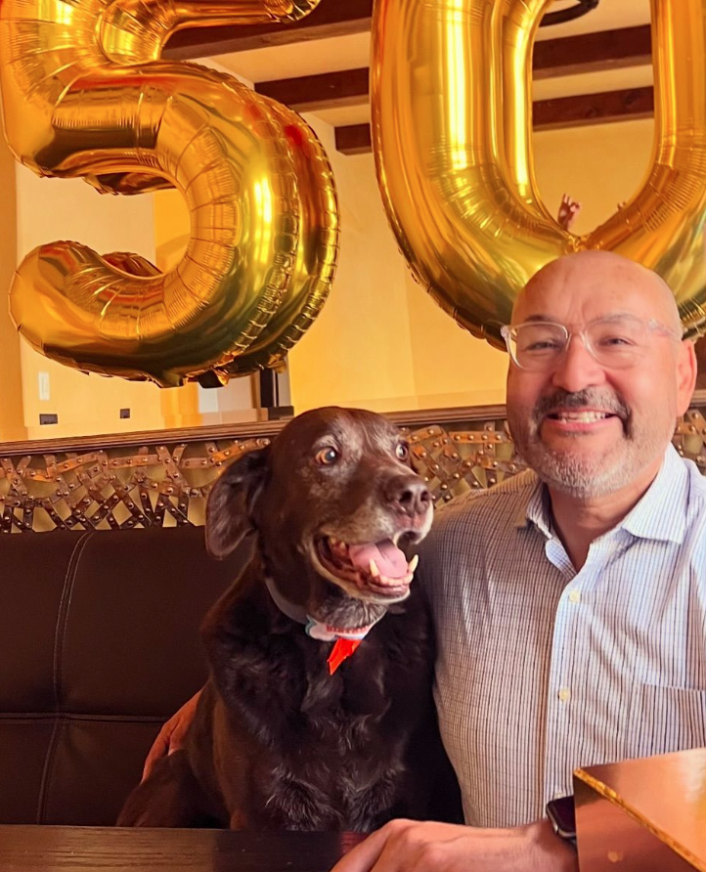
Notes:
This year has been a special year, a lot is happening this year, I turned 50 this year, thanks to everyone who come out to help me celebrate. You really made it special. I also had a chance to celebrate with my family. You can see the picture with our chocolate lab Oso. He became part of our family when I turned 40 and ever since then we’ve celebrate birthdays together. So, we also celebrated his 10th birthday.
Thank everyone
Scott & Peter
Michelle and Kulvi
Izzy, Scott (great to see him back!), and Jeronimo
Facilities and operations staff

Slide 9
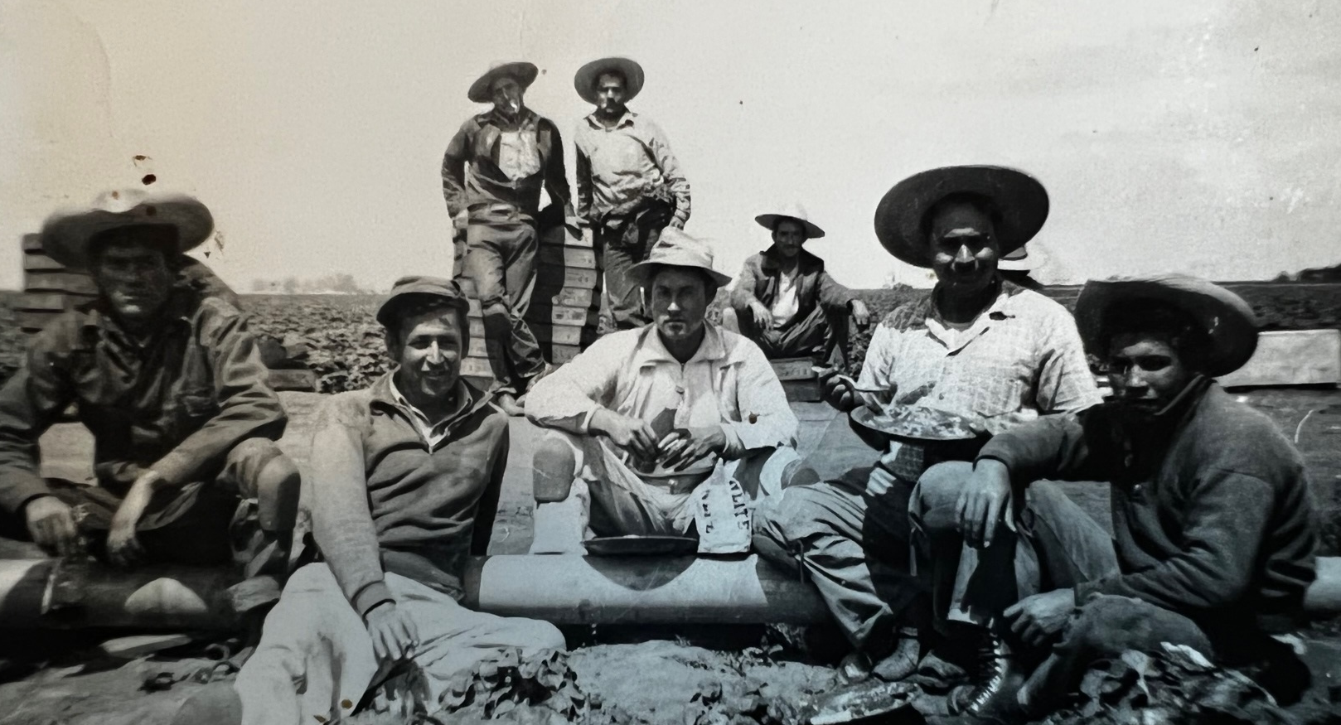

Slide 10
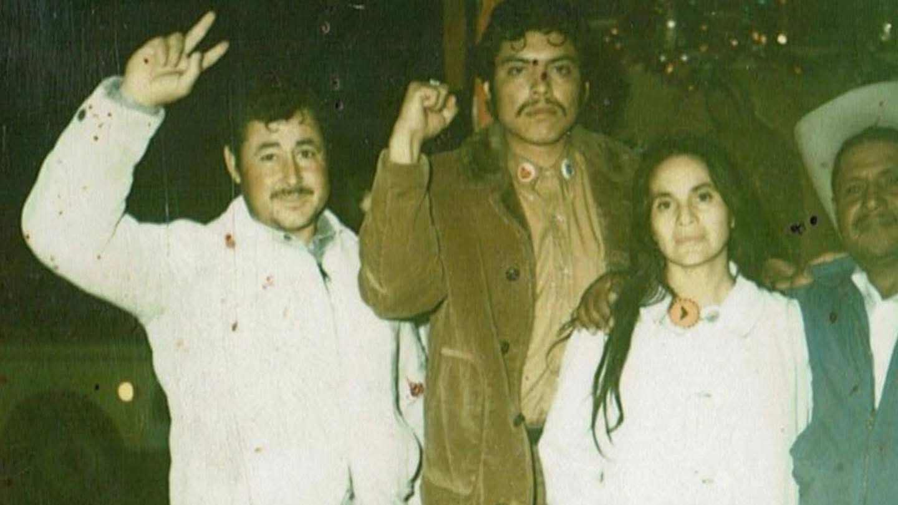

Slide 11
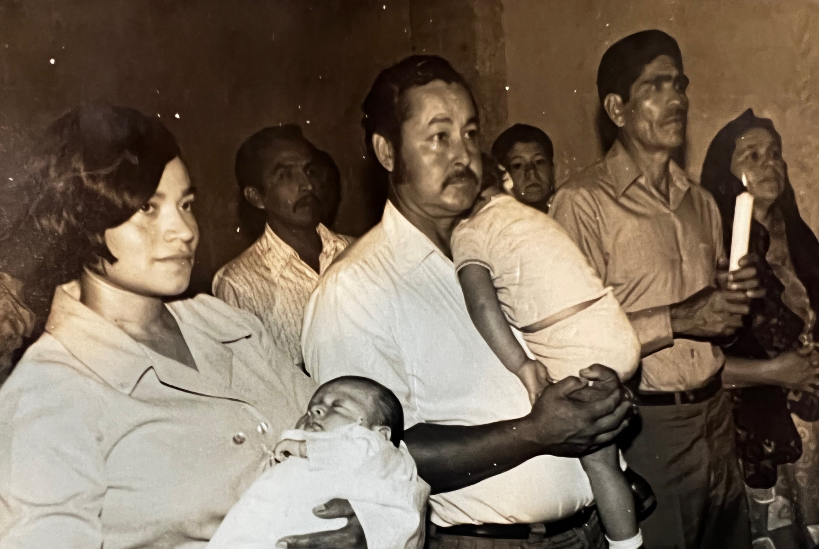

Slide 13
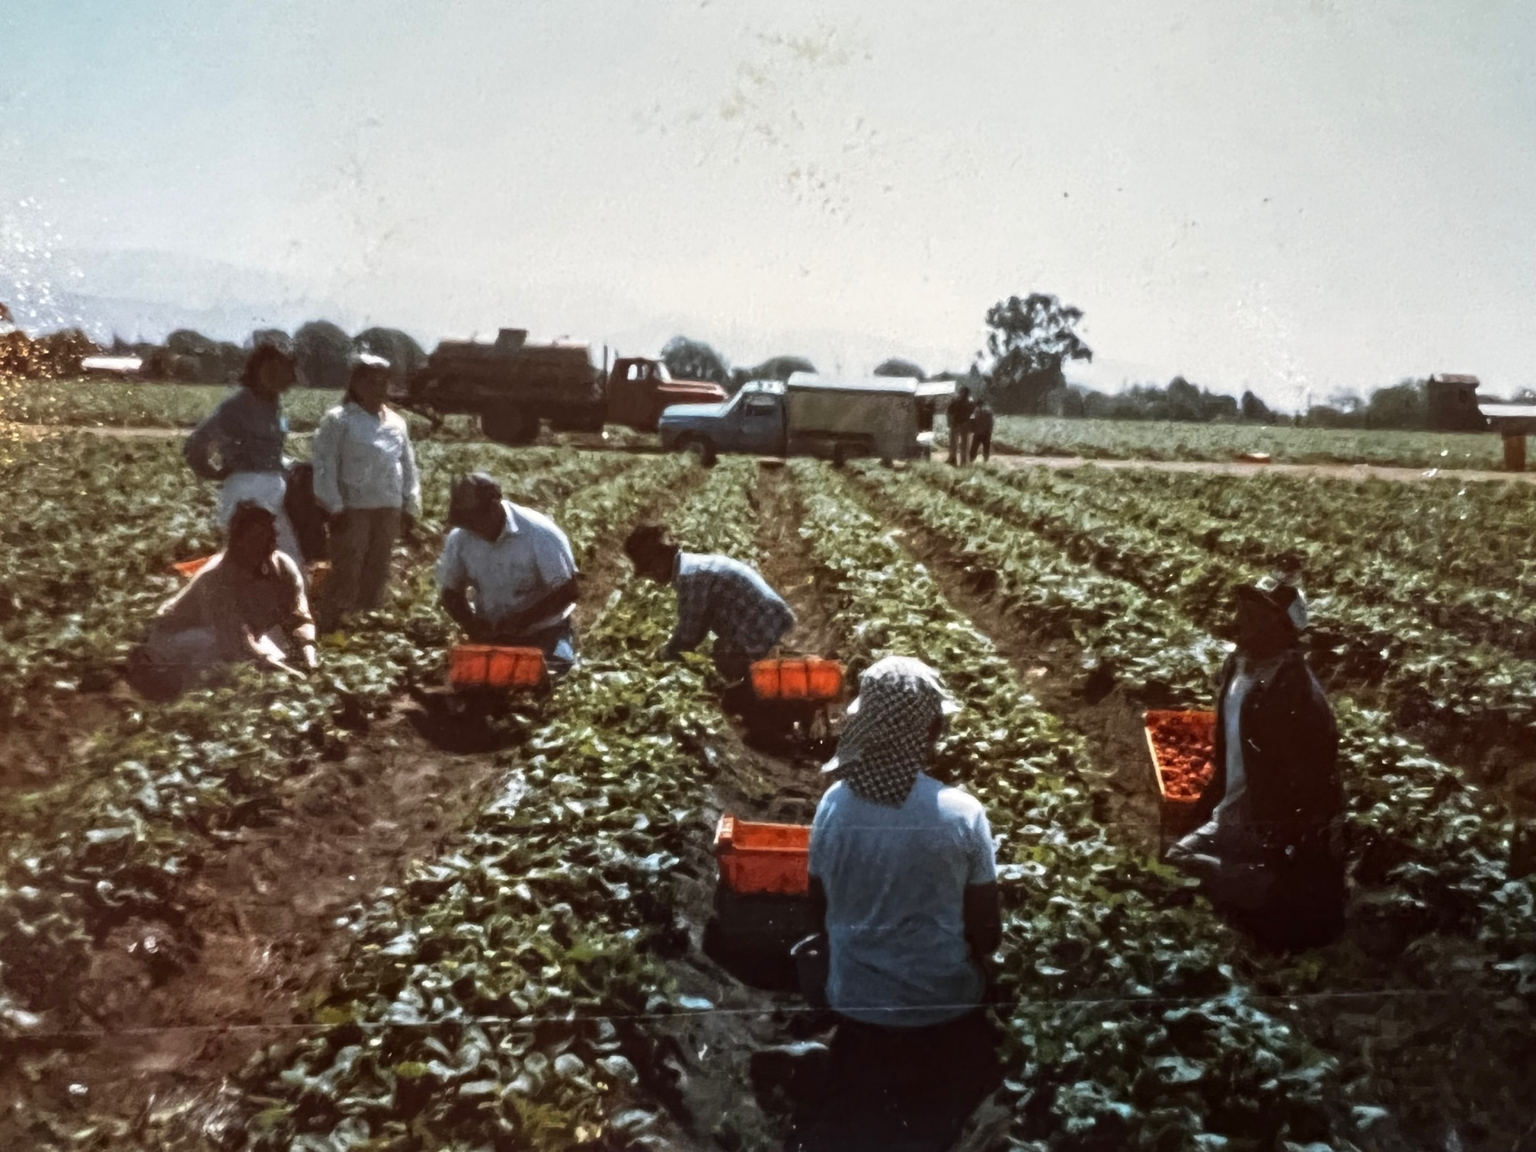

Slide 14
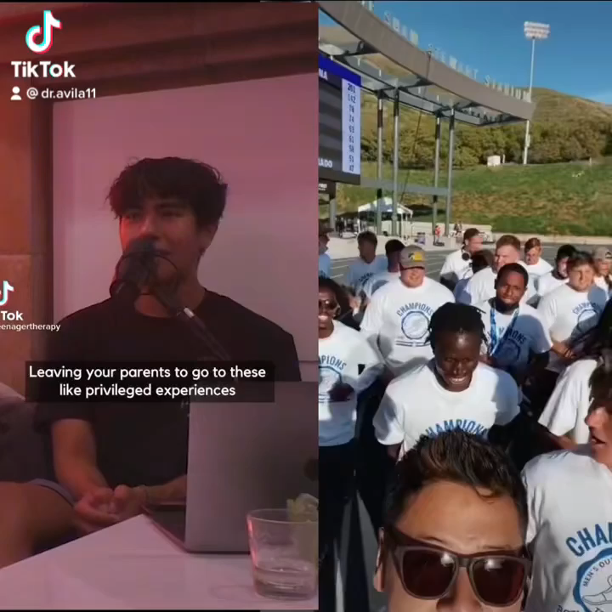

Slide 15








My Path to the Presidency at Gavilan College
Notes:
My academic journey started at Fresno State. I went straight into the private sector, but soon discovered it did not fulfill me and I wanted to give back. ..........I realized I was moving up rather fast, so I put the brakes. I realized how important it was to learn all aspects of a college, especially student services. I purposefully spent many years as a VP.

Slide 16
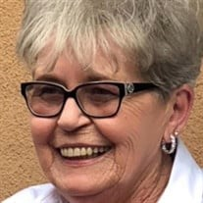
Darlene Georgatos
District Director of Enrollment
West Hills College

Slide 17
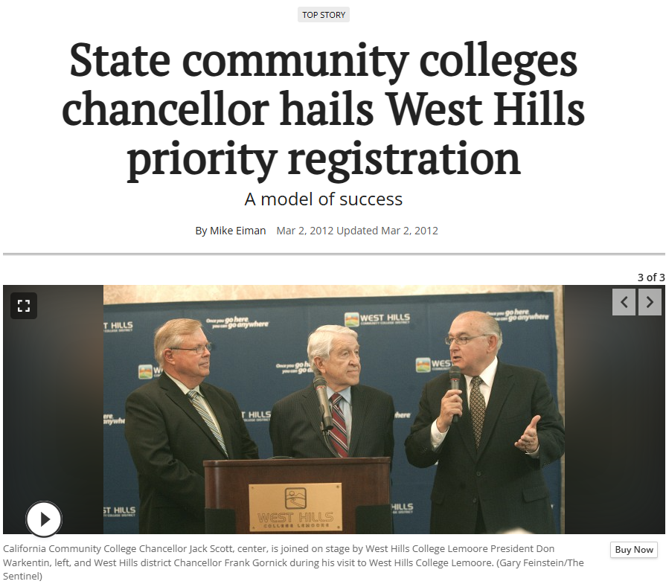
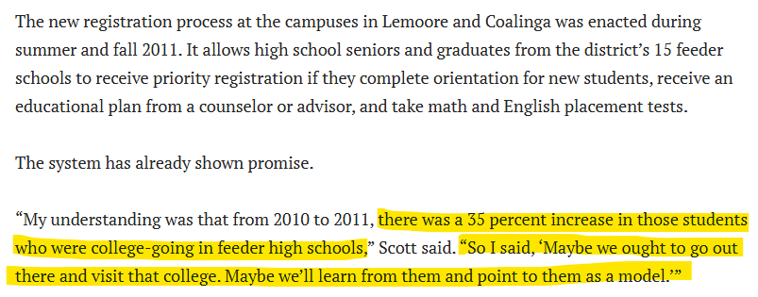

Slide 18
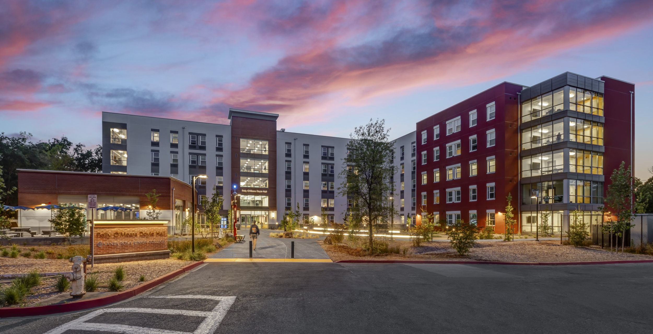
Santa Rosa Junior College Student Housing

Slide 19
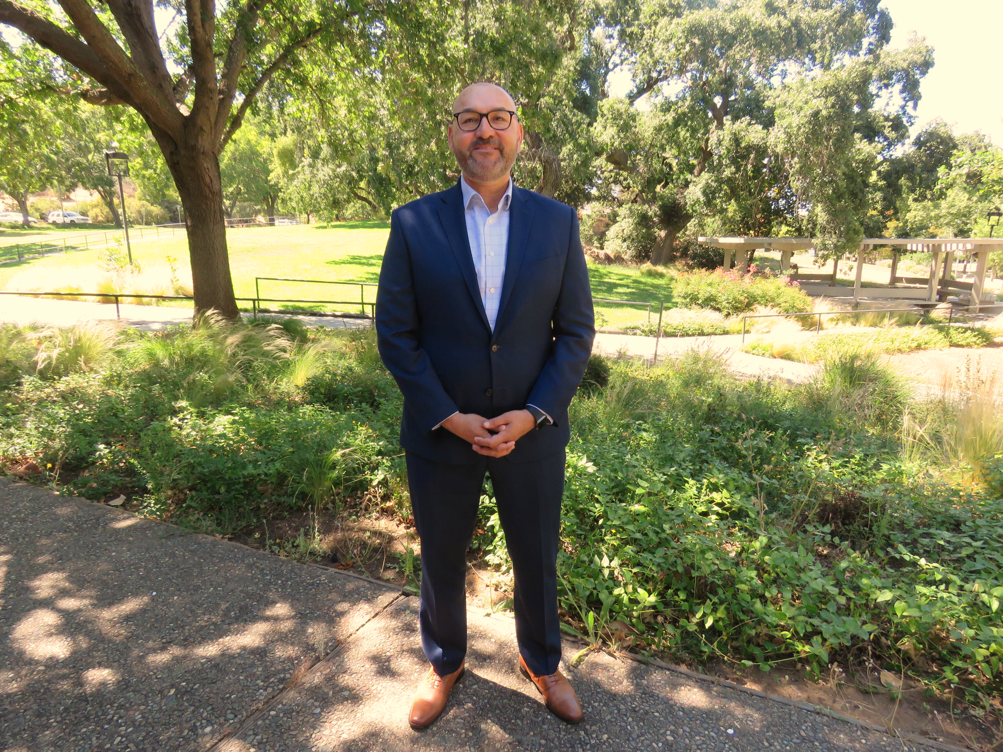
Equity Minded Leadership requires personal and institutional responsibility for students’ success. I acknowledge that systemic inequities have historically disadvantaged individuals or groups of people, and I am committed to taking action to address those inequities. Through a collective process, I will lead our institution to identify, disrupt, and transform institutional processes, policies, traditions, and philosophies perpetuating structural inequities.
Dr. Pedro Avila
Superintendent/President

Slide 20
Q&A

