Slide 1
2025 CACCRAO Conference:
Chancellor’s Office Educational Services and Support Updates

Slide 2
Chancellor’s Office Speaker Introductions
Kati Kouklis, Analyst, Educational Services and Support Division
Allison Beer, Dean, Educational Services and Support Division
Imran Majid, Director of Fiscal Advocacy, Government Relations
Michelle Smith, Assistant Vice Chancellor, Chancellor’s Office
Notes:
Slide 1 Speaker Notes – 2025 CACCRAO Conference
Welcome, everyone!
Before we dive into updates from the Chancellor’s Office, I’d like to take a moment to introduce our panel.
My name is Kathleen Kouklis, and I’ve served as the Admissions and Records Analyst at the California Community Colleges Chancellor's Office for 5 years. My primary focus is on admissions and records and I am a support person to several equity programs.
At this time, I’ll hand it over to Allison to introduce herself.
Once Allison finishes, allow each panelist 30 seconds for introductions.
We kindly ask that you hold any questions until the end of our presentation—thank you!

Slide 3
Agenda
Vision 2030 and Student Services Program Updates
2025 Legislative Update
Dual Enrollment
Transfer

Slide 4
Vision 2030
A Roadmap for
California Community Colleges
What is it?
A seven-year action plan that:
  Guides field practice.
  Removes systemic barriers.
  Opens doors for policy reform.
Notes:
Vision 2030 reaffirms California Community Colleges’ commitment to achieving equity in education by addressing systemic barriers based on race, ethnicity, religion, class and gender, with a specific focus on students facing persistent disparities tied to their racial and ethnic identities.
The system will explicitly identify barriers, allocate necessary resources, prioritize equity, and adjust structures to ensure equitable opportunities and support for all students, as embodied in Vision 2030’s three equity-focused goals.

Slide 5
Vision 2030 Framework
Vision 2030
3 Goals
Equity in Success
Equity in Access
Equity in Support
Vision 2030
3 Goals
Equity in Success
Equity in Access
Equity in Support
Vision 2030
6 Outcomes & Metrics
12 Actions within our Three Strategic Directions
Notes:
Vision 2030 outlines three central equity goals — Equity in Success, Equity in Access and Equity in Support — as the driving force behind the transformational change within the system. These goals aim by 2030 to reduce and ultimately eliminate equity gaps for students of color who are underrepresented, students of low income and students with disabilities.

Slide 6
How We Know We’re Getting There: Goals & Metrics
Increase with equity the number of California Community College students:
  Who complete a meaningful educational outcome.
  Who attain a baccalaureate degree.
  Who earn a living wage.
Equity in Success
Increase with equity the number of students attending a California community college, with particular emphasis on the number of underserved Californians.
Equity in Access
Increase with equity the number of California Community Colleges students receiving state and federal aid for which they are eligible to better support their educational journey.
Decrease the number of units in excess of 60 units for the Associate Degree for Transfer.
Equity in Support
Notes:
Rowena to hand over to Erik after this slide

Slide 7















Programs we proudly support and serve.
Notes:
Chancellor’s Office: Programs We Administer
Dual Enrollment – expanding early-college access for high-school students
AMEND – African American Male Education Network & Development initiative
Rising Scholars Network – tailored support for justice-impacted learners
MESA – Mathematics, Engineering, Science Achievement program
HBCU Transfer Guarantee – streamlined pathways to partner Historically Black Colleges & Universities
Umoja Community – culturally responsive learning communities for Black students
PUENTE Project – writing, counseling, and mentoring to boost Latinx student transfer & success
Together, these flagship programs advance equity, access, and student success across California’s community colleges.

Slide 8
Supporting Foster Youth
In 2023-24, the NextUp Program served 11,495 students systemwide
  Two possible reasons: program’s age eligibility requirement has decreased from 16 to 13 years of age and the program’s expansion from 46 to 115 community colleges offering services statewide
Foster Youth College Access Demonstration Project
Butte, Chabot, Los Angeles Pierce, Mt. San Antonio, Rio Hondo, Riverside City colleges
Project will support colleges in serving high school foster youth and improve outcomes by strengthening the high school to college pipeline
  Utilize a case management model to lower barriers to college enrollment and promote student success​
    Support the enrollment and completion of dual enrollment classes
    Assist with college and financial aid application process and planning​
    Support with relevant social safety net program applications
Notes:
Talking Points: Supporting Foster Youth in California Community Colleges
Good [morning/afternoon], everyone. I’m honored to share key updates on how our California Community Colleges are supporting foster youth across the state.
As we all know, education is one of the most powerful tools we have to break cycles of instability and open pathways to opportunity. Our colleges are doing incredible work to ensure that foster youth receive the resources, relationships, and support they need to thrive.
In 2023–24, the NextUp Program made a significant impact—serving over 11,495 students systemwide. This increase reflects two major changes:
Expanded eligibility—In 2022, the age threshold shifted from foster care at age 16 to age 13, making more students eligible for support.
Statewide expansion—Thanks to a historic investment, funding for NextUp increased from $19.25 million to $51.3 million, allowing us to grow from 46 participating colleges to all 115 community colleges statewide.
Now, every foster youth in California—no matter where they live—has access to the robust support services that NextUp provides. This includes academic counseling, financial aid assistance, basic needs support, and most importantly, a sense of community.
These efforts align with the Chancellor’s Office Vision 2030, which prioritizes comprehensive, equity-centered student support.
In addition, I’m excited to highlight the Foster Youth College Access Demonstration Project, a new initiative designed to strengthen the high school to college pipeline for foster youth.
Six colleges were selected to lead this work:
Butte College
Chabot College
Los Angeles Pierce College
Mt. San Antonio College
Rio Hondo College
Riverside City College
These colleges will implement a case management model that:
Supports dual enrollment participation
Assists with college and financial aid applications
Connects students with social safety net programs
Removes barriers to enrollment and completion
Through these initiatives, our commitment is clear: We believe in the potential of foster youth. And we are doing the work to ensure every student has the support to pursue their dreams and complete their goals.

Slide 9
Students with Disabilities
DSPS
  In 2023-2024, DSPS served 116,089 students, which is almost 10,000 more than the previous year. The number of DSPS students being served is continuing to increase post-Covid.
  The updated DSPS Allocation Funding Formula is currently in Year 2 of its 5-year implementation plan to phase-in the new funding formula.
Universal Design for Learning Task Force​
  Began Fall of 2024, intended to make curriculum and learning in the classroom and in service delivery more accessible and to ensure all students experience community college as a place where they belong.​
  We are currently waiting release of the UDL recommendations. Our next step, as a Task Force, is to determine how best to implement these recommendations.
Notes:
Talking Points: Supporting Students with Disabilities in California Community Colleges
I’m excited to share some important updates on how we are advancing support for students with disabilities across our system.
Our Disabled Students Programs and Services (DSPS) continues to grow in reach and impact. In 2023–24, DSPS served 116,089 students—an increase of nearly 10,000 students compared to the previous year.
This growth reflects not only the increasing needs of our students post-COVID, but also the commitment of our colleges to create more inclusive learning environments.
We are also in Year 2 of the 5-year implementation plan to phase in the updated DSPS Allocation Funding Formula.
This formula is designed to better reflect the real costs of serving students with disabilities and ensure equitable distribution of resources across our colleges.
In addition to DSPS, we are proud to share the progress of the Universal Design for Learning (UDL) Task Force, which officially launched in Fall 2024.
The UDL Task Force was created to make curriculum, instruction, and service delivery more accessible for all students, ensuring that every student experiences our community colleges as spaces where they truly belong.
We are currently awaiting the release of the Task Force’s recommendations. Once they are available, our next step will be to work collaboratively to determine the most effective ways to implement these recommendations across the system.
Through these initiatives, our message is clear: Accessibility and belonging are not optional—they are essential.
We are committed to breaking down barriers, designing with all students in mind, and fostering environments where every student can succeed.

Slide 10
Veterans & Military Affiliated Students
2022-23, Veterans Resource Centers supported 48,617 veterans, active duty, reservists and National Guard and 36,652 military dependents.
Veterans Symposium 2025 - Mapping the Journey: A Roadmap for Veteran Success in Higher Education will be held June 23-24 in San Diego, CA. An intersegmental conference: faculty, staff and partners.
Webinar: Warriors Dilemma – Veterans and Mental Health, May 2nd 10:00-11:30; Presenter Dylan Bender, MA LMFT, Irvine Valley College Director of Veterans Services Center. Registration to follow on CSSO list.
Veterans Mental Health Demonstration Project
10 Colleges selected: Cabrillo, Citrus, ELAC, Fullerton, LAVC, Lemoore, Riverside, San Diego, Shasta, and Ventura.
Access to mental health and wellness supports
Campuswide professional development on unique needs of student veterans
Peer engagement
Notes:
Talking Points: Supporting Veterans and Military-Affiliated Students
Next up, sharing updates on how we’re continuing to support veterans and military-affiliated students across California’s community colleges.
In 2022–23, our Veterans Resource Centers served a total of 48,617 veterans, active-duty service members, reservists, and National Guard members, along with 36,652 military dependents.
The reach of our support services demonstrates our deep commitment to meeting the academic, wellness, and career needs of our military-connected students.
We are excited to announce the Veterans Symposium 2025, titled Mapping the Journey: A Roadmap for Veteran Success in Higher Education. This intersegmental conference—bringing together faculty, staff, and external partners—will be held June 23–24, 2025, in San Diego. You can find event details here.
Additionally, on May 2, we will host a webinar titled Warrior’s Dilemma: Veterans and Mental Health from 10:00 to 11:30 AM. Presented by Dylan Bender, MA, LMFT, and Director of the Veterans Services Center at Irvine Valley College, this session will explore critical mental health challenges facing student veterans. Registration information was be sent out via the A&R listserv.
Another major effort underway is the Veterans Mental Health Demonstration Project, where 10 colleges have been selected to pilot enhanced support models:
Cabrillo College
Citrus College
East Los Angeles College
Fullerton College
Los Angeles Valley College
West Hills College Lemoore
Riverside City College
San Diego City College
Shasta College
Ventura College
These colleges are expanding:
Access to mental health and wellness services
Campuswide professional development focused on the unique needs of student veterans
Peer engagement opportunities to build connection and community
Lastly, for those who work closely with funding or data reporting for Veterans Resource Centers, please note the release of a new memo regarding a data source change impacting the Veterans Resource Center Funding Formula.
Through these collective efforts, we are reaffirming that California’s community colleges stand with our veterans, active military, and their families—providing the pathways, support, and opportunities they deserve.

Slide 11
Comprehensive Educational Planning
System focus on ensuring all non-exempt students receive Comprehensive Educational Plans (CEPs) in their first academic year​.
​
New MIS data element definition for CEPs: at least 2 terms in length and must include all courses and requirements needed to achieve the students declared course of study​
2025-2028 Student Equity Plan: track CEPs by student population in first academic year; must plan to address disproportionate impact. Colleges must also list strategies to ensure all students receive CEP in first academic year.​
Proposed regulatory changes to ensure CEPs for non-exempt students in the first academic year "to the maximum extent possible."
Notes:
Talking Points: Comprehensive Educational Planning
Sharing important updates regarding Comprehensive Educational Planning across our system. There is a renewed systemwide focus on ensuring that all non-exempt students receive a Comprehensive Educational Plan (CEP) during their first academic year. We know that early planning is critical for student persistence, completion, and success. To support this effort, the Management Information System (MIS) data element definition for CEPs has been updated.
A CEP must now:
Cover at least two academic terms, and
Include all courses and requirements needed to complete the student’s declared course of study.
Additionally, under the 2025–2028 Student Equity Plan, colleges will be required to:
Track CEP completion by student population within the first academic year, and
Identify and address any disproportionate impact in CEP completion rates across student groups. Colleges must also describe the strategies they will use to ensure all students receive a CEP during their first year.
Finally, proposed regulatory changes are underway that would formally require colleges to provide CEPs to non-exempt students “to the maximum extent possible” within the first academic year. This regulatory language emphasizes both urgency and flexibility, recognizing that while the goal is universal coverage, some students’ individual circumstances may vary. Together, these changes strengthen our commitment to providing students with clear, structured pathways from their first steps on campus to successful program completion.

Slide 12
Maximizing Aid for Students
Supporting students complete the FAFSA/CADAA is best way A&R offices can help students maximize their financial aid award
  Colleges can participate in Cash for College workshops or hold their own events, in partnership with student services programs (e.g. Dream Resource Centers, Veterans Resources Centers)
Work with financial aid offices when students need cost of attendance adjustments, e.g. for childcare expenses, and to support satisfactory academic progress
Connect students to Basic Needs Centers and inform students when they may be eligible for public benefits programs, e.g. CalFresh
Notes:
Talking Points: Supporting Students to Complete FAFSA/CADAA and Maximize Financial Aid
Highlighting how Admissions and Records (A&R) offices can play a critical role in helping students maximize their financial aid opportunities.
One of the most impactful ways A&R offices can support students is by encouraging and assisting them to complete either the Free Application for Federal Student Aid (FAFSA) or the California Dream Act Application (CADAA). Timely completion of these applications can significantly expand a student’s access to grants, scholarships, work-study, and other vital resources.
Colleges can further support this effort by:
Participating in Cash for College workshops, or
Hosting their own FAFSA/CADAA completion events in partnership with key student services programs, such as Dream Resource Centers, Veterans Resource Centers, and others.
It’s also important for A&R offices to collaborate closely with Financial Aid Offices to:
Assist students who need cost of attendance (COA) adjustments—for example, to account for childcare expenses or other unique financial circumstances.
Support students in maintaining Satisfactory Academic Progress (SAP), which is essential to remain eligible for aid.
Finally, we encourage A&R staff to connect students with Basic Needs Centers and help inform them when they may be eligible for public benefits programs, such as CalFresh. Addressing students' basic needs holistically ensures they can focus on their academic goals without the added burden of food insecurity, housing instability, or other unmet needs.
Through these partnerships and proactive efforts, we can help ensure that financial aid truly becomes a tool for access, retention, and success.

Slide 13
Maximizing Aid for Students
A&R professionals should be aware of recent and forthcoming policy changes for financial aid and basic needs services
  Students completing the CADAA can now complete the AB540 Affidavit (non-resident tuition exemption) as part of the application. Colleges can access students' affidavit through CSAC's WebGrants portal.
  AB1885 - Beginning 2025-26, students with disabilities who are enrolled in 9+ units per semester (or quarter equivalent) may qualify for the Student Success Completion Grant (SSCG) as full time, as part of an Academic Accommodation Plan
  AB2458 – By 2026-27, colleges will be required to standardize cost of attendance adjustments for student parents, including for childcare, housing, and transportation expenses. A Chancellor's Office memo is forthcoming by July 2025.
Notes:
Talking Points: Maximizing Aid for Students
It’s important to stay aware of recent and forthcoming policy changes impacting both financial aid and basic needs services. These changes create new opportunities to better serve our students and ensure they receive the full range of support available.
A few key updates to highlight:
CADAA and AB 540 Affidavit Integration:
Students completing the California Dream Act Application (CADAA) can now also submit their AB 540 Affidavit—for nonresident tuition exemption—as part of the CADAA process.
Colleges can access students’ affidavits directly through CSAC’s WebGrants portal, streamlining the process and reducing paperwork barriers for Dreamers.
AB 1885 – Expanding Full-Time Status for Students with Disabilities:
Starting in 2025–26, under AB 1885, students with disabilities who are enrolled in 9 or more units per term (or quarter equivalent) and have an Academic Accommodation Plan may be considered full-time for purposes of receiving the Student Success Completion Grant (SSCG).
This change will help ensure students with disabilities are not disadvantaged in their access to critical financial aid.
AB 2458 – Standardizing Cost of Attendance Adjustments for Student Parents:
By 2026–27, colleges will be required to standardize Cost of Attendance (COA) adjustments for student parents, including adjustments for childcare, housing, and transportation expenses.
The Chancellor’s Office will issue a guidance memo by July 2025 to support colleges in implementing this important change.
These policy shifts are designed to reduce barriers, promote equity, and ensure that financial aid truly meets the diverse needs of our student population.

Slide 14
Affirmed Name and Gender – Legislation Overview
AB 2315 (Arambula, 2022):
  Requires CCCs to implement systems allowing students, staff, and faculty to declare affirmed name and gender identity.
  Requires updates to records: email addresses, ID cards, class rosters, transcripts, diplomas.
  Legal name may be used where required, e.g. FAFSA requires legal name
  No extra fees for reissued documents with affirmed details.
AB 760 (Wilson, 2023):
  Expands AB 2315 provisions to CSU and UC.
  Confirms inclusion of official and unofficial transcripts in update requirements.
  Effective Starting: Academic Year 2023–24

Slide 15
Chancellor’s Office Memo – ESLEI 24-31 (May 14, 2024)
AB 2315 addresses deadnaming and promotes inclusive campuses. We must honor affirmed identities across all educational records.
Implementation Recommendations:
  Provide a system for students/employees to declare affirmed names/genders (no legal docs required).
  Make post-registration name/gender change forms easily accessible.
  Proactively notify students of options to update IDs, rosters, emails, and transcripts.
  No Extra Fees: For updating records per affirmed identity.

Slide 16
Chancellor’s Office Legal Guidance
Legal Opinion (July 16, 2024 & April 1, 2025 Updates):
For current students/staff/faculty - Colleges must update records with affirmed names/genders upon request, except where required to use legal names.
For former students -
  Colleges must reissue records (e.g., transcripts, diplomas) with affirmed identity upon receiving valid government-issued documentation.
  Colleges must update data systems to reflect affirmed names/genders—and may purge outdated records when feasible and in student’s best interest.
The April '25 update addresses that the use of legal names on transcripts may vary based on the circumstance.
Notes:
Are transcripts legal documents?
Not categorically, but may carry legal weight depending on context (e.g., licensing, forgery laws).
Core Principle: Respecting identity and preventing harm through deadnaming.

Slide 17

CACCRAO Spring Legislative Update
Imran Majid, Director of Fiscal Advocacy, Government Relations
Notes:
Introductions, greetings, etc.

Slide 18
State Legislation Overview
The Chancellor’s Office is currently monitoring 102 Tier 1 bills.
A full Legislative Matrix can be found by visiting the State Relations page on the Chancellor’s Office website.
February
Bill Introductions
March–May
1st House Hearings
June–August
2nd House Hearings
September
Legislative Deadline
October
Governor’s Final Actions
Notes:
The Chancellor’s Office is currently tracking 99 Tier 1 bills.
February 21st was the last day for new bills to be introduced.
All bills that are tagged fiscal must pass policy committee by May 2nd.

Slide 19

Legislation shapes our system. Tell us what you think.
If a bill causes you concern, raise those concerns early on
Seek input from the constituencies you engage with (CSSOs, CBOs, CEOs) before a bill is signed
Help us understand what we don’t know

Slide 20

Student Admissions and Records
AB 731 (Fong): Streamlining CCAP opportunities.
AB 850 (Pacheco): Institutional Debt Transparency Act.
AB 934 (Berman): Auto awarding of degrees and certificates.
SB 305 (Reyes): Universal FAFSA/CADAA completion for CCCs.
20

Slide 21
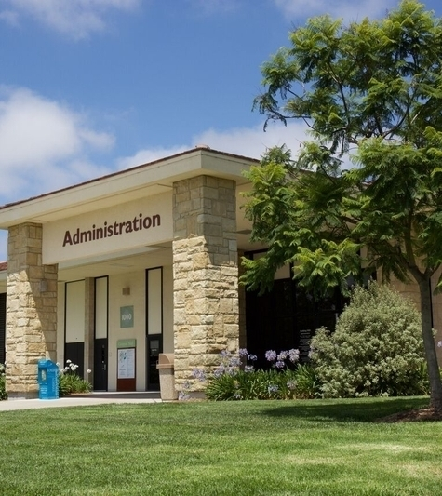
Student Information and Orientations
AB 466 (Solache)
  Donate Life California student orientation.
AB 727 (M. Gonzalez)
  Trevor’s Project information on student IDs.
SB 640 (Cabaldon)
  Dual admissions information.

Slide 22

Residency and Attendance Accounting
AB 695 (Fong): Nonresident tuition exemptions for deported students.
AB 395 (Gabriel): Holiday observances.
AB 268 (Kalra): Diwali holiday.

Slide 23
Government Relations Contact
govrelations@cccco.edu
imajid@cccco.edu

Slide 24
Dual Enrollment
Notes:
Introductions, greetings, etc.

Slide 25
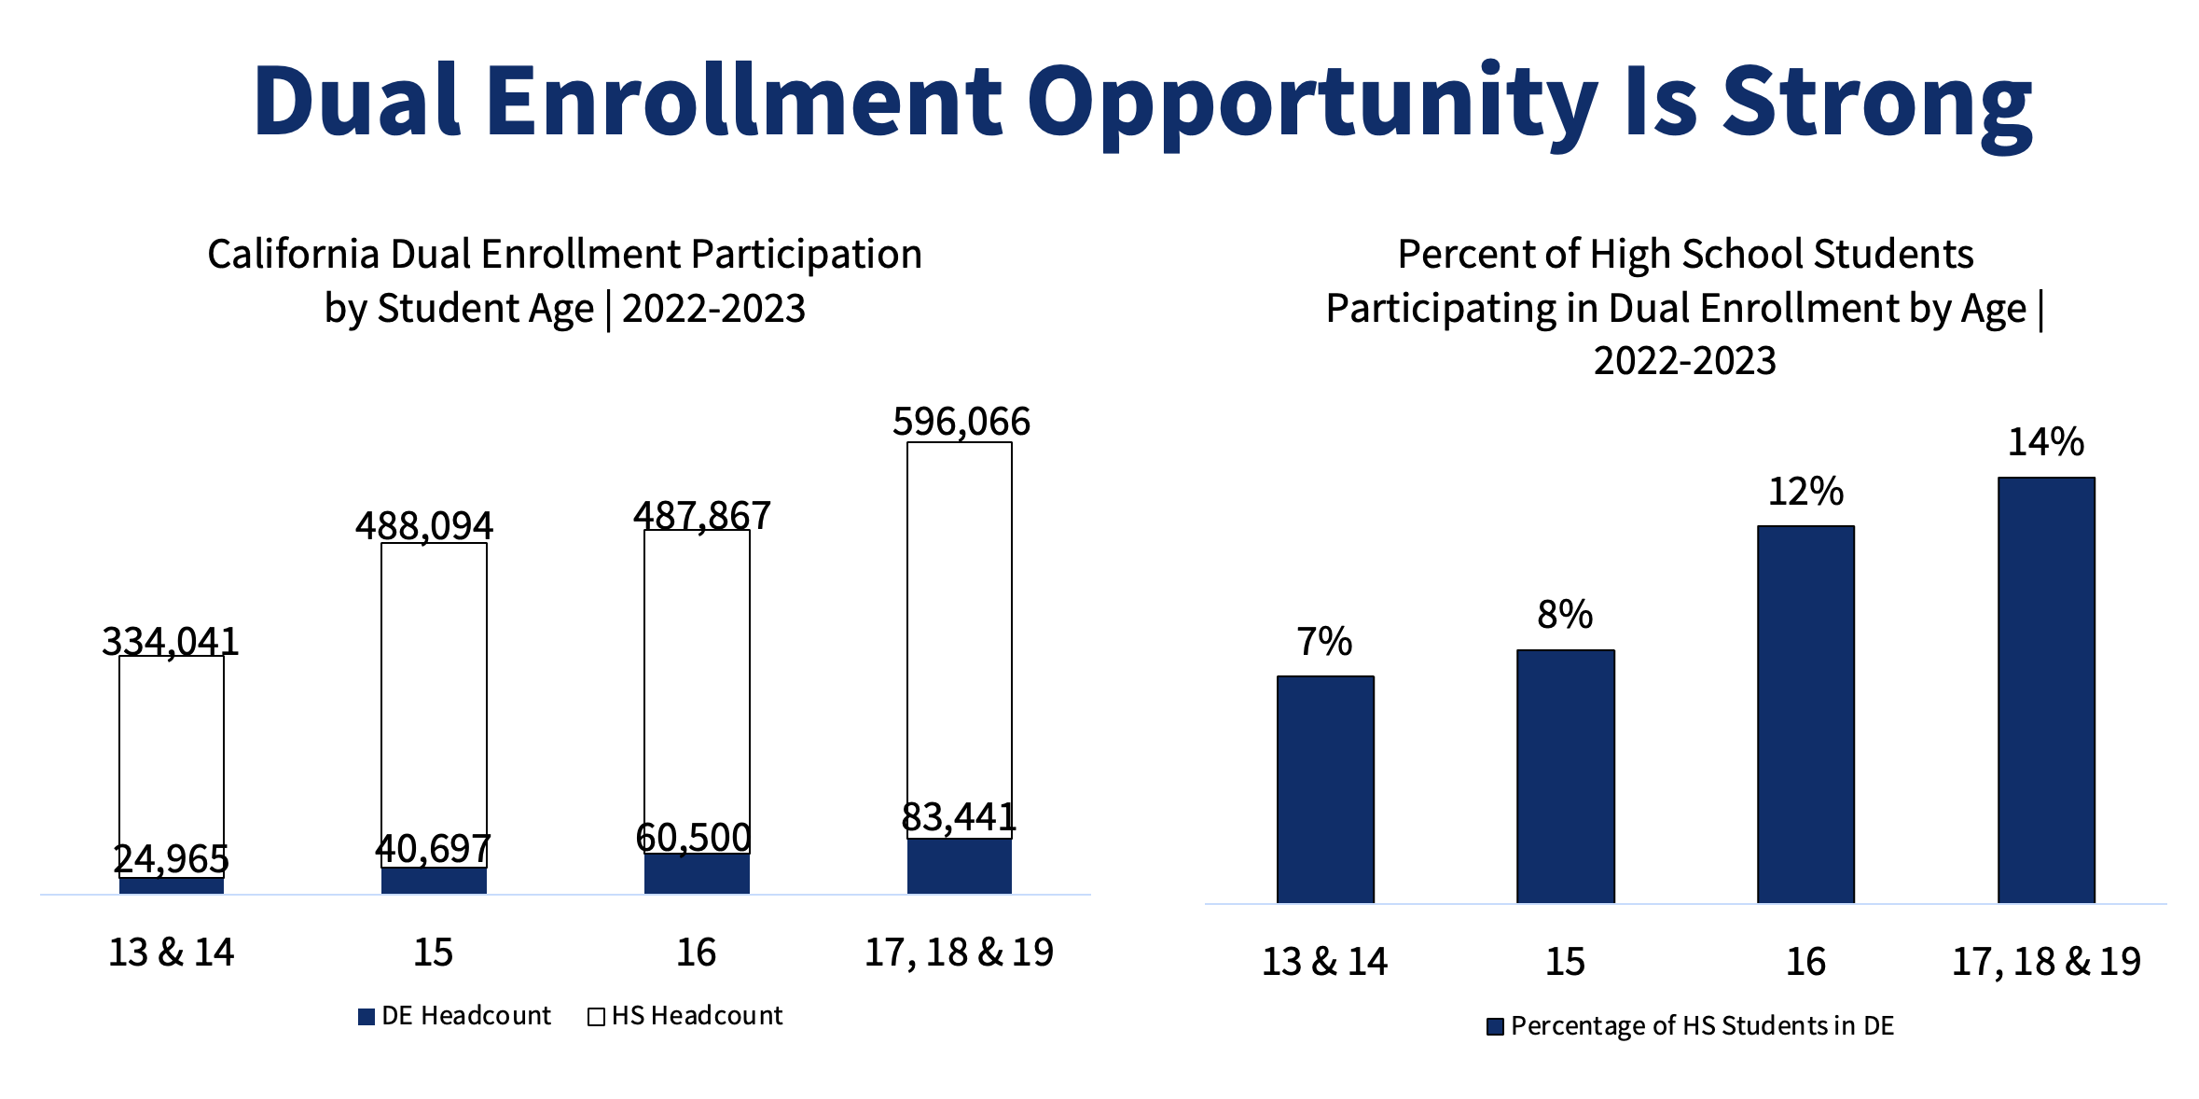
Notes:
Michelle
Dual Enrollment Opportunities are strong.

Slide 26
Dual Enrollment
college course-taking by students who are simultaneously enrolled in high school or adult education programs
Non-College and Career Access Pathways
(Non-CCAP)
Education Code
48800-48802
(Scholastic Advancement)
Education Code
52620-52621
(Adult Learners)
Middle College High School
(MCHS)
Early College High School
(ECHS)
Education Code
11300-11302
(MCHS on college campus & ECHS on high school campus)
College and Career Access Pathways
(CCAP)
Education Code
76004
(Historically Underrepresented)
Notes:
Michelle
A primary focus is providing technical assistance to the community colleges for Dual Enrollment.
Dual Enrollment refers to college course-taking by students who are simultaneously enrolled in high school or adult education programs who are seeking their high school diploma or high school equivalency certificate. Types of dual enrollment programs include:
Non-CCAP: Scholastic Advancement, traditionally, this is dual enrollment where students are enrolled in a college course after their regular school day and attend the course on the college campus.
CCAP: Partnerships are formal agreements between community college districts and high school districts, county offices of education or governing boards of charter schools. Purpose of offering or expanding dual enrollment opportunities for students who may not already be college bound or who are underrepresented in higher education, with the goal of developing seamless pathways from high school to community college for career technical education or preparation for transfer, improving high school graduation rates, or helping high school pupils achieve college and career readiness.
Middle College High School: Middle College High Schools are alternative high school located on community college campuses and serve at-promise students by integrating high school and college coursework. This model aims to reduce dropout rates and prepare students for college and careers.
Early College High School: Early College High Schools allow students to earn a high school diploma and up to two years of college credit simultaneously. These programs are partnerships between high schools and a local community college, the CSU or UC providing a seamless transition to higher education.

Slide 27

9th Grade – 12 credits in 4 years
Every incoming ninth grader enrolls in a college course
Develops a college education plan to include at least 12 college credits (e.g., student development course)
Equitable Dual Enrollment Expansion:
“The 9th Grade to Baccalaureate Degree Completion Strategy”
10th through 12th grade expansion
12 college credits in 3 years
12 college credits in 2 years
12 college credits in 1 year
Notes:
Michelle
Vision 2030 is our strategic initiative aimed at expanding dual enrollment opportunities. By fostering partnerships between high schools and community colleges, we aim to create seamless pathways for students to transition to higher education, promoting equity and access.
“The 9th Grade Strategy” focuses on expanding opportunities by ensuring every incoming ninth grader enrolls in a college course and creates a college education plan that includes 12 college credits.
In addition to the 9th Grade Strategy, we are also expanding dual enrollment opportunities for 10th through 12th graders. This expansion ensures that students at all high school levels can benefit from early exposure to college coursework, helping them to:
Earn college credits while still in high school.
Reduce the overall cost of their college education.
Enhance their college readiness and academic skills.
By providing these opportunities, we aim to support students in achieving their academic and career goals, while promoting a more equitable and accessible higher education system.

Slide 28
College and Career Access Pathways (CCAP)
Senate Bill 1244
Signed and chaptered on
September 27, 2024
Amended
California Education Code 76004
Effective January 1, 2025
Introduced significant amendments to College and Career Access Pathways Partnerships (CCAP)
Amendments expand the flexibility of community college districts (CCD) and local education agencies in establishing and amending CCAP agreements
Notes:
Michelle
SB1244 is a recent amendment to the Education Code that allows high school districts to enter into CCAP agreements with community colleges outside their service.
Key Highlights include:
SB1244 was Signed and Chaptered: September 27, 2024
Amended: California Education Code 76004
Effective Date: January 1, 2025
Key Changes of SB1244 is that it
Introduced significant amendments to College and Career Access Pathways (CCAP) Partnerships.
Expands the flexibility for community college districts (CCDs) and local education agencies in establishing and amending CCAP agreements.
This legislation aims to enhance educational opportunities and access for students across the state.
Let's now move on to the specific requirements under the new law.

Slide 29

Chancellor’s Office Guidance
This bill establishes a process for high school districts to enter a CCAP agreement with another CCD outside of their service area.
This is not intended to disrupt your current partnership with a local school district, nor should it be construed as an indication that your partnership is ineffective.
SB 1244 aims to provide greater course access to students if your community college district is not able to provide it.
CCDs should continue collaborating with their high school districts within their service area to ensure that high school students have equitable access to dual enrollment opportunities.
2024 Report Chaptered Legislation and Guidance
Notes:
The Chancellor’s Office Government Relations team prepared a 2024 Chaptered Legislation and Guidance Report. This report serves as an official notice to districts of new laws enacted in 2024. This report helps campuses take the necessary steps to implement new legislation, providing equitable opportunities for students, faculty, and staff.
Included in the report was key guidance regarding SB1244. This guidance included the following:
This bill establishes a process for high school districts to enter a College and Career Access Pathways (CCAP) agreement with another Community College District (CCD) outside of their service area. It's important to note that this is not intended to disrupt your current partnership with a local school district, nor should it be construed as an indication that your partnership is ineffective.
The primary goal of SB 1244 is to provide greater course access to students if your community college district is not able to offer the necessary courses. Therefore, CCDs should continue collaborating with their high school districts within their service area to ensure that high school students have equitable access to dual enrollment opportunities.

Slide 30
For Questions about Dual Enrollment:
CCAP
ccapp@cccco.edu
Middle College High School
middlecollege@cccco.edu
General
dualenrollment@cccco.edu

Slide 31
Transfer & AB928 Committee
Notes:
Introductions, greetings, etc.

Slide 32
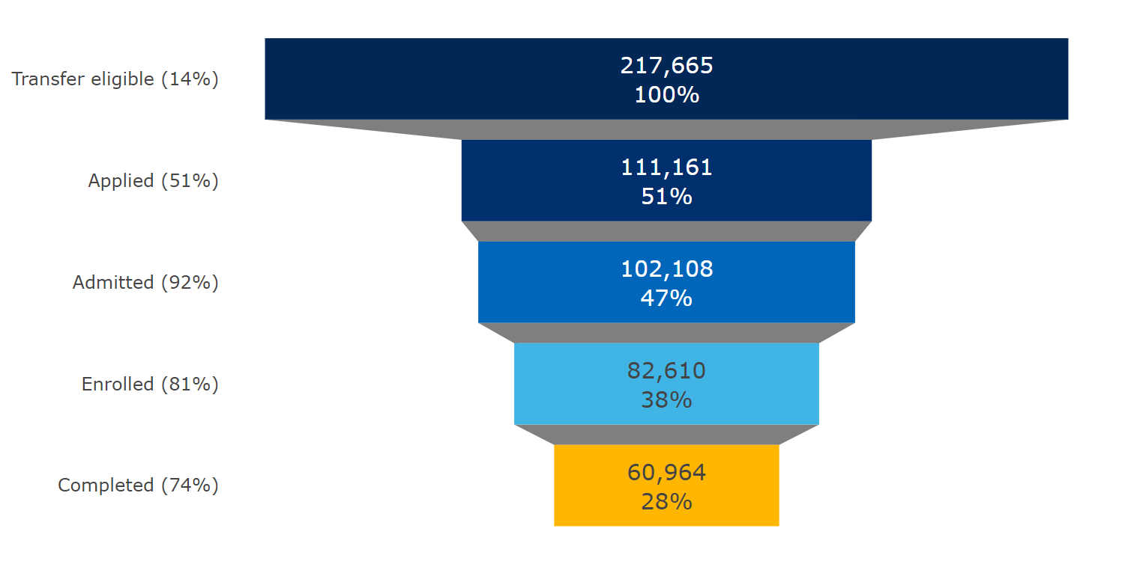
Enrollees in CCC in AY 2017-2018
Transfer Pipeline | CCC to CSU and UC
The denominator for % in parentheses on the left is the stage above; the denominator for % inside the pipeline figure are all the transfer-eligible students enrolled in CCC in AY2017-2018.
The highest loss point of the UC+CSU transfer pipeline occurred at the application stage.
We applied a fuzzy match between the COMIS and the UC data to identify students who applied to UC and their subsequent transfer outcomes among transfer-eligible students in CCC (methodological notes in next slide).
Notes:
Michelle
Before unpacking data, explanation of pipeline - Identified key stages in the transfer pipeline to provide a micro look of getting students from eligible to completion (eligible, applied, admitted, enrolled, and completed)
Our range of influence declines as students move beyond transfer eligible, with outcomes becoming highly dependent on receiving institutions.
Growing transfer eligible will always be our goal but bloating of eligible will occur – with limited change to BA in CC attainment - if other areas do not grow as well
Many ways transfer “eligible” “ready” “prepared” can be defined. For the following data, transfer eligible is defined as:
Completed transfer-level English and Math, and
Completed at least 60 transferable units with at least 2.0 GPA.
Data summary - in combination, 51%, about half of transfer eligible students applied to a UC or CSU.

Slide 33
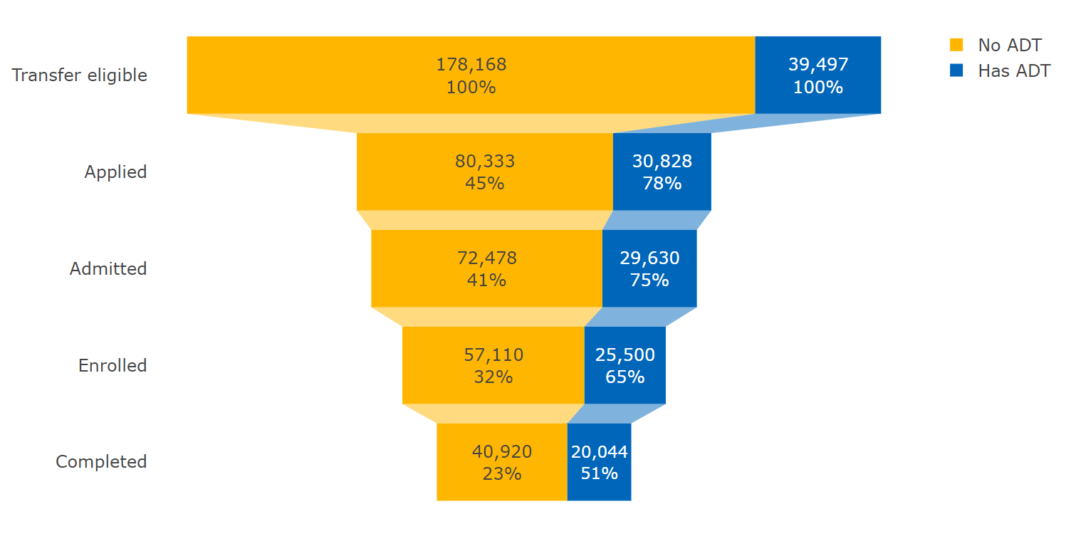
Transfer Pipeline | CCC Students with ADT
Enrollees in CCC in AY 2017-2018
ADT students are defined as those obtained ADT by AY 2017-18.
Notes:
As you can see in the slide, ADT students are much more likely to progress through the transfer pipeline.

Slide 34
Associate Degree for Transfer Intersegmental Implementation Committee (AB 928 Committee)
2024 Legislative Report
  Purpose: planning & accountability for ADTs and
  student-facing ADT communications plans
  Recommendations
    5 for TMC/ADT – Intersegmental infrastructure and council, metric reporting, timelines, resources
    4 for ADT/transfer communications planning – ADT outreach, resources, info sharing, website
AB 2057 Extension to 2027
  Meetings include relevant stakeholder presentations
  Discussing priorities for its future work with initial items including nontraditional student voice, related projects/pilots/programs, intersegmental collaboration, articulation, and capacity
Notes:
2024: Throughout 2024, the AB928 Committee’s work was guided by student interactions and input; the expertise of informed practitioners; and in-depth data and evidence about persistent equity gaps in transfer student outcomes, in particular by race and ethnicity, income, and region. The AB928 Committee has conducted its work alongside another critical statewide initiative, the implementation of Common Course Numbering. 2024 Final Report & Recommendations, December 2024 (https://static1.squarespace.com/static/63294b64e0e6c61627d6b28e/t/6764930e7cf2ed294d066d44/1734644506525/-2024-ab928-finalreportandrecs-dec2024-foundation-a11y.pdf)
Extension: AB 2057 (https://leginfo.legislature.ca.gov/faces/billNavClient.xhtml?bill_id=202320240AB2057) extended the committee’s work through June 2027. The committee emphasized the continuation of relevant stakeholder input as was done in the past (CID/TMC, Cradle to Career, ASSIST, Articulation Process, Transfer Technology). New and continuing work focus could encompass diverse student voices (incarcerated, ADT earners who do not transfer); related programs of impact (dual enrollment, dual admission, CCN, UCLA ADT pilot); intersegmental articulation processes and impacts (ADT pathways, ASSIST).

Slide 35
Transfer Audit
State audit of the three systems of public higher education (CCC, CSU, UC) to assess systems’ efforts on improving the rate of community college transfer to CSU and UC
Report published in September 2024
Audit highlights the role of education planning and transfer services
Recommendations provided for all systems and the Legislature to streamline the transfer process to increase access to bachelor’s degrees
https://www.auditor.ca.gov/reports/2023-123/
Notes:
A state audit was conducted of the three public higher-education systems to assess efforts on improving the rate of transfer from community colleges to CSU and UC systems
The audit recognized that each of the State’s three systems plays a critical role in helping Californians earn bachelor’s degrees, but that there is still work to do to streamline transfer.
Some key findings from the report published last September were that the three systems have struggled to meet some transfer‑related goals; the variation in transfer requirements across and within the three systems makes the process difficult for students to navigate; and the three systems could better facilitate transfer through more effective outreach and support.
The audit made 22 recommendations to the three higher education systems and the Legislature.
The recommendations currently being addressed by the CCCCO involve guidance to help increase its monitoring efforts to ensure that community colleges provide effective support and services to transfer‑intending students. These include:
Providing suggested actions to allow as many transfer-intending students as possible to receive counseling and have a current, comprehensive education plan.
Monitoring and reporting on the percentage of transfer-intending students who have a current, comprehensive education plan and the percentage who have received timely counseling services.
Identifying community colleges with staffing levels that are insufficient to provide necessary transfer-related guidance, and
Updating the equity plan template to emphasize transfer.

Slide 36
Auto ADT & Cal-GETC
Place transfer intending students on an ADT (if one exists in their self determined major) and provide comprehensive education planning (Auto ADT, EDC 66749.8)
Singular lower division GE pathway (Cal-GETC, EDC 66749.8)
Streamline the transfer process to increase the number of community college students who transfer to a four-year college or university and close racial equity gaps in transfer outcomes
Reduce excess credit accumulation and eliminate repetition of courses
Funding provided to colleges to implement provisions
Notes:
Rowena
AB 928, The Student Transfer Achievement Reform Act of 2021, directs CCCs to place transfer intending students on an ADT pathway if one exists for the student's declared major. During counseling and advising sessions, counselors should be updating student education plans with these ADT pathways, with some exceptions, and indicating any opt-outs or exceptions.
AB 928 also requires the establishment of a singular lower division GE pathway used to determine eligibility and sufficient academic preparation for transfer from a CCC to CSU/UC.
-The Intersegmental Committee of the Academic Senates (ICAS) developed this GE pattern known as Cal-GETC in collaboration with representatives from system administrators and student associations. Implementation of Cal-GETC is moving forward for Fall 2025.
These provisions are intended to streamline the transfer process to increase the number of CCC students who transfer to a 4-year college/university. Goals also include reducing excess credit accumulation and eliminating the repetition of courses.
CCCs received funding last spring ($565,217) to implement these provisions. Funds may be spent through FY 2025-2026.
Examples of activities that can be supported by these funds include augmenting staff, making required technological changes or updates, or providing resources for collaboration and coordination, to help implement Auto-ADT and Cal-GETC. For more information, please refer to the funding memo from the CCCCO which will be posted on the slides you receive.
Funding memo: https://www.cccco.edu/-/media/CCCCO-Website/docs/memo/ab928-funding-memo-final-12-11-23-a11y.pdf?la=en&hash=52FADBCA7FB4EDD6E20A34C2DFB7D343A80674DC

Slide 37
Demonstration Project: Matriculation of ADT Completers
Pilot automatic matriculation of Associated Degree for Transfer (ADT) completers to the California State University (CSU) campuses:
  Next phase of Central Valley Transfer Pathways demonstration project
  Utilize CCC Common Cloud Student Data Platform
  Establish near-real-time data sharing with CSU systems
  Allows CSU to notify and support potential ADT transfer students
    Reduce risk of stop-outs
    Aligns resources for smooth transfer
Notes:
This demonstration project provides data on ADT completers at the CCCs to the CSUs so that CSU can invite the ADT completers to apply. This is expanded beyond the central valley and scaling is expected to begin next year.

Slide 38
Dual Admission / Transfer Success Pathway
Transfer pathway for first-time freshman applicants (Ed Code 66744.2, 66744.1)
Increase access to the UC and the CSU
UC Dual Admission
  Three-year pilot program (2023 - 2026)
CSU Transfer Success Pathway
  Ongoing transfer program
https://www.cccco.edu/About-Us/Chancellors-Office/Divisions/Educational-Services-and-Support/dual-admission
Notes:
The Dual Admission Program at both UC and CSU is designed for first-time, first-year students, and is intended to increase access to the UC and CSUs, particularly for students from underrepresented backgrounds and/or those experiencing high school curriculum limitations, geographical constraints, and financial challenges.
UC Dual Admission program is by invitation only. For this past 2024-2025 year, the program was expanded to include invitations to students who were not missing an A-G requirement and were not admitted to a UC campus. UC is currently in year 2 of a three-year pilot program (2023-2026)
CSU offers their Transfer Success Pathway (TSP) program to any first-time, first-year student post high school completion, as well as eligible international students and any CSU Redirect student who did not respond to that invitation. CSU has established a commitment to this program as an ongoing transfer program.
Every college has an identified Dual Admission/TSP liaison for these programs, typically the transfer center director. This individual can provide support and information about these programs.
More information about program eligibility, timelines, and benefits of participation are available on the CCCCO Dual Admission page:
https://www.cccco.edu/About-Us/Chancellors-Office/Divisions/Educational-Services-and-Support/dual-admission

Slide 39
For Questions about Transfer:
AB928 Committee
Kim Anderson, Visting Administrator, kanderson@cccco.edu
General
Erin Larson, Dean, elarson@cccco.edu

Slide 40

Questions?
Notes:
20 minutes
Now, I'd like to open the floor to questions and discussions. If you have any inquiries regarding the legislative updates we've covered today or any related topics, please feel free to ask.
I want to emphasize that we’re here to provide support, and we can assist with interpreting bills, understanding their implications, and addressing any concerns you may have.
However, it's important to note that the implementation of these bills often involves policies and procedures, which are local district or college level decisions. Each institution may have its unique context and considerations that influence how a bill is put into practice.
So, while we can offer insights and guidance, please remember that the specifics of how a bill is implemented can vary from one college to another. These local decisions are essential in tailoring the legislation to best meet the needs of your institution and students.
Your questions and discussions are greatly appreciated, and we’re here to help and share knowledge. So, let's open the floor to any queries you may have.

Slide 41

Admissions and Records Points of Contact:
Abeer@cccco.edu
KKouklis@cccco.edu
Msmith@cccco.edu
Notes:
In closing, I want to express my sincere gratitude to all of you for your dedication and commitment to admissions and records in our community colleges. Your work is instrumental in shaping the educational landscape in California.
If you have any questions, need further information, or would like to provide feedback, please don't hesitate to reach out. My goal is to serve and support you in the best way possible.
Thank you for your time, and I look forward to our continued work together in navigating the dynamic landscape of admissions and records in California community colleges.

