Slide 1
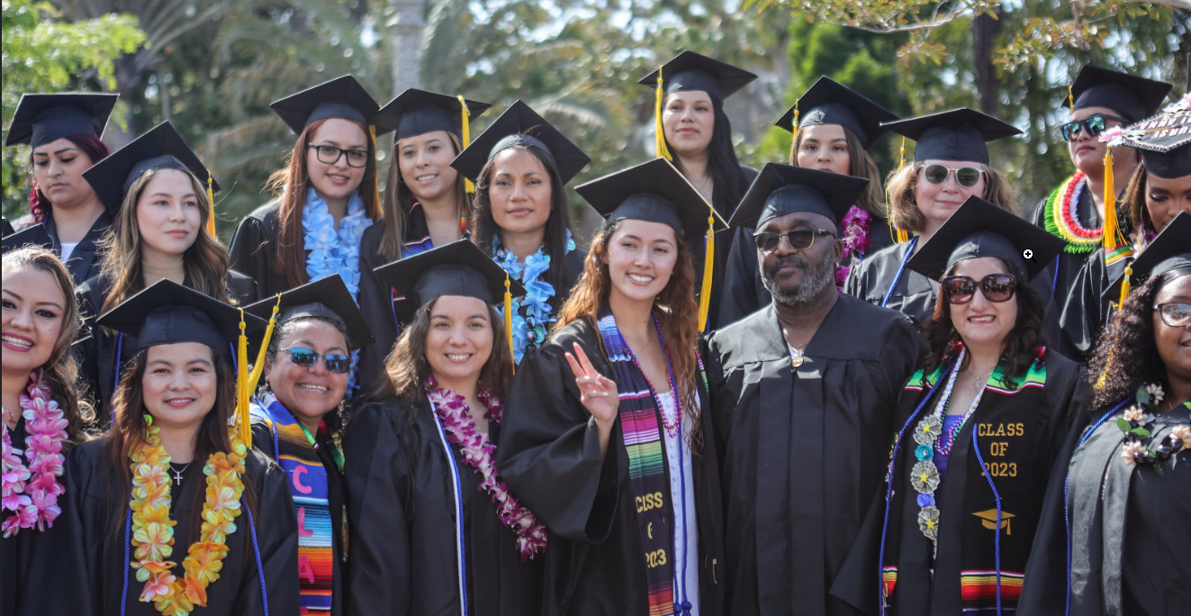
So you have a Baccalaureate…
2024 CACCRAO Annual Conference

Slide 2


Join at slido.com
#1687391
ⓘ Start presenting to display the joining instructions on this slide.

Slide 3

Audience Q&A Session
ⓘ Start presenting to display the audience questions on this slide.

Slide 4

Welcome and Introductions
Victor DeVore, Dean, Student Services
Shelly Hess, Dean, Instructional Services

Slide 5

Agenda
Introductions and Getting to Know You
San Diego Community College District
How we Got Here Planning and Collaboration
  BDP Team
  Internal Approvals and Budgeting
  BDP Manual
Student Services Impact
Transcripts and Graduation

Slide 6

Getting to know you…
Currently offering a baccalaureate degree?
Interested in offering a baccalaureate degree or offering more degrees at your institution?

Slide 7

Where is your college at?
ⓘ Start presenting to display the poll results on this slide.

Slide 8
San Diego Community College District (SDCCD)
One of largest of California’s 73 community college districts
Serves 80,000 students annually:
  Three credit colleges
    City College
    Mesa College
    Miramar College
  Noncredit
    College of Continuing Education
Active partnerships with local business and industry, community, and military
Graduates have a combined economic benefit to the region $4.5 billion annually
SDCCD’s adopted budget for fiscal year 2023-2024: $1 billion

Slide 9
SDCCD Baccalaureate Degrees
Health Information Management, Bachelor of Science
Mesa College, implemented fall 2015
Cyber Defense and Analysis, Bachelor of Science
City College, implementing fall 2024
Public Safety Management, Bachelor of Science
Miramar College, implementing fall 2025
Physical Therapist Assistant, Bachelor of Science
Mesa College, pending CSU consultation

Slide 10
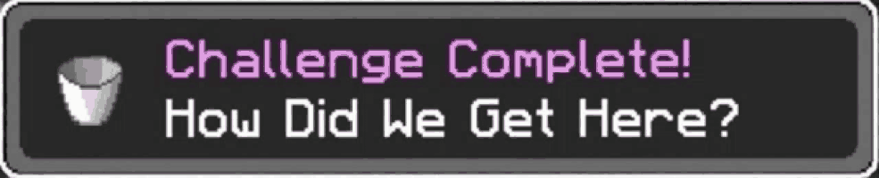
How did we get here?
Planning and Collaboration

Slide 11
Baccalaureate Degree Program Team
Faculty Champions
Academic Senate
Curriculum Committee
Campus Administrators: President, Vice President Instruction, Vice President Student Services, Vice President Administrative Services, and School Dean
District Educational Services
Chancellor’s Cabinet
Governing Board

Slide 12
Internal Approval Process
College Approval Process
  Program viability
  Campus constituents (Academic Senate, President’s Cabinet, College Councils, and Curriculum Committee)
  *Program is vetted through a defined college process
District Process
  Chancellor’s Cabinet
  District Governance Council
  Board of Trustees

Slide 13

Comprehensive Funding Plan
Start-up costs
Enrollment Projections/Revenue
Facilities and Equipment
Additional Staffing
  Faculty
  Upper-division general education
  Counseling
  Support Services
  Classified Professional Support

Slide 14
Budget Calculation Tool
Program Revenue Estimator: Helps colleges estimate the program revenue and forecast the potential
Classroom Expenses: Estimating costs associated with offering the upper division courses
Non-classroom expenses
Contract Expenses (program director, classified professionals—evaluators and student services technicians)
Non-Academic and Non-Classified (NANCE Expenditures)
Operating Expenses

Slide 15
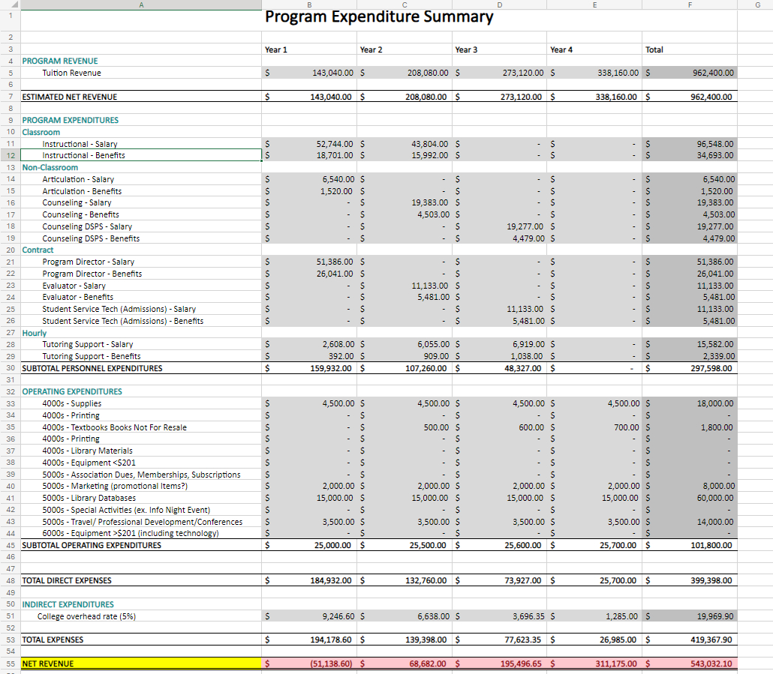
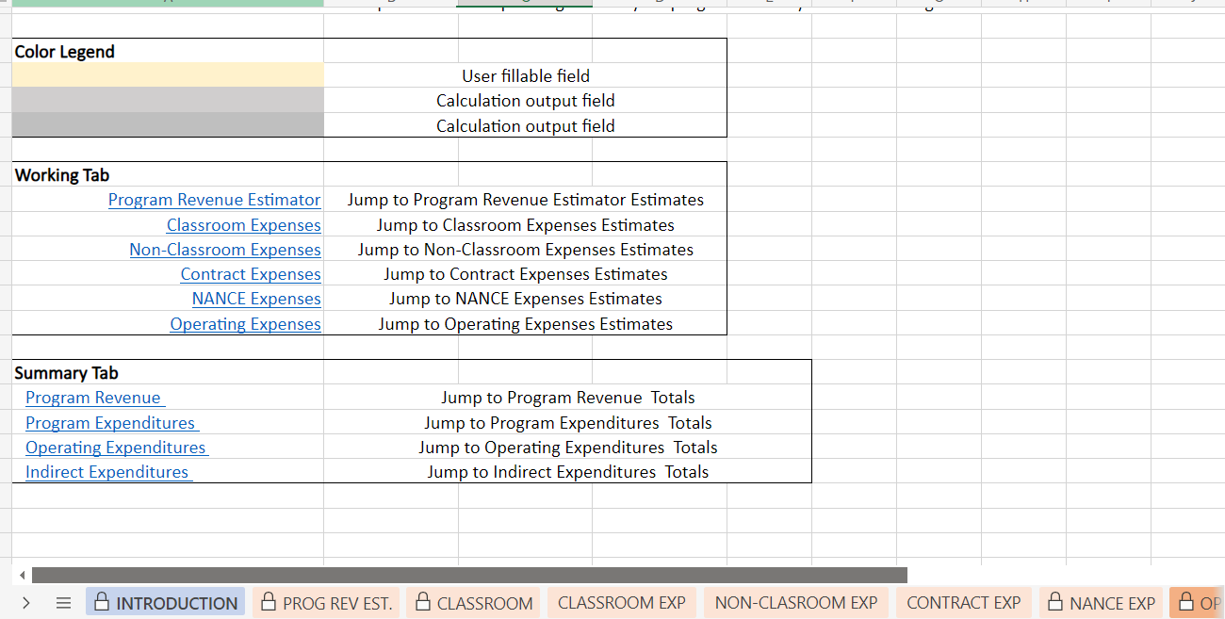
Budget Calculation Tool

Slide 16
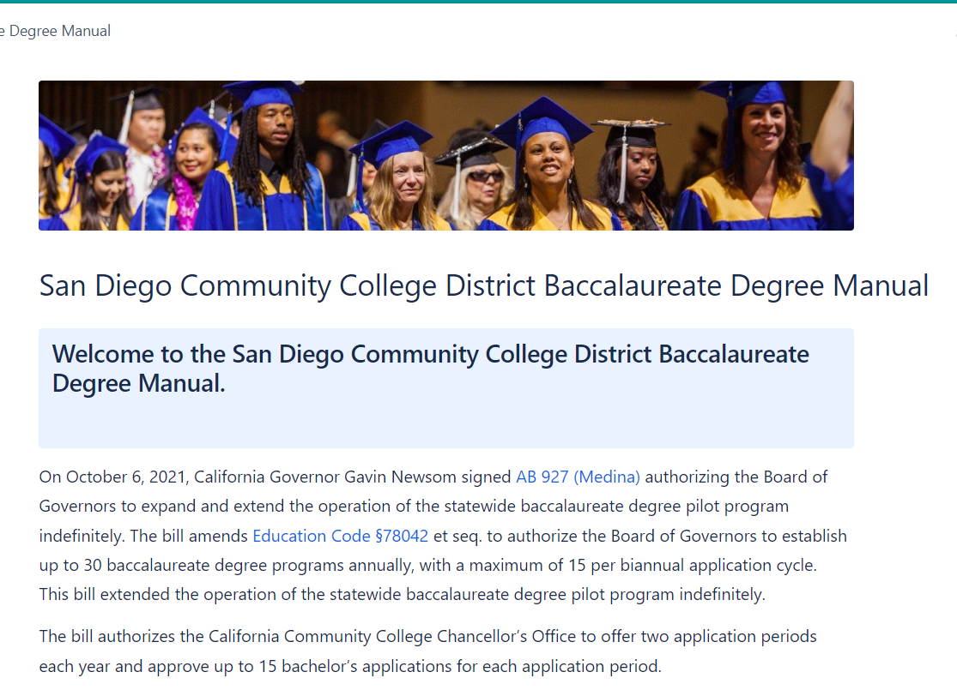
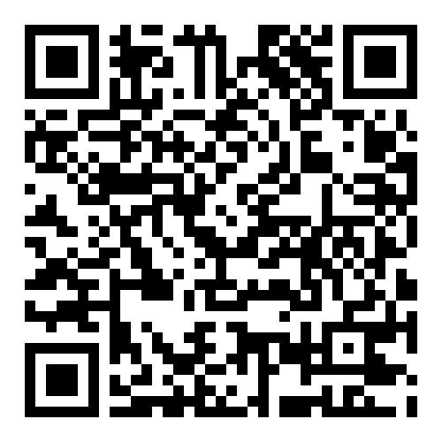
Baccalaureate Degree Manual
https://mysdccd.atlassian.net/wiki/spaces/SBDM/overview

Slide 17

Student Services
Scaling up and Districtwide Expansion

Slide 18

California Community Colleges
Open admissions
Students may apply at anytime
No application Fees
No admissions review; only requirement is a high school diploma or equivalent or the age of 18.

Slide 19

Application Process
Unique Challenges:
  Open-entry for associate degree
  Selection process for baccalaureate degree
First-come, first-serve

Slide 20
Application Process
Recruitment and Marketing
Selection Process and Criteria
  Establish scoring rubric
  Know your cohort size
BDP Application Submission Process
  Application materials
Application Deadlines
  Establish your deadlines early on

Slide 21

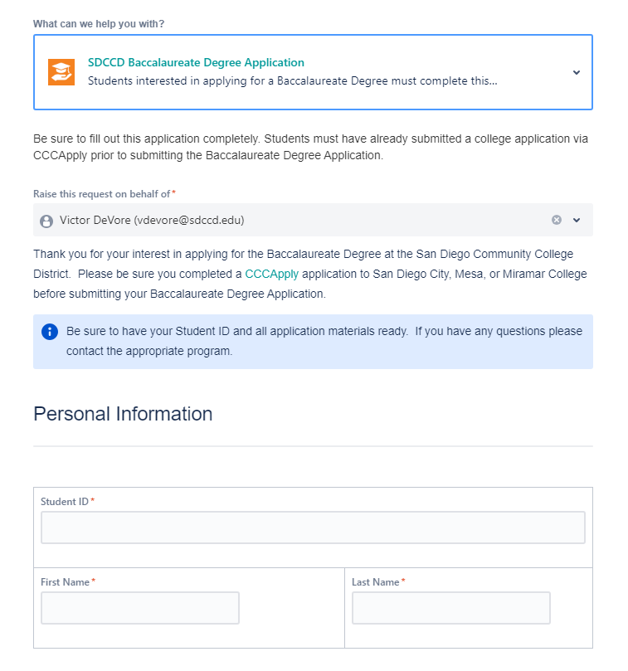
Streamlining Admissions
Creating one central application for all baccalaureate degree programs.
Streamline the admissions/evaluations process while building to scale
Still allow for college-specific deadlines but student experience is consistent.

Slide 22
Admissions Timeline
REGULAR DECISION - Fall Admits
Application Window Opens | October
Submit all required application materials and supplemental application | March/April
Admission decisions | Early May
Reply to offer of admission | June
Submit Official Transcripts (Transfer Students Only) | July
Fall Cohort Begins | August/September
Notes:
Admission to Registration
Application Process
Selection Process and Criteria
Admission Process
Track 1 – Students Entering Baccalaureate Program
Track 2 – Students Entering As Juniors
A. First Tier
B. Second Tier
Selection Criteria
Overall G.P.A 2.0 and 3.0 G.P.A.
Complete Application for Admission including
*Incomplete applications will not be accepted.
Official Transcripts
Students who meet the initial screening criteria will be invited to an interview that includes a written exercise.
Application deadlines:
Applications Due
Review application window
Send offer letters
Deadline to accept
Official Transcripts (for transfer students)

Slide 23
Sample Rubric
Category | Points | Points
G.P.A.
3.75 – Up |  | 5 pts.
3.50 – 3.74 |  | 4 pts.
3.00 – 3.49 |  | 3 pts.
2.75 – 3.00 |  | 2 pts.
2.5 – 2.74 |  | 1 pt.
Below 2.50 |  | 0
Application Materials
Essay |  | 5 pts
References |  | 5 pts. Each
Work Experience |  | 1 pt.
Total Points |  | 26
Notes:
Admission to Registration
Application Process
Selection Process and Criteria
Admission Process
Track 1 – Students Entering Baccalaureate Program
Track 2 – Students Entering As Juniors
A. First Tier
B. Second Tier
Selection Criteria
Overall G.P.A 2.0 and 3.0 G.P.A.
Complete Application for Admission including
*Incomplete applications will not be accepted.
Official Transcripts
Students who meet the initial screening criteria will be invited to an interview that includes a written exercise.
Application deadlines:
Applications Due
Review application window
Send offer letters
Deadline to accept
Official Transcripts (for transfer students)

Slide 24
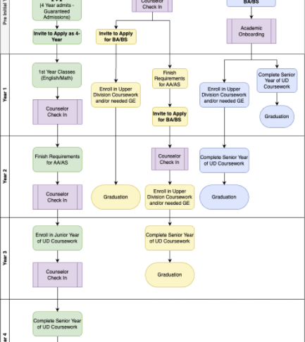
Student Pathways
Four-Years: New students admitted to pre-major (2+2)
Pre-Majors: Students who have completed or on track to complete the corresponding associate degree
Transfer Track
Guaranteed Admissions?

Slide 25
Financial Aid
If colleges have not already been approved to offer a Baccalaureate Degree program, they must submit a substantive change application to the Department of Education prior to offering financial aid to students enrolled in the Baccalaureate Degree.
This only needs to be done once. Once approved, colleges are able to offer new Baccalaureate Degree programs without having to go through the approval process again.

Slide 26


Update your PPA and your IPA
Collect all your documents supporting new educational level offering
  Copy of the CCCCO – Approval Letter from the State Agency indicating new educational level
  Copy of the ACCJC – “Substantive Change” Approval Letter
  Copy of the School’s Baccalaureate Degree program description (submitted to ACCJC)
  Make sure your college website is updated indicating the new program is coming/approved
  Copy of the school’s published academic calendar
Resolve any additional request for materials or concerns as soon as possible
Notes:
Get sample letter to show

Slide 27
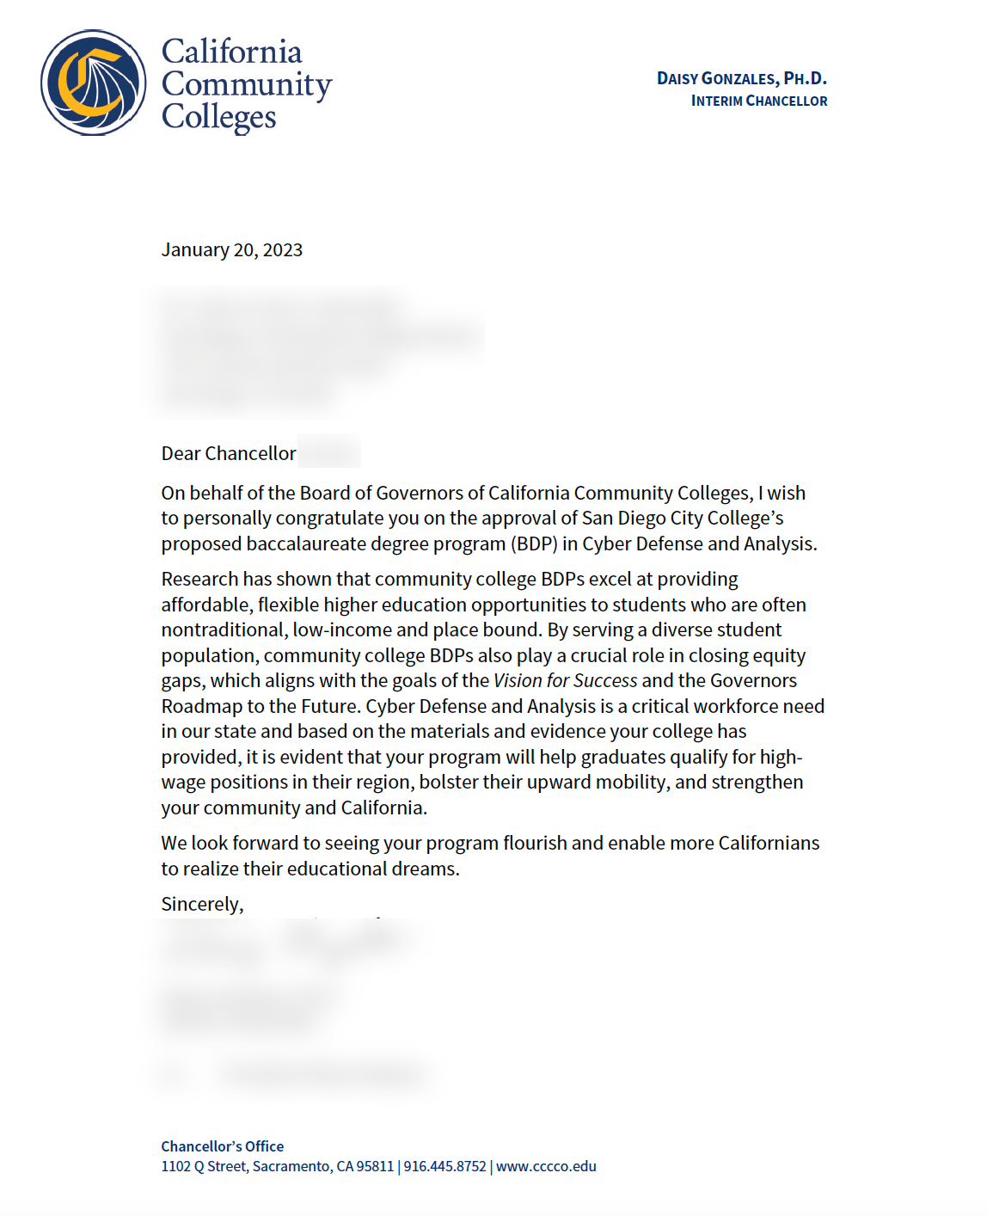

CCCCO Approval Letter
Notes:
Get sample letter to show

Slide 28
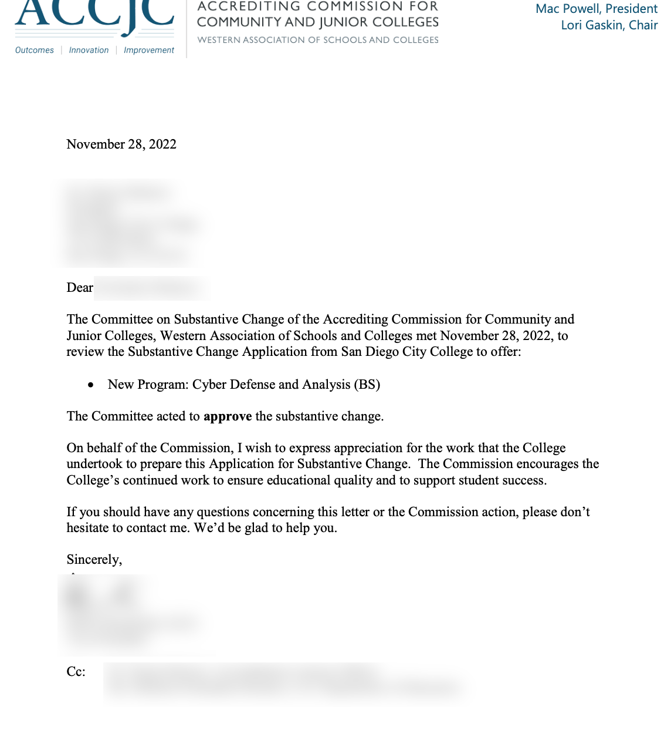
ACCJC Approval Letter
Notes:
Get sample letter to show

Slide 29
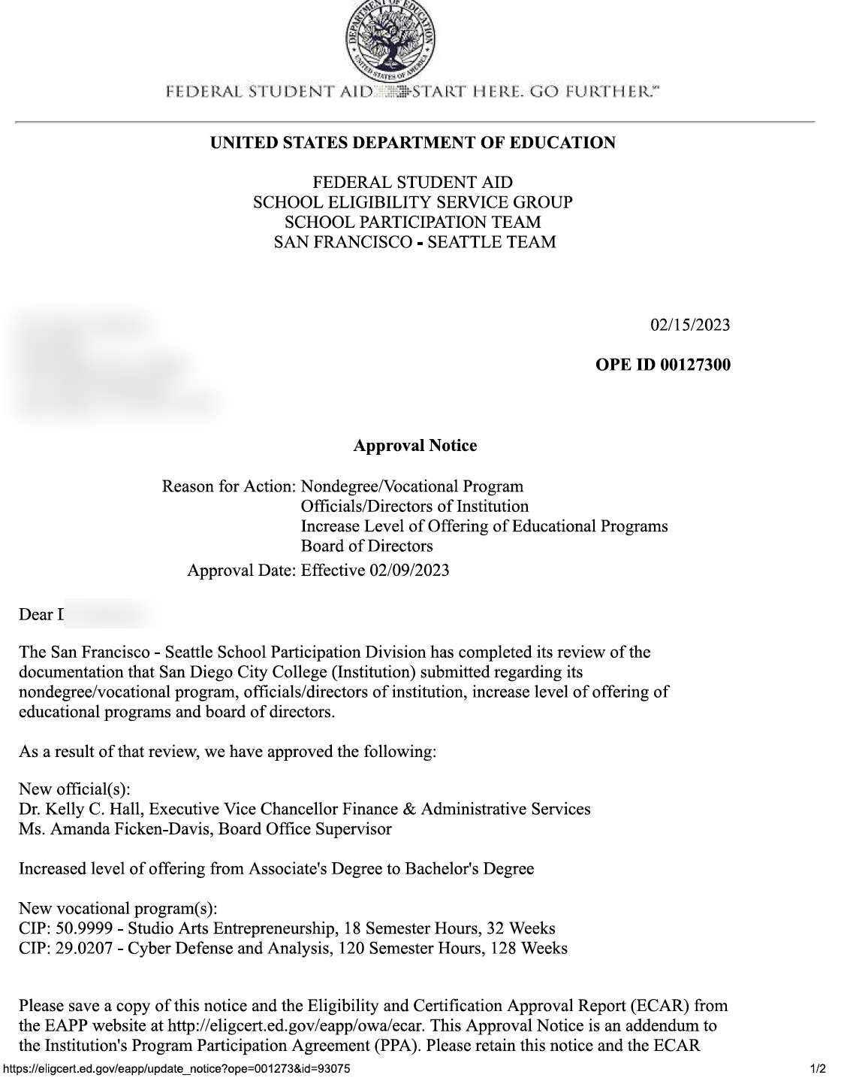
Approval letter from department of education
Notes:
Get sample letter to show

Slide 30
Financial Aid
Work with your Financial Aid Office:
  Satisfactory Academic Policy (SAP) for Bachelor’s Students
  Student Budgets and Loans
  California College Promise Grant (CCPG) cannot be used to waive the Bachelor’s Degree Enrollment Fee ($84.00/unit)
  Student eligibility for additional financial aid (e.g. CalGrant)

Slide 31
Registering and Enrolling Students
Initially, enrollment is being done manually by staff.
Use of requisites to restrict Upper Division to appropriate Baccalaureate Degree Students
It is important to provide flexibility and long-term educational plans/pathways.
Maintain separate records for students enrolled in upper division/lower division
Notes:
Admission to Registration
Application Process
Selection Process and Criteria
Cohort Model?
Application deadlines:
Applications Due
Review application window
Send offer letters
Deadline to accept
Official Transcripts (for transfer students)
Registration: Enrolling Students
Restrict upper division classes to those in the appropriate Baccalaureate program.
Readmission
Promising Application and Selection Practices to remove biases in admission criteria: provide clear, transparent application and selection process; send out acceptance letters--include clear instructions for students to respond;
Cohort Considerations
Unforeseen student issues that may cause a delay in program completion
Students do not pass a class or need to drop
Benefits of Cohorts: facilitates collaborate and engagement for students; provides support for students; promotes structure; and promotes networking opportunities.

Slide 32
Student Fees
Mandatory Student Fees:
Enrollment Fee: $46.00/unit
Baccalaureate Fee: $84.00/unit for upper division coursework only
  Code so that the college offering the course receives the fee.
Non-resident fees: Still apply for out-of-state students
Total Cost: Est. $13,000 for the entire program
Notes:
Admission to Registration
Application Process
Selection Process and Criteria
Cohort Model?
Application deadlines:
Applications Due
Review application window
Send offer letters
Deadline to accept
Official Transcripts (for transfer students)
Registration: Enrolling Students
Restrict upper division classes to those in the appropriate Baccalaureate program.
Readmission
Promising Application and Selection Practices to remove biases in admission criteria: provide clear, transparent application and selection process; send out acceptance letters--include clear instructions for students to respond;
Cohort Considerations
Unforeseen student issues that may cause a delay in program completion
Students do not pass a class or need to drop
Benefits of Cohorts: facilitates collaborate and engagement for students; provides support for students; promotes structure; and promotes networking opportunities.

Slide 33
Student Support Services
Disabled Student Programs and Services
EOPS/CARE
CalWORKs
Veterans and Service Members
Counseling
Career Counseling
Library and Learning Resources
Notes:
May need to assist two-year students who are admitted to Baccalaureate Degree Program in their first year, with accessing specific general education classes to ensure they remain on track to complete lower division requirements in two years.
Recommendation that counselors have familiarity with the corresponding associate degree program tied to the baccalaureate degree.
Look at use of faculty mentors

Slide 34
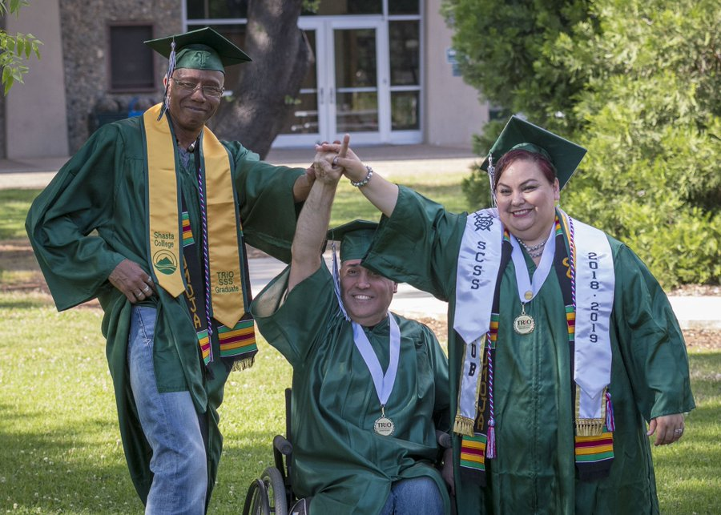
Transcript Evaluations and Graduation

Slide 35


Transcript Evaluations
Lower Division GE requirement: CSU GE or IGETC
Transfer students (junior-level)
Internal Processes

Slide 36
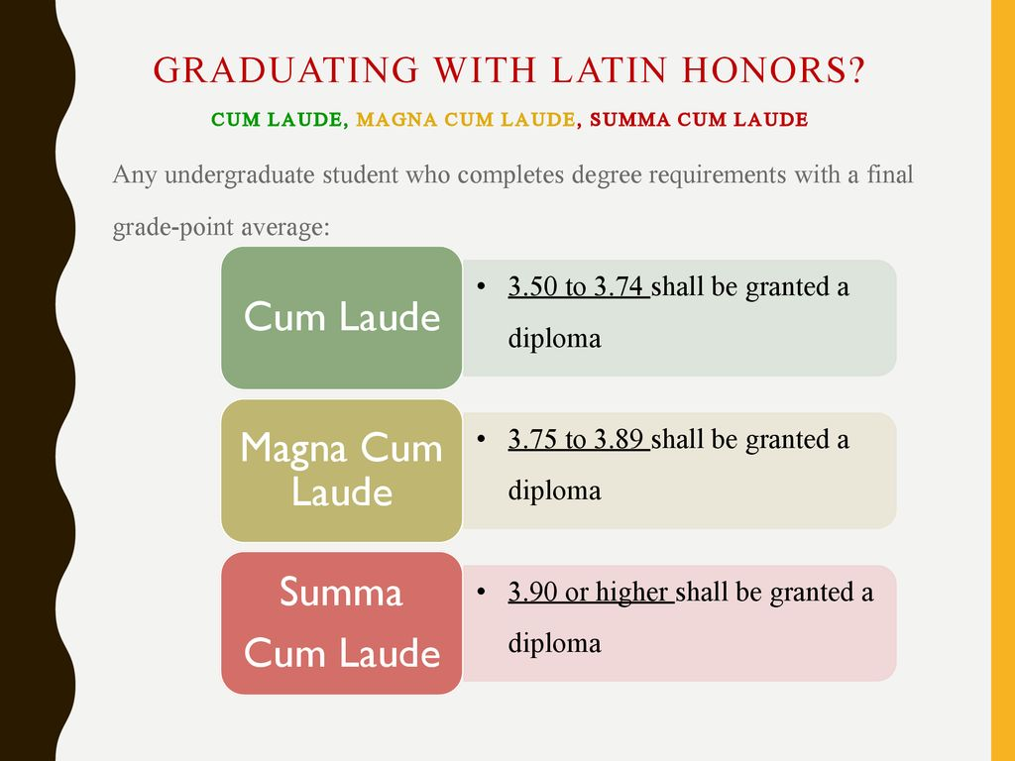
Graduation
Considerations
Transcripts
Latin Honors:
  Criteria
  Programming/Processing
Commencement for Baccalaureate Students
Diploma

Slide 37

How are you feeling?
ⓘ Start presenting to display the poll results on this slide.

Slide 38
Questions and Answers

Slide 39

THANK YOU
2024 Counselor Conference

