Slide 1

Dual Enrollment
CACCRAO
Tonya M. Williams, Ph.D., Dean, Educational Services & Support
Devin Rodriguez, Specialist, Educational Services & Support
March 26, 2024

Slide 2
Agenda
Welcome/Introductions
Chancellor’s Office Program Administration
Framing: Vision 2030, 9th Grade to Baccalaureate Strategy & Equity Programs
Legislative and Regulatory Updates: Proposed/Chaptered Legislation and adopted title 5 changes
Quick Reminders: CCAP Agreements, Reporting, Technical Assistance
Practitioner Perspective: We want your feedback
Closing Remarks

Slide 3







Programs we support and serve

Slide 4

Interventions Programs and Grants Unit (IPGU):
An Overview Our Work
Field Guidance & Implementation
Policy & Regulatory Action
Planning, Research & Reporting
Equity at the Core
Funding and Agreement Management
Technical Assistance & Professional Development
Innovations
for Systems Change
Notes:
Tonya
All actions, policies and procedures, will be enacted centering equity and inclusion and dismantling prejudice and racism at all levels.

Slide 5
Framing
Notes:
Vision 2030 spotlights certain categories of students and future learners who continue to need focused attention responsive to legislation that was enacted where the implementation is not yet at scale or where new state and federal investments have been made in light of the pandemic’s impact on increasing income inequality and poverty.

Slide 6
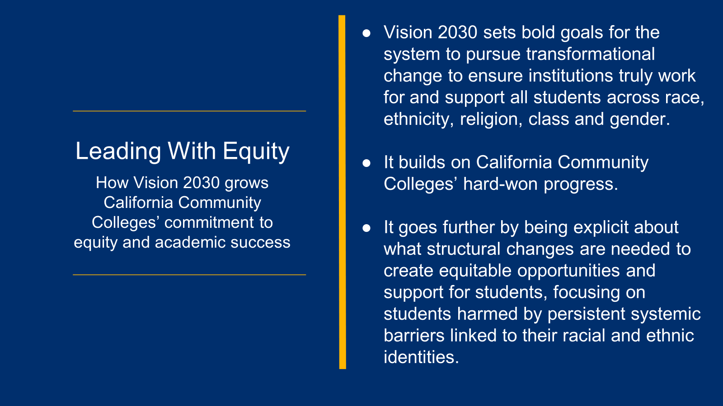
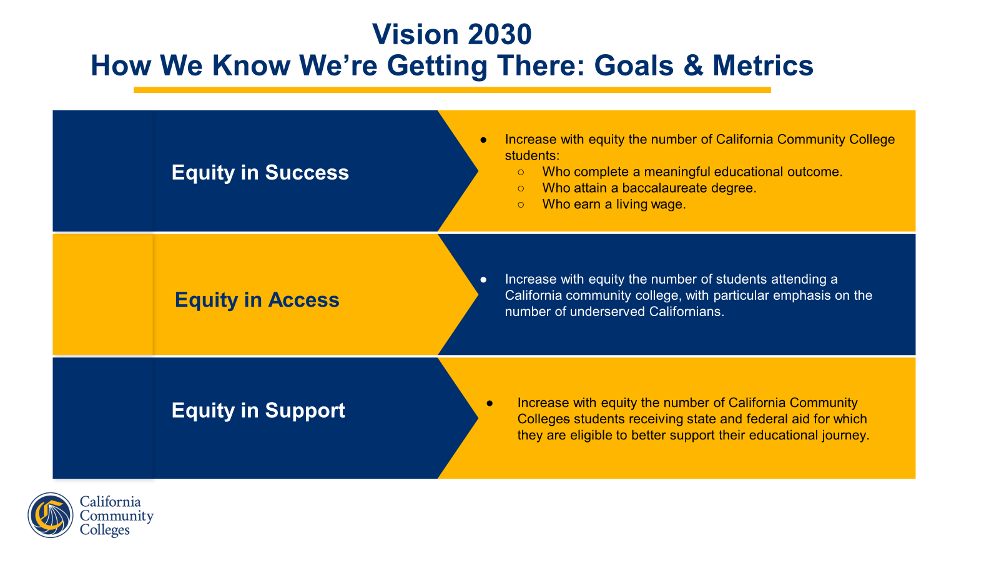
Dual Enrollment Program Administration
California College and Career Access Pathway (CCAP) STEM Academy
Six college districts/Seven colleges
Partnerships with college/K12 and business partners
CCAP
64 districts and 98 colleges
Expand dual enrollment to students who may not already be college bound or who are underrepresented in higher education
Approximately 125 Fully Executed Agreements submitted for 2023-24
Middle College High School
16 colleges
Goal is to select at-promise high school students and place them in an alternative high school on a college campus
Funding and Contracts Management
Notes:
Vision 2030 is an ambitious, equity-focused, seven-year roadmap that assists the California Community Colleges in bringing college to our students and future learners.
Equity in success: Increase the number of California Community College students who: complete a meaningful educational outcome, attain a baccalaureate degree and earn a living wage.
Equity in Access: Increase the number of students attending a California Community College, focused on the number of underserved Californians.
Equity in Support: Increase the number of California Community Colleges students receiving state and federal aid

Slide 7
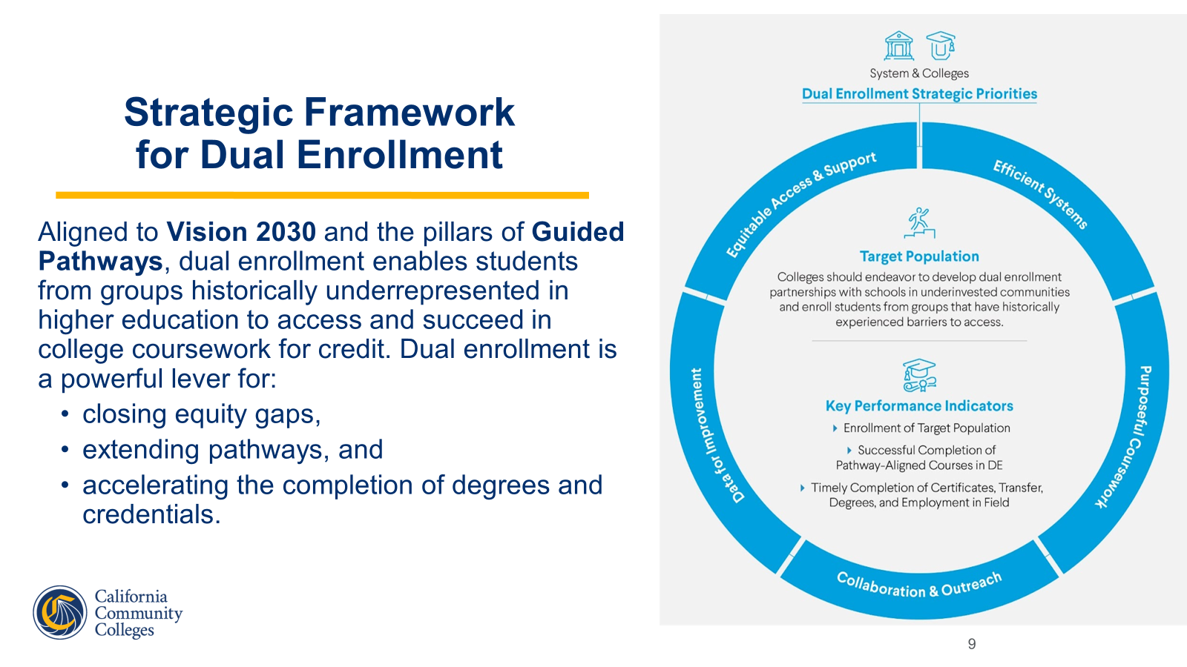
An Overview of Our Work
Dual Enrollment Program Administration
Field Guidance & Implementation
Policy & Regulatory Action
Planning, Research & Reporting
Equity at the Core
Funding and Contracts Management
Technical Assistance & Professional Development
Innovations
for Systems Change

Slide 8
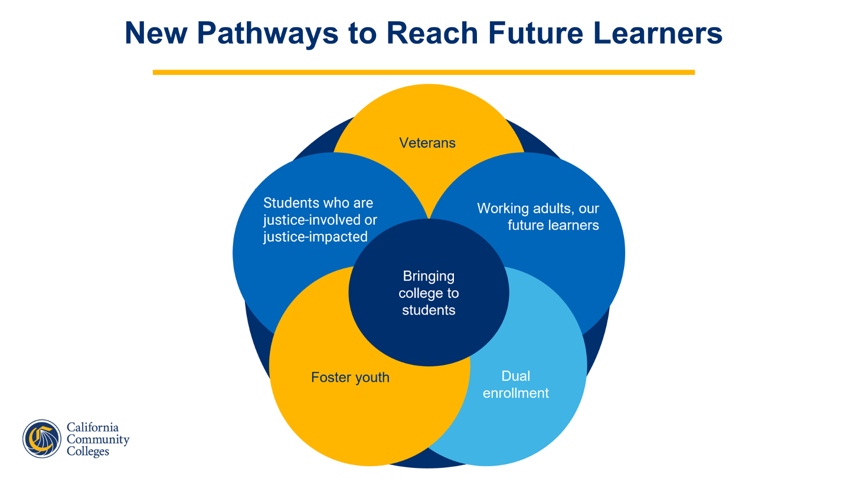
Notes:
Vision 2030 spotlights certain categories of students and future learners that continue to need focused attention responsive to legislation that was enacted where the implementation is not yet at scale or where new state and federal investments have been made in light of the pandemic’s impact on increasing income inequality and poverty.

Slide 9
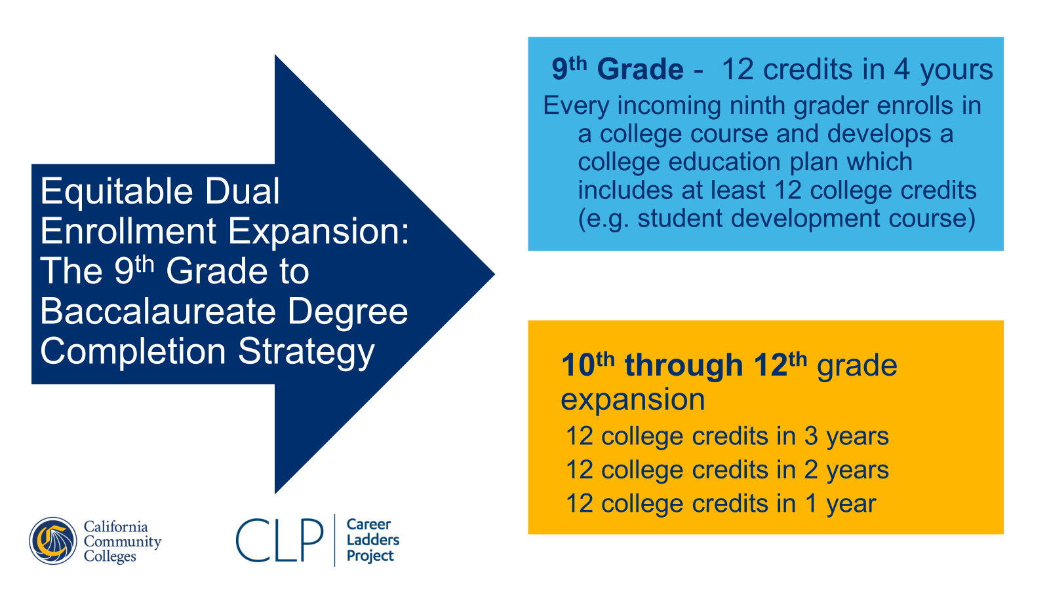
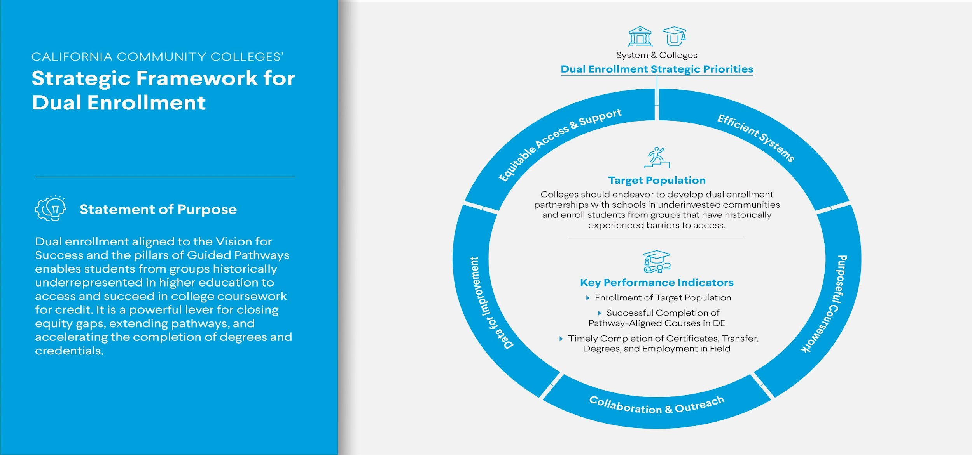
Strategic Framework for Dual Enrollment
Aligned to Vision 2030 and the pillars of Guided Pathways, dual enrollment enables students from groups historically underrepresented in higher education to access and succeed in college coursework for credit. Dual enrollment is a powerful lever for:
closing equity gaps,
extending pathways, and
accelerating the completion of degrees and credentials.

Slide 10
Vision 2030 calls out justice-involved and dually enrolled students as priority populations to be served equitably through access to higher education, and Rising Scholars programs across the state are positioned to put Vision 2030 into practice.
- Kellie Nadler, Rising Scholars Network Coordinator

Slide 11
Justice impacted students should be integrated into all dual enrollment expansion work
44 community colleges awarded 5-year grants to support justice involved students
$15 million on-going funding​
Must offer dual enrollment to justice impacted youth, which includes students who are detained, in an alternative placement, and in the community
Provide comprehensive educational and career pathways
Provide wrap around services and transition support services
Dedicated staff, space and formal partnerships
High level technical assistance provided by RSN Regional Coordinators ​
Equitable Dual Enrollment Expansion
Justice Impacted Youth
Expand the number of juvenile justice-involved students participating and succeeding in community colleges

Slide 12
A snapshot of the work we’ve accomplished for Vision 2030 so far…
In collaboration with the California Department of Education (CDE), the CCCCO supported the development of the Exemplary Dual Enrollment Awards for high schools with model programs
Developed and distributed dual enrollment memorandum highlighting title 5 regulatory changes that removed administrative barriers
In partnerships with Career Ladders Project, held 15 local equitable expansion dual enrollment workshops and 10 sub/regional convenings
Provide monthly technical assistance office hours to support field guidance
Distribute empowerment memorandum in partnership with the Academic Senate for California Community Colleges (ASCCC) highlighting a shared commitment to dual enrollment as an equity lever

Slide 13
Legislative and Regulatory Updates
Notes:
As mentioned in the prior slide of what has been accomplished so far for the Vision 2030, the Chancellor’s Office is continuing to actively consider policy changes to remove barriers in dual enrollment. With that, the next slides include chaptered legislation, proposed legislation for 2023-24 and adopted title 5 regulatory changes. We will begin with the chaptered legislation.

Slide 14
Chaptered Legislation
Specifies groups of students who may be considered “underrepresented in higher education” for these purposes.
Requires the governing board of a community college district participating in a CCAP partnership to enroll high school pupils in any course that is part of a CCAP partnership offered at a community college campus, and would expressly authorize courses to be offered at the community college campus or the participating high school campus.
Requires a community college district to assign priority for enrollment and course registration to a pupil seeking to enroll in a community college course that is required for the pupil’s CCAP partnership program.
Exempts all pupils seeking to enroll in a community college course that is required for the pupil’s CCAP partnership program from specified fee requirements.
AB-369 College and Career Access Pathways partnerships
  Effective January 1, 2024
https://leginfo.legislature.ca.gov/faces/home.xhtml

Slide 15
Proposed Legislation
(2023-2024)
AB-359 - Pupil instruction: dual enrollment: College and Career Access Pathways partnerships
  https://leginfo.legislature.ca.gov/faces/billNavClient.xhtml?bill_id=202320240AB359
SB-1244 - Pupil instruction: dual enrollment: College and Career Access Pathways partnerships
  https://leginfo.legislature.ca.gov/faces/billNavClient.xhtml?bill_id=202320240SB1244
AB-2019 - Early and middle college high schools and programs
  https://leginfo.legislature.ca.gov/faces/billNavClient.xhtml?bill_id=202320240AB2019
AB-1796 – Pupil instruction: course offerings: parental notification
  https://leginfo.legislature.ca.gov/faces/billNavClient.xhtml?bill_id=202320240AB1796
AB-2588 – College acceleration programs: study
  https://leginfo.legislature.ca.gov/faces/billNavClient.xhtml?bill_id=202320240AB2588
https://leginfo.legislature.ca.gov/faces/home.xhtml
Notes:
AB 359 – Would amend CCAP partnerships to align with best practices and streamline access to dual enrollment for K-12 students throughout the state. There are 17 major provisions.
SB 1244 – This bill would amend education code 76004 and would authorize a community college district to enter into a CCAP partnership within the service area of another community
college district if the community college district declined a request.
AB 2019 - This bill would expand the definition of early and middle college high schools to include early and middle college programs established within a high school.
AB 1796 – Would require high schools to notify parents about the availability of dual enrollment
AB 2588 –Would require the CDE to do a study on “college acceleration” programs including dual enrollment.

Slide 16
Title 5 Regulatory Changes
Adopted and Filed with Secretary of State
Dual Enrollment - Program Consent and Documentation
  Effective November 16, 2023
  Subchapter 6. Dual Enrollment
    The following rules apply to both the special admit and CCAP programs:
    (a) When parental or guardian consent is required to admit a student to a community college dual enrollment course, the consent obtained shall apply to all community college dual enrollment courses attempted by the student until parental or guardian consent is withdrawn in writing.
    (b) Community college districts may accept but shall not require students to provide high school transcripts or social security numbers as a condition of dual enrollment.
    Note: Authority cited: Section 70901, Education Code. Reference: Sections 48800.5, 52620, 70901, 76000, 76001, 76002, 76003 and 76004, Education Code.
https://www.cccco.edu/About-Us/Chancellors-Office/Divisions/General-Counsel/Pending-Regulatory-Action

Slide 17
Quick Reminders

Slide 18
Submitting CCAP Agreements
Alchemer link
  Sent to current CCAP contact listed on CCAP directory
  Link is open from 7/1 to 6/30
Submit the following:
  New Fully Executed Agreements (signed by both partners)
  Updated Appendix (addition(s) or deletion(s) of course offerings)
  Amendment to CCAP partnership agreement (additions, deletions, changes within subsections of agreement)

Slide 19
Reporting
California Community Colleges Management Information System (MIS)
Special Admit Student
SB11 Student Education Status
CCAP
SG13 Student CCAP Status
Student participation in the program must be verified by the college
Reporting submitted 30 days after the end of the term
MCHS
SG07 Student MCHS ECHS Status
Student participation in the program must be verified by the college
Reporting submitted 30 days after the end of the term
https://webdata.cccco.edu/ded/ded.htm

Slide 20
Technical Assistance Office Hours
Drop-ins
1:00 pm – 2:00 pm
Dates:
  Mar 28, 2024
    April 25, 2024
    May 23, 2024
Join from PC, Mac, Linux, iOS or Android:
  https://cccconfer.zoom.us/j/81734812228?pwd=SWJHK0xBQXYyTnVQZ3Z6YTVnUFI5UT0
  Password: 874141

Slide 21
Vision Resource Center
Dual Enrollment Module
General Discussion
Legislative Reports
Memos and Legal Opinions
Recorded Webinars
Login Vision Resource Center
Dual Enrollment Community aims to:
Facilitate collaboration and communication across colleges
Share promising practices and resources
Serve as a central location to ask questions
Get updates on the latest information surrounding Dual Enrollment
Notes:
The Dual Enrollment Community aims to facilitate collaboration and communication across colleges, share promising practices and resources, serve as a central location to ask questions and get updates on the latest information surrounding Dual Enrollment.
The community includes:
A Dual Enrollment Module
Topics that include General Discussion, Legislative Report submitted by the Chancellor’s Office and Memos and Legal Opinions

Slide 22

Practitioner Perspectives
How can we integrate the expertise of Registrars and Admissions Officers to ensure equitable access, supports and success in dual enrollment?
What questions or concerns do you have regarding dual enrollment as a means to promote equitable opportunities?
What possibilities do you envision for equitable expansion in dual enrollment in your local context?
What type of support, resources, and/or training do practitioners need to advance equitable dual enrollment expansion?
Notes:
LW

Slide 23
“Our time is now.”
- Chancellor Christian
Devin Rodriguez, Specialist, Educational Services & Support Division
ccapp@cccco.edu
dualenrollment@cccco.edu
Tonya M. Williams, Ph.D.
Dean, Educational Services and Support Division
lmwilliams@cccco.edu

