Slide 1
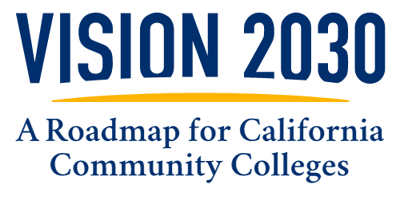
Taking care of our students, our communities and our planet
Notes:
Vision 2030: A Roadmap for California Community Colleges is a living document, collaboratively developed to be collaboratively maintained and designed to provide focus and direction for our 116 community colleges in this great and diverse state of California.

Slide 2
Meeting the Needs of Today and the Opportunities of Tomorrow
Evolving student body
Today’s students and future learners expect more from their education experience.
Vision 2030
Changing landscape
We must strengthen our systems to get students to and through our colleges faster and more equitably.
Communities need a skilled workforce across fast-growing career fields.
New circumstances
We must reckon with our new climate reality and the impact of new tech on teaching and learning.
Notes:
Higher education is changing quickly. Today’s students and future learners expect more from their education experience. Communities need a skilled workforce across fast-growing career fields. Addressing rapid disruptions to our climate requires new approaches to our operations and programs. The way we do teaching and learning has been forced to evolve by new circumstances and challenges like the pandemic.
Vision 2030 is designed to help the California Community Colleges to evolve with these changes and deliver more by holistically addressing the needs of colleges and students.

Slide 3
Vision 2030
A Roadmap for
California Community Colleges
What is it?
A seven-year action plan that:
  Guides field practice.
  Removes systemic barriers.
  Opens doors for policy reform.
Notes:
Vision 2030 reaffirms California Community Colleges’ commitment to achieving equity in education by addressing systemic barriers based on race, ethnicity, religion, class and gender, with a specific focus on students facing persistent disparities tied to their racial and ethnic identities.
The system will explicitly identify barriers, allocate necessary resources, prioritize equity, and adjust structures to ensure equitable opportunities and support for all students, as embodied in Vision 2030’s three equity-focused goals.

Slide 4
Vision 2030 envisions a higher education system more inclusive of all Californians that ensures access points for every learner across race, ethnicity, region, class and gender to enter a pathway, with tailored supports and exit points to transfer or complete a community college baccalaureate or obtain a job with family-sustaining wages.
Notes:
Vision 2030 envisions a higher education system more inclusive of all Californians that ensures access points for every learner across race, ethnicity, region, class and gender to enter a pathway, with tailored supports and exit points to transfer or complete a community college baccalaureate or obtain a job with family-sustaining wages.

Slide 5
Building for the Future Based on Where We’ve Been
Vision for Success Goals
(2017-2022)
Governor’s Roadmap Goals
(2021-2027)
Vision 2030
(2023-2030)
Notes:
Vision 2030 has been guided by the Vision for Success (2017), the Governor’s Roadmap (2021), current issues and considerations for the future of our students.
Vision for Success: Progress made under the Vision for Success centered bold goals to improve student outcomes, including closing achievement gaps, increasing degree and certificate attainment, increasing transfers to four-year institutions, reducing excess unit accumulation by students, and securing gainful employment.
The Roadmap built on the Vision for Success by keeping most goals outlined previously while outlining more areas for improvement. Some steps included sharing academic success data, with data sets focused on students from disadvantaged backgrounds and establishing academic pathways for high school, transfer and dual-enrollment students.
Vision 2030 is a future-focused roadmap that builds on the foundation of the previous two plans while incorporating more focus on key areas, including Equity in Access, Equity in Support, Climate action, and Generative artificial intelligence.
Vision 2030 grows California Community Colleges’ commitment to equity and academic success. It sets bold goals for the system to pursue transformational change to ensure institutions truly work for and support all students across race, ethnicity, religion, class and gender.
Vision 2030 builds on California Community Colleges’ hard-won progress. It goes further by being explicit about what structural changes are needed to create equitable opportunities and support for students, focusing on students harmed by persistent systemic barriers linked to their racial and ethnic identities.
As we launch the Vision 2030 goals, we commit to being more explicit about the systematic barriers we face in our efforts to transform and the resources truly necessary to reach these important goals.

Slide 6
New Pathways to Reach Future Learners
Veterans
Students who are justice-involved or justice-impacted
Students with lower wages, lower incomes, or conflicting work obligations
Bringing college to students
Foster youth
Dual enrollment
Notes:
Vision 2030 spotlights certain categories of students and future learners who continue to need focused attention responsive to legislation that was enacted where the implementation is not yet at scale or where new state and federal investments have been made in light of the pandemic’s impact on increasing income inequality and poverty.

Slide 7

Our What
Actions, Outcomes and Metrics
Mikala Hutchinson from MiraCosta College
Notes:
Mikala’s story: Mikala Hutchinson embodies what California’s community colleges are all about. Growing up in a family that often faced homelessness, Hutchinson was forced to attend nearly a dozen different high schools and would ultimately leave without earning a diploma.
Everything changed when she met with a MiraCosta College (MCC) counselor, who discovered Hutchinson was just one science class short of securing a high school diploma and encouraged her to enroll in the MCC Adult High School Diploma Program. “Once I got my high school diploma, I wanted to continue and get my college degree,” she said.
Hutchinson hasn’t looked back. She is currently receiving support from several basic needs programs and services on campus to help with her college journey. The Campus Assessment, Resources and Education (CARE) programs’ food pantry and Child Development Center day care service are providing invaluable assistance for both her and her children. She’s also utilizing Extended Opportunity Programs and Services to help pay for textbooks.

Slide 8
Vision 2030 Framework
Vision 2030
3 Goals
Equity in Success
Equity in Access
Equity in Support
Vision 2030
3 Goals
Equity in Success
Equity in Access
Equity in Support
Vision 2030
6 Outcomes & Metrics
12 Actions within our Three Strategic Directions
Notes:
Vision 2030 outlines three central equity goals — Equity in Success, Equity in Access and Equity in Support — as the driving force behind the transformational change within the system. These goals aim by 2030 to reduce and ultimately eliminate equity gaps for students of color who are underrepresented, students of low income and students with disabilities.

Slide 9
How We Know We’re Getting There: Goals & Metrics
Increase with equity the number of California Community College students:
  Who complete a meaningful educational outcome.
  Who attain a baccalaureate degree.
  Who earn a living wage.
Equity in Success
Increase with equity the number of students attending a California community college, with particular emphasis on the number of underserved Californians.
Equity in Access
Increase with equity the number of California Community Colleges students receiving state and federal aid for which they are eligible to better support their educational journey.
Decrease the number of units in excess of 60 units for the Associate Degree for Transfer.
Equity in Support

Slide 10
What We’re Doing to Get There:
Strategic Directions + Actions
Equitable Pathways
to Baccalaureate Attainment
Equitable Workforce
and Economic Development
The Future of Teaching and Learning
California Community Colleges are committed to the governor’s ambitious higher education goal of 70% postsecondary degree and certificate attainment among working-aged Californians by 2030.
Vision 2030 furthers the sector approach to workforce development through more partnerships between community colleges and industry to invest in hands-on training for career readiness.
The priority sectors are health care, climate, STEM and technology, education and early education.
Generative artificial intelligence (AI) provides new opportunities and challenges for education.
Use of tools such as ChatGPT has already become a part of students’ studying, research and more.
Guidance concerning AI must have oversight and a deep commitment to diversity, equity and inclusion.

Slide 11
Strategic Direction 1:
Equitable Baccalaureate Attainment
Equitable Pathways
to Baccalaureate Attainment
Equitable Workforce
and Economic Development
The Future of
Teaching and Learning
Actions 1-6 will advance Strategic Direction 1 in particular but will also positively impact Strategic Directions 2 and 3.
All actions, policies and procedures will be enacted centering equity and inclusion and dismantling prejudice and racism.
Increase equitable access, success and support for: dual enrollment in degree pathway, justice-involved and justice-impacted Californians, foster youth, those with lower wages and incomes, and veterans.
Improve systems of access, including financial support and program mapping.
Increase the number of eligible students who apply for and receive federal, state and local financial aid grants, including the federal Pell Grant, the state Cal Grant and the California College Promise Grant, among others.
Increase flexible term structures, flexible schedules and credit for prior learning opportunities.
Increase credit mobility and transfer opportunities.

Slide 12
Strategic Direction 2:
Equitable Workforce and Economic Development
Equitable Pathways
to Baccalaureate Attainment
Equitable Workforce
and Economic Development
The Future of
Teaching and Learning
Actions 7-11 will advance Strategic Direction 2 in particular but will also positively impact Strategic Directions 1 and 3.
Increase educational access for prospective learners of low income to enhance their socioeconomic mobility by developing a customized educational and training opportunities to them.
Health care: Expand access to health care pathway programs with particular attention to nursing, mental and behavioral health.
Climate action: Advance community college engagement with the four fields of climate practice — facilities, workforce and curriculum, community engagements and benefits, and resource development.
STEM: Expand success, access and support in science, technology, engineering and math disciplines for historically underrepresented students.
Education: Increase system capacity to decrease faculty shortages in key sectors including nursing, early childhood pathways and education.

Slide 13
Strategic Direction 3:
The Future of Learning
Equitable Pathways
to Baccalaureate Attainment
Equitable Workforce
and Economic Development
The Future of
Teaching and Learning
Action 12 will advance Strategic Direction 3, in particular, while also positively impacting Strategic Directions 1 and 2.
12. Actively engage with the impacts of generative AI on the future of teaching and learning:
  Improve the student experience with the use of generative AI as well as smart analytics applied to the “big data” systems (e.g., Student Information System, Learning Management System)
  Modernize system technology infrastructure to support online education delivery and faculty.
  Develop an analysis of the impact of generative AI technology and its potential implications for teaching and learning, and take the necessary action in policy reform, systems development and practices to advance success, access and support for our students.

Slide 14
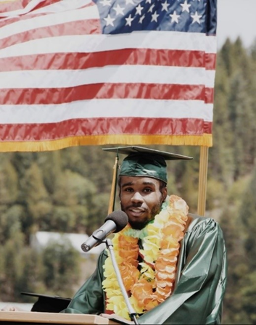
Our How
Advancing Vision 2030
Jesse Williams from Feather River College
Notes:
Jesse Williams
Feather River College (FRC) alumnus Jesse Williams embodies the positive impact of wraparound services covering basic needs such as financial aid, food, housing, transportation and mental health services, along with academic and career counseling.
While attending FRC, Williams participated in the work study program and received the Cal Grant, Pell Grant and a COVID-relief grant. Financial aid covered most of his housing. He also obtained free mental health support and utilized the food pantry, and college officials helped him apply for CalFresh/SNAP. Additionally, every Thursday the school’s culinary arts program provided a complimentary lunch.
“The people at FRC opened their doors, they opened their arms for me, they inspired me, fed me, they treated me like I was one of their own,” Williams said of FRC’s support network. “They didn’t care about my race. They didn’t care about what social class I was from. They saw me. They believed in me.”
The result: Williams earned an associate degree and then transferred to the University of California, Davis, where he earned a bachelor’s degree in English. His sights are now set on becoming a teacher with a long-term goal of running a nonprofit where he can help students from lower-income backgrounds achieve their higher education goals.
Williams’ success helps illustrate how financial aid, basic needs resources and individual support can help students achieve their dreams. His message?
“Thank you for encouraging me,” Williams said. “Thank you for inviting me to places that I didn’t think I belonged and helping me get everything I needed. Thank you for believing in me.”

Slide 15
How Will the Chancellor’s Office Advance This Work?
People
Systems
Chancellor’s Office supporting the field
Establish and engage in active partnerships with people in the field to guide practice.
Review whole systems development to remove barriers at scale.
To ensure implementation at scale for this transformational change that Vision 2030 calls for, the Chancellor’s Office will provide colleges with support through four spheres of engagement — people, systems, resources and policy.
Resources
Policy
Lead state, federal and philanthropic growth to support fiscal sustainability.
Identify and advance policy reform across state, federal, Title V and local district policies to unlock potential.
Notes:
People: Active partnership with people in the field — partnerships are between the districts, constituent groups, students and the Chancellor’s Office. This includes data dashboards with local information relevant to colleges and partnerships in professional development connected to Vision 2030 actions (e.g., online teaching and learning).
Systems: Systems development to remove barriers — this includes data systems and the common ERP, systems to support adults of low income and bring college to them, common course numbering and intersegmental learning management system, and online teaching and learning.
Resources: Resource development for fiscal sustainability — this includes federal resources, state resources, philanthropy and maximizing local resources (Student Centered Funding Formula (SCFF)).
Policy: Policy reform to unlock potential — this includes federal policy, state policy, Title V and district policies.

Slide 16
Admissions & Records: The Heart of CCCs
Facilitate seamless transitions for students, with tailored supports & personalized assistance for the V2030 student populations.
Deeply engage in program offerings to help guide student’s paths and ensure equitable access.
Leverage existing and emerging technologies to streamline processes and eliminate barriers that impede student progress.

Slide 17
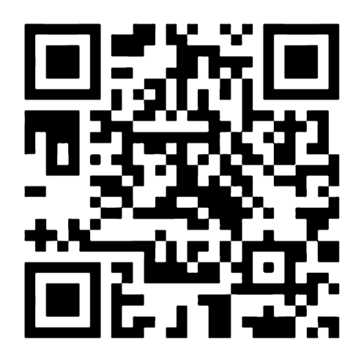
How You Can Get Involved!
Visit our website: CCCVision2030.org.
Share your ideas and feedback.
Important dates:
Monthly Consultation Council meetings (third Thursday of the month).
System Webinars Every First Wednesday of the Month
(Nov. 1 and Dec. 6).
Statewide Events and District Town Halls (Ongoing).
Board Presented With Final Revisions (Jan. 22, 2024).

