Slide 1

Legislative Update
CACCRAO Conference 2024
California Community Colleges Chancellor’s Office
March 25, 2024
Notes:
Linda

Slide 2
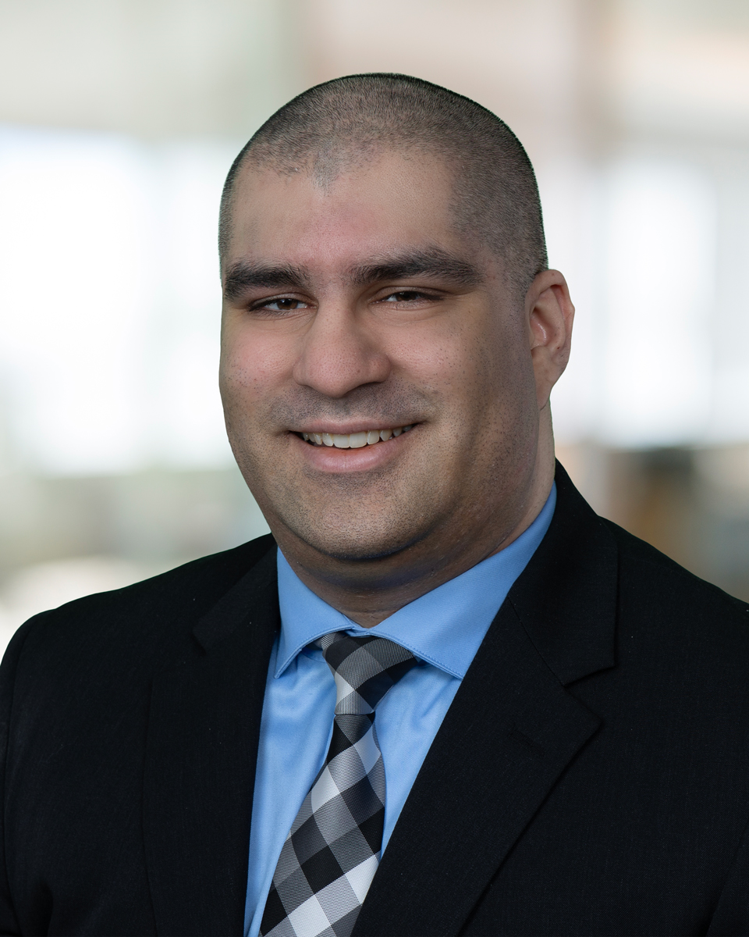
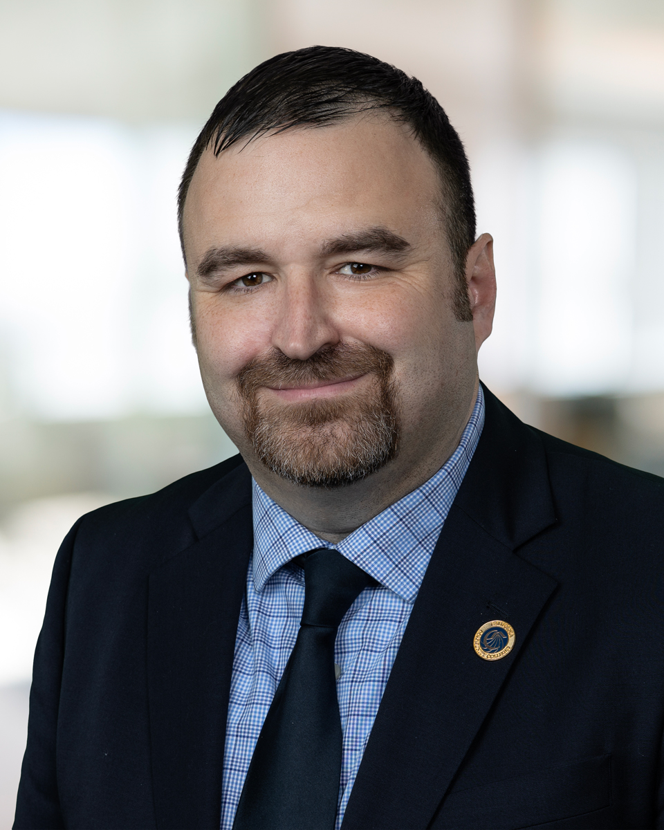
Chancellor’s Office Introduction
Imran Majid
Senior Legislative Advocate
Justin C. Salenik
Senior Legislative Advocate

Slide 3
Agenda
Legislative Advocacy Overview
2023 Legislation Implementation Update
Update on 2024 Legislative Session
3
Notes:
Any announcements?

Slide 4
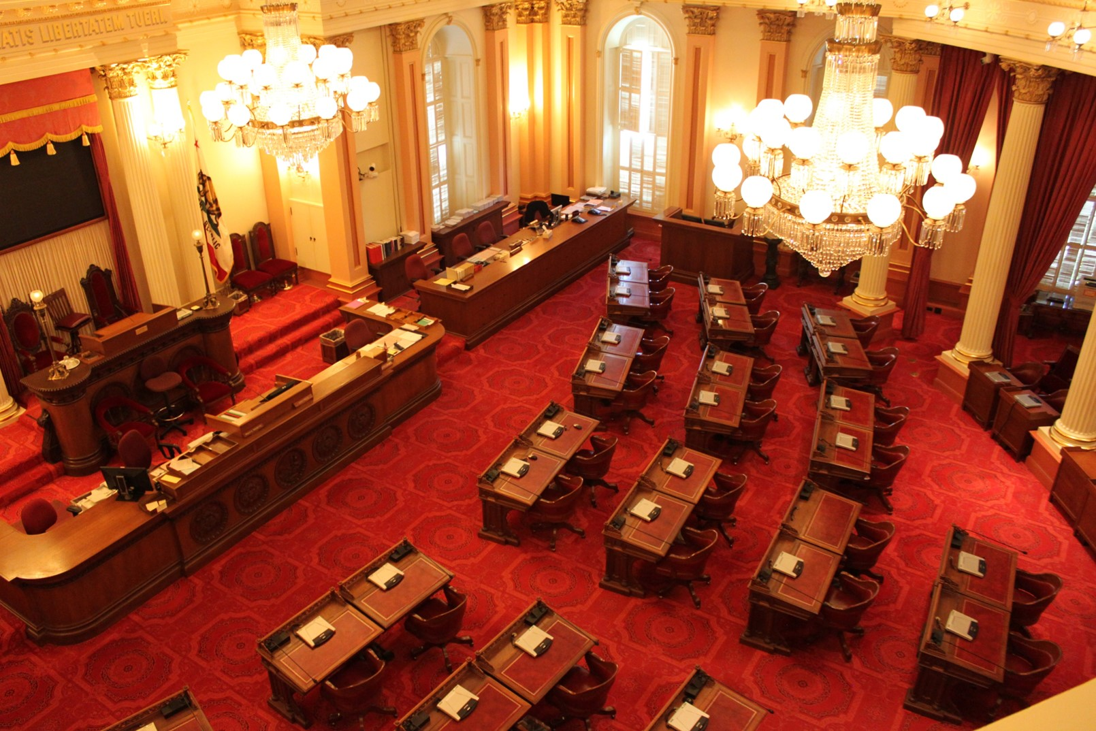
Legislative Advocacy Overview
4
Notes:
Justin

Slide 5
Advocating for Vision 2030 Goals
Advocate on behalf of California Community Colleges at the state and federal level.
Support and sponsor legislation that advances Vision 2030.
Represent the Chancellor’s Office in legislative and oversight hearings.
Plan and coordinate advocacy days, legislative briefings, and presentations.
Provide technical assistance to legislative committees and Department of Finance.
Coordinate with our Washington DC based federal liaison on federal legislation and regulations.
Notes:
Advocacy and policy development are the primary roles of our division. Our system’s needs are as diverse as our students, and requires us to be informed and intentional in representing those needs in front of policymakers and other stakeholders.
Some of our other functions include the following:
Provide updates to the Board of Governors, Consultation Council and other system stakeholders.
Guide Board of Governors members through their Senate confirmation process
Develop the annual system budget request in conjunction with the College Finance and Facilities Planning Division

Slide 6
Understanding the Legislative Process
Bill Introduction Deadline
(February)
1st House Floor Vote Deadline
(May)
Legislative Deadline
(August)
Governor’s Final Actions
(September)
Effective Date of Statutes
(January 1)
New Requests
1st House Committee Hearings
(March-May)
2nd House Committee Hearings (June)

Slide 7
2024 Legislative Guiding Principles
Vision 2030 guides our policy advocacy efforts and serve as a basis for determining recommendations on legislative proposals.
Support legislation that advances the goals of Vision 2030.
Support local governance, unless the proposal inhibits Vision 2030.
Justification for state intervention is compelling and supported by data and evidence.
Maximize all financial resources. Concerned with unfunded mandates.
Ensure equitable representation and serve as equal partners with the other education segments.
Notes:
Advocacy and policy development are the primary roles of our division. Our system’s needs are as diverse as our students, and requires us to be informed and intentional in representing those needs in front of policymakers and other stakeholders.
Some of our other functions include the following:
Provide updates to the Board of Governors, Consultation Council and other system stakeholders.
Guide Board of Governors members through their Senate confirmation process
Develop the annual system budget request in conjunction with the College Finance and Facilities Planning Division

Slide 8
Legislation doesn’t always…
Articulate a problem (it doesn’t have to)
Articulate a complete vision (too vague)
Account for potential duplication
Account for the workload and potential costs
Dictate the how (implementation)
HELP US UNDERSTAND THE HOW
Notes:
No articulated problem (bill on first responders). And who can say no to that? Why object? Our job is to challenge the need….i

Slide 9
How to Understand a Bill
What is the bill asking to do?
Create or modify a program?
Implement regulations?
Write a report?
Form a working group?
Create or change local policies?
What challenges could impact implementation?
Duplication?
Conflicts with Title 5 or CCCCO priorities?
Unfunded mandate/workload?
How are we (as a system) involved in this issue?
Title 5?
Prior legislative/budget requirements?
Working groups?
More…
Timeline for implementation doable?

Slide 10

Remember…
Does not include everything in the bill!
Bills can add, modify, or remove requirements or programs.
Not all requirements are listed in the same place! So we have to cross reference ed code & statute
Use this button!

Slide 11

Legislation shapes our system. Tell us what you think.
If a bill causes you concern, raise those concerns early on
Seek input from the constituencies you engage with (CSSOs, CBOs, CEOs) before a bill is signed
Help us understand what we don’t know

Slide 12
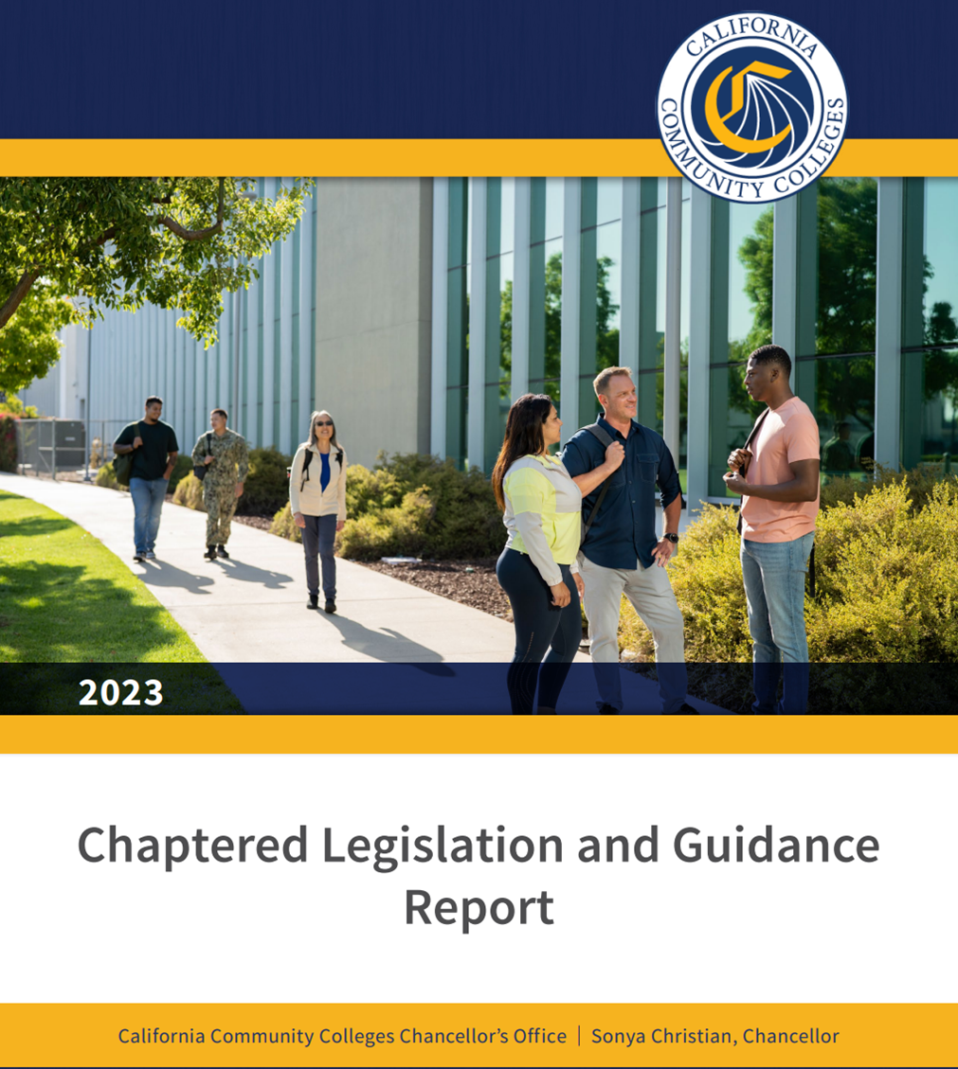
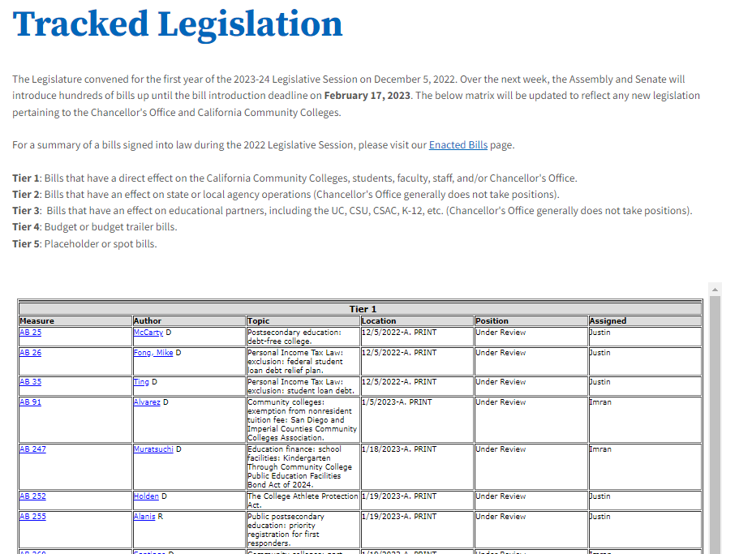
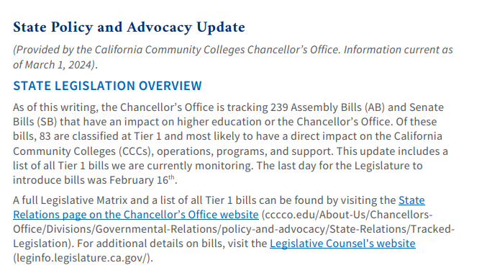
How We Keep You Informed

Slide 13

Being vigilant is key – a trickle can become a waterfall overnight
We remain engaged because ideas are swirling before they become bills
Some bills create a lot of buzz (we monitor press releases, Tweets, emails, etc.)…which means it becomes a high priority for us

Slide 14
AB 2683: Sexual Violence and Harassment Training
Required CCCs to provide annual sexual harassment and sexual violence prevention training to students, starting September 1, 2024.
AB 2608 (Gabriel, 2024) would expand the training to include additional information on drug-facilitated sexual assault.
  The implementation date is not specified.

Slide 15

AB 2881 (Student Parents)
Required priority registration to a student who has a child under 18 years of age who will receive more than half of their support from that student.
AB 2458 (Berman, 2024) would change the definition of student parent.

Slide 16

AB 1540 (M. Fong) Proposed Title 5 Regulations
Students Seeking AB 540
Require students to verify their eligibility by submitting a California Nonresident Tuition Exemption form to their district or the California Student Aid Commission (CSAC).
Supplemental Information
Requires districts to accept CSAC’s determination of AB 540 eligibility unless the district has information that calls the student’s eligibility into question.
Authorizes districts to request supplemental information if there’s a reasonable basis to question the student’s eligibility.
Conformity with AB 1096 (L. Rivas, 2021)
Replaces the dehumanizing term "alien" previously used in state law in reference to persons who are not citizens or nationals of the U.S.

Slide 17

State Advocacy Overview
246 bills that have an impact on higher education
104 bills classified as Tier 1 and most likely to have a direct impact on the CCCs, faculty, and students
April 26th: Deadline for policy committees to hear fiscal bills
A full Legislative Matrix can be found by visiting the State Relations page on the Chancellor’s Office website.
May 17th: Deadline for fiscal committees to hear bills
Notes:
We are currently tracking 130 two-year and newly introduced bills.
Of these 130 bills, 56 bills are classified as Tier 1.
Of these 56 bills classified as Tier 1, 13 Tier 1 bills are two-year bills that were introduced last year. Most of these bills have been referred to the inactive file.
The bill introduction deadline for new bills is February 16th.

Slide 18
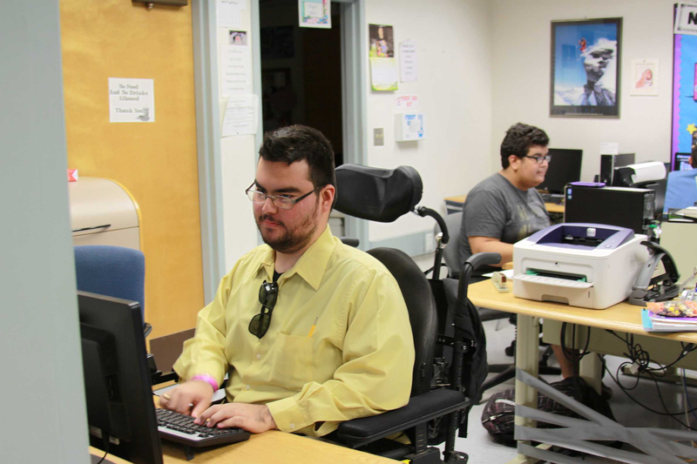
Chancellor’s Office Sponsored Bills
Would allow students receiving support under the Disabled Services and Programs for Students (DSPS) who are classified as full-time to also receive a Student Success and Completion Grant.
AB 1885 (Addis)
Equitable Financial Aid for DSPS Students
Passed Assembly Higher Education Committee 10-0 on March 12th

Slide 19

Chancellor’s Office Sponsored Bills
Would authorize the usage of multi-criteria screening for admission decisions in allied health programs.
Passed Assembly Higher Education Committee 10-0 on March 12th
AB 1891 (Weber)
Multi Criteria Screening for Allied Health Programs

Slide 20

Dual Enrollment
AB 359 (Holden) Makes changes to CCAP to align with other dual enrollment programs and removes barriers to students seeking dual enrollment.
AB 1796 (Alanis) Requires high schools to notify parents of dual enrollment program that are available
AB 2019 (V. Fong) Exempts a pupil from the 240 instructional minute minimum school day if they are in a dual enrollment program
AB 2588 (Chen) Requires Department of Education to evaluate the effectiveness of college acceleration programs including dual enrollment
SB 1244 (Newman) Allows a community to enter into a CCAP agreement with a high school outside its service area

Slide 21
Fees, Residency and Apportionment
AB 2093 (Santiago)
AB 3015 (Ramos)
AB 3290 (Committee)
Expands College Promise eligibility to CCC baccalaureate students.
Provides residency to students from neighboring Indian tribes.
Expands non-resident exemption for members of Armed Forces
SB 916 (Seyarto)
Waives fees for veterans enrolled in extension courses
SB 971 (Portantino)
Exempts students impacted by war from nonresident tuition.
AB 3110 (M.Fong)
Makes pre-apprenticeship programs eligible for state apportionment funding

Slide 22
Enrollment
AB 1160 (Pacheco)
Restricts debt collection practices that colleges may use
AB 2608 (Gabriel)
Adds information on drug induced sexual assault to training required by AB 2683 (2022)
SB 1378 (Min)
Requires the phone number for the US Dept. of Education’s Office of Civil Rights to be listed on Student ID cards
AB 2458 (Berman)
Requires data collection on student parents
SB 1278 (Glazer)
Requires colleges to have code conduct policies that protect students expressing free speech

Slide 23

Questions?

Slide 24
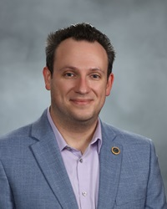
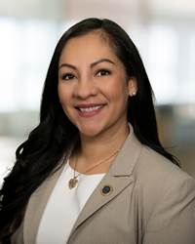
Government Relations Division
Justin C. Salenik, Government Relations Analyst
jsalenik@cccco.edu
(916) 324-2547
Imran Majid, Government Relations analyst imajid@cccco.edu
(916) 324-2363
Cody Peters, Office Technician
cpeters@cccco.edu
(916) 327-5488
David O'Brien, Vice Chancellor of Government Relations
dobrien@cccco.edu
(916) 323-5951
Linda Vazquez, Assistant Vice Chancellor for State and Federal Relations
lvazquez@cccco.edu
(916) 322-6888

Slide 25

Notes:
Again, a sincere thank you for your time and leadership and I welcome any questions
Or feedback.

