Slide 1
Title 5, Repeats, Withdrawals, and More
Lillian Justice, Registrar, El Camino College
Kathy Lucero, Director of Admissions, Chaffey College

Slide 2
Governance of California

Slide 3
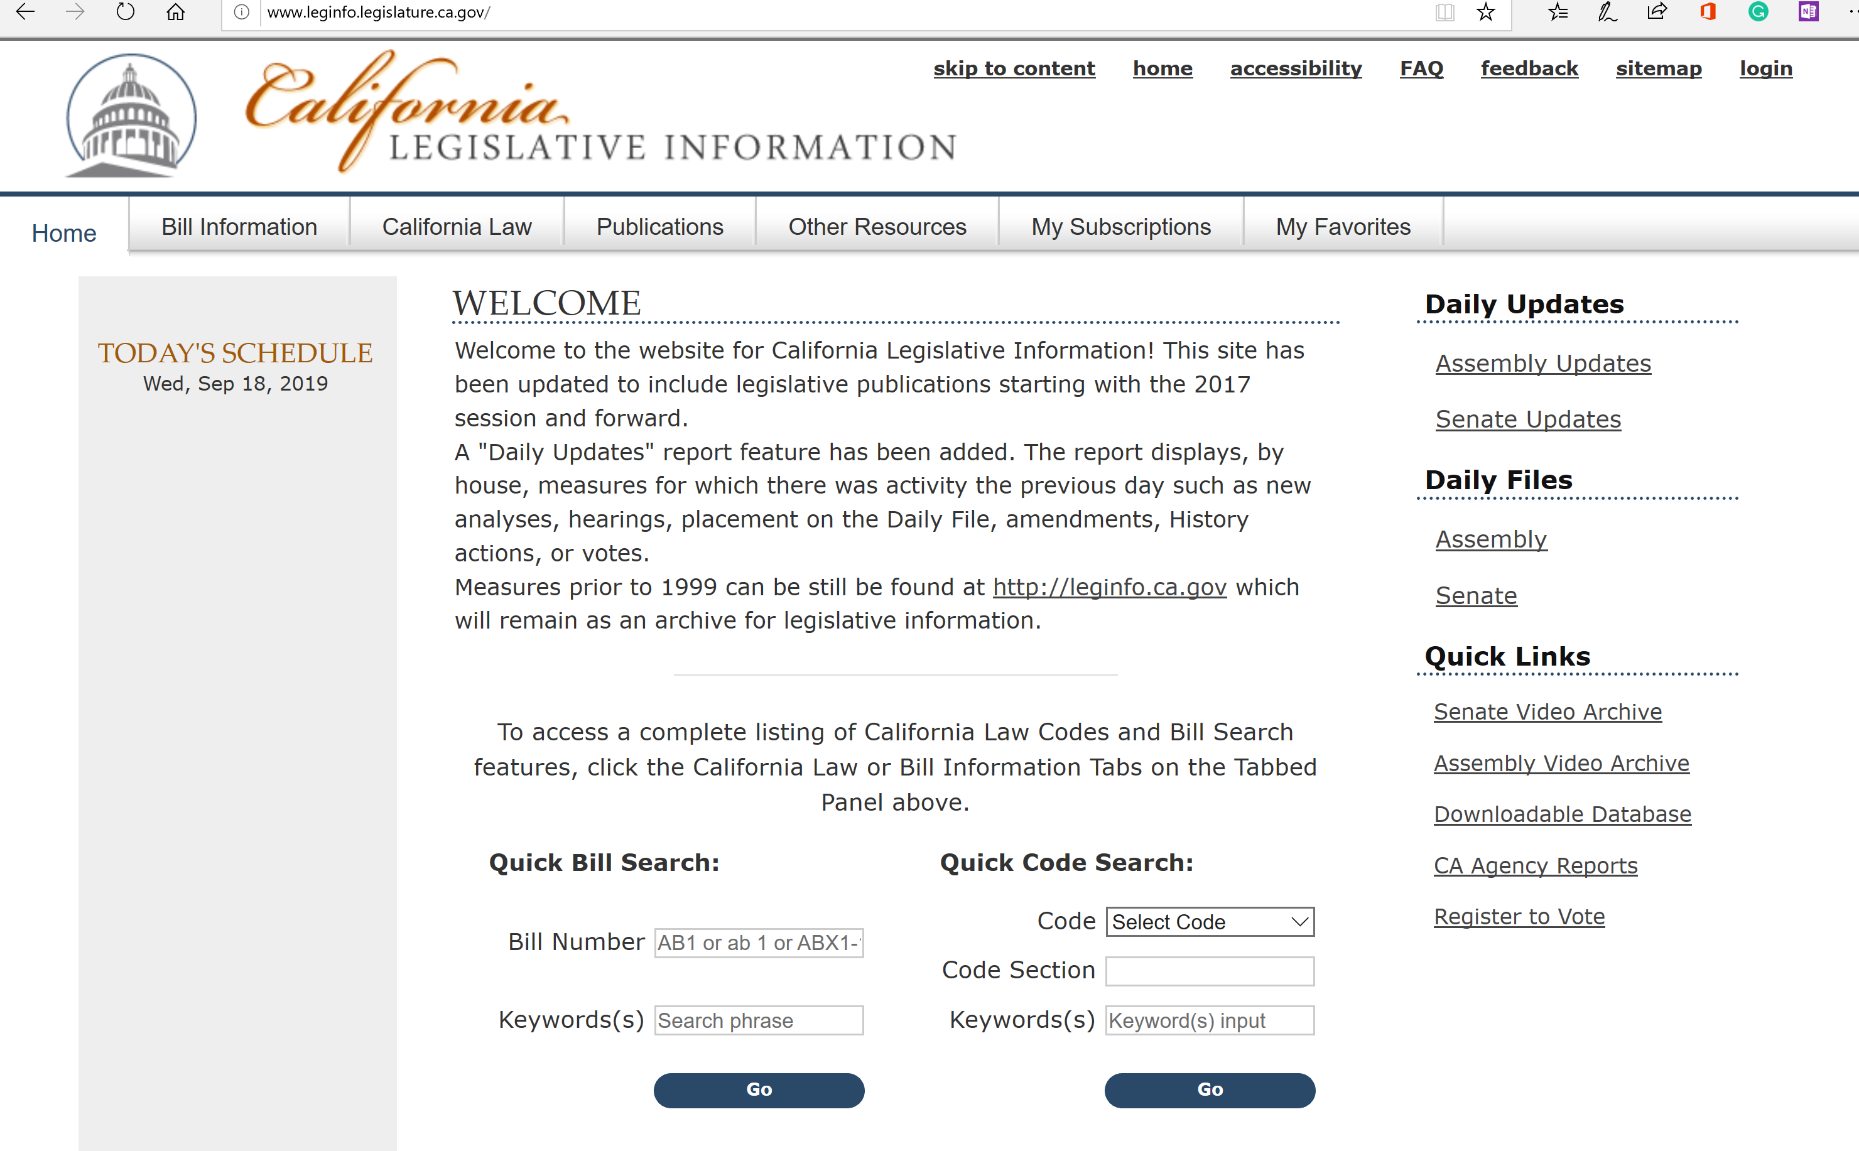
California Education Code and Bill Information
leginfo.legislature.ca.gov

Slide 4
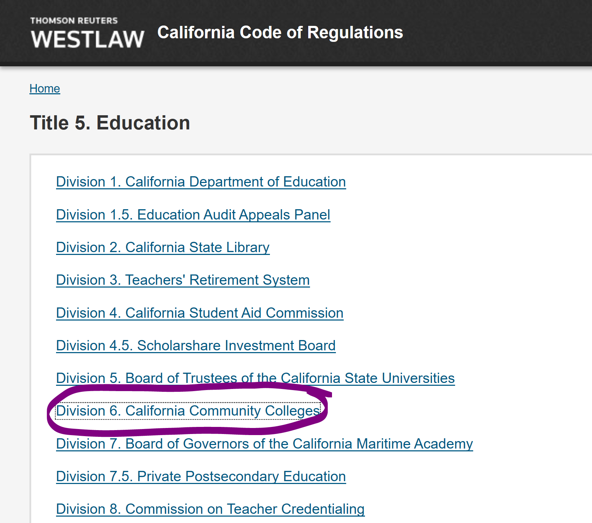
California Code of Regulations Title 5.Education/Division 6
govt.westlaw.com

Slide 5
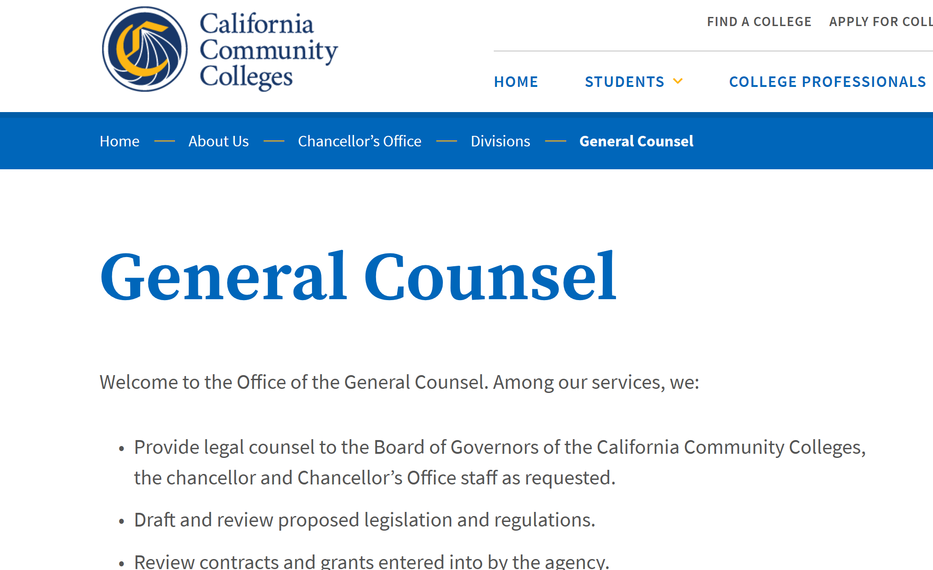
California Community College Chancellor’s Office: General Counsel
https://www.cccco.edu/About-Us/Chancellors-Office/Divisions/General-Counsel

Slide 6
Repeats
Title 5, sections: 55024 (withdrawals), 55040-45 (repetition), 58161-12 (money)
Credit Course Repetition Guidelines
Credit Course Repetition PowerPoint…Michelle Goldberg

Slide 7
Withdrawals
Title 5 section 55024
EW
CCCCO Memorandum 19-07
Background of EW

Slide 8
Enrollment Process
CCCApply
Admissions Requirements (EDC 76000)
Special Admissions (Dual Enrollment {CCAP and Non CCAP})
Enrollment (Open Enrollment and Exceptions to Open Enrollment)
Enrollment Requirements and Priorities
Loss of CPG (formely BOG)
Adding and Dropping Classes
Overlaps
No Shows
Refunds
Prerequisites
Repeats
ETC.

Slide 9
Questions

Slide 10
Thank You

