Slide 1
Dual enrollment Processes
Erin Cruz, Porterville College
Steve Erwin, College of the Canyons
September 18, 2019

Slide 2
CCAP and non-CCAP
Special Admit K-12 students
College and Careers Access Pathways
CCAP: taught within the high school day
Non-CCAP: taught outside the high school day
Unit limitations: 15 for CCAP; 11.99 (less than full-time) for Non-CCAP

Slide 3

WELCOME TO
PORTERVILLE COLLEGE
DUAL / CONCURRENT ORIENTATION

Slide 4
How to Earn Credit
Dual Enrollment
  A college course that is taught by a high school instructor who meets Porterville College’s minimum qualifications
Concurrent Enrollment
  A college course that is taught by one of our college instructors on the high school campus
Articulation/Credit by Exam
  A high school course that is the same as a college course but credit is awarded through examination

Slide 5


Slide 6


Slide 7
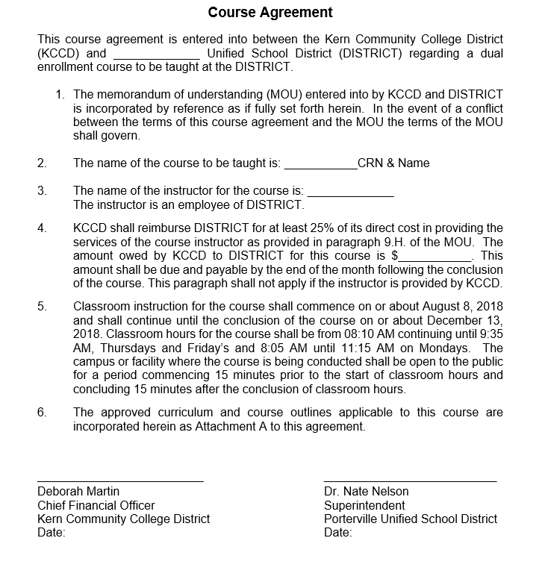

Slide 8
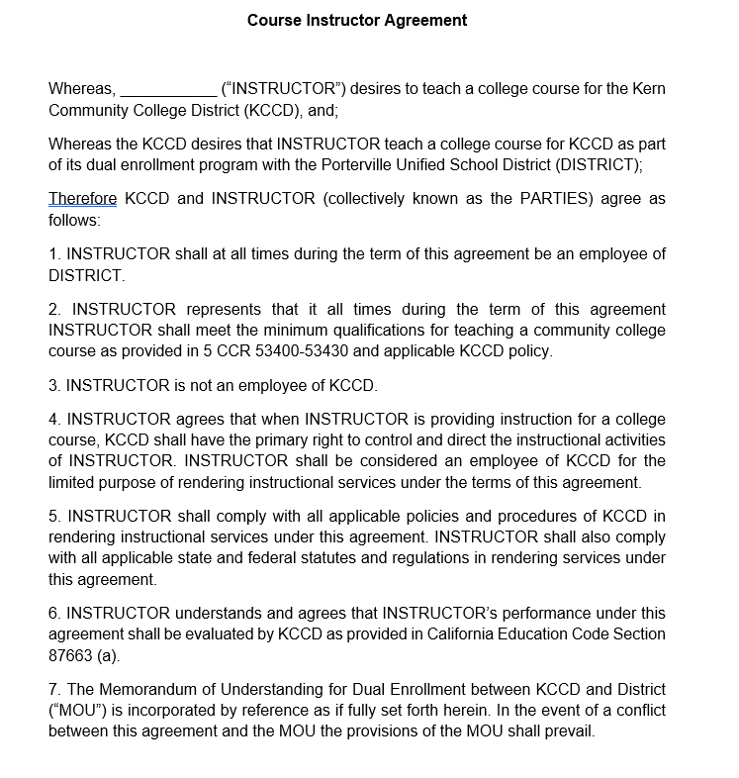

Slide 9
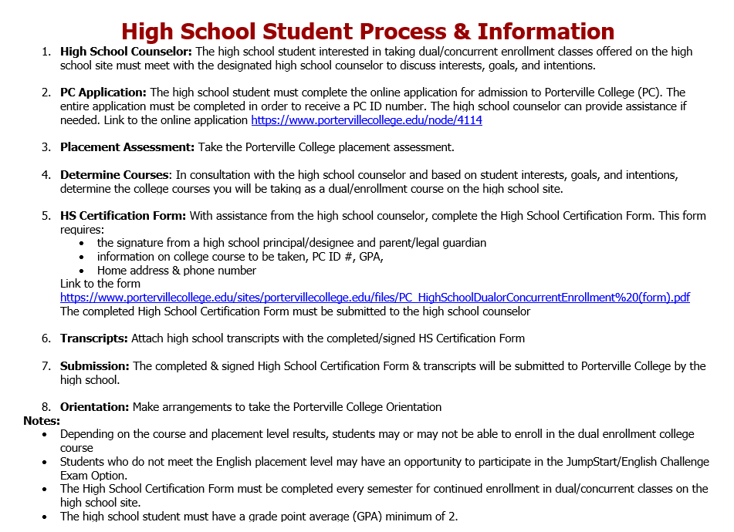

Slide 10
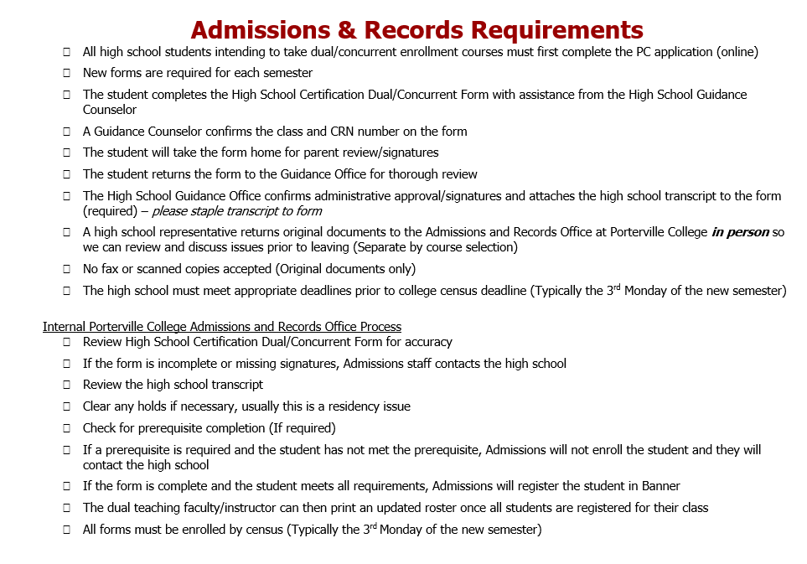

Slide 11
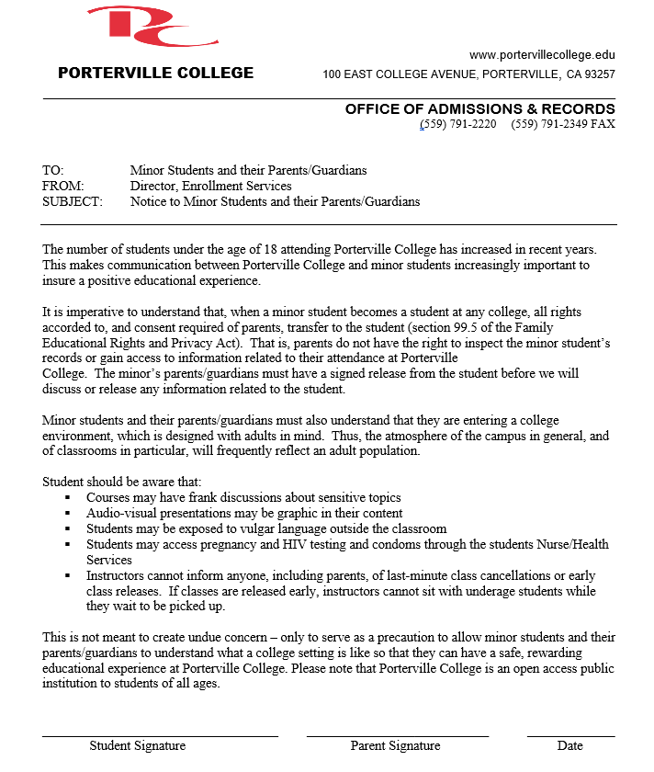

Slide 12
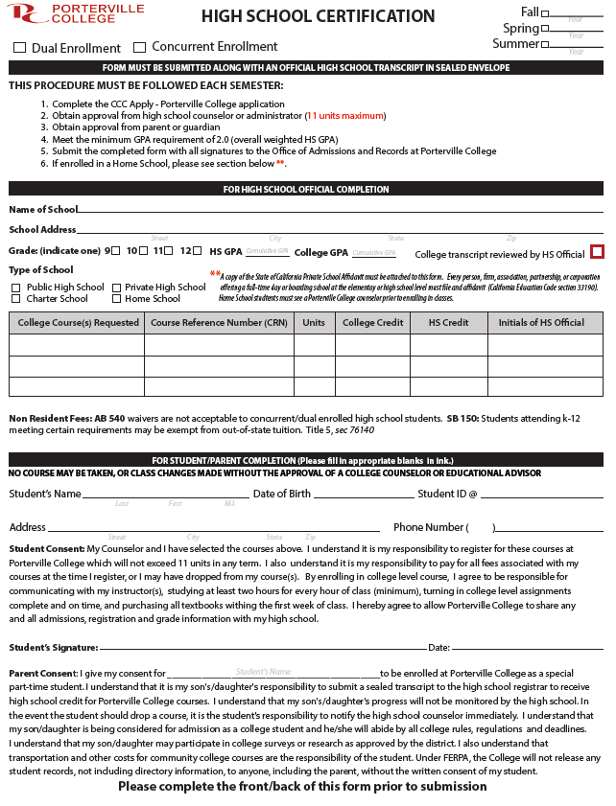

Slide 13
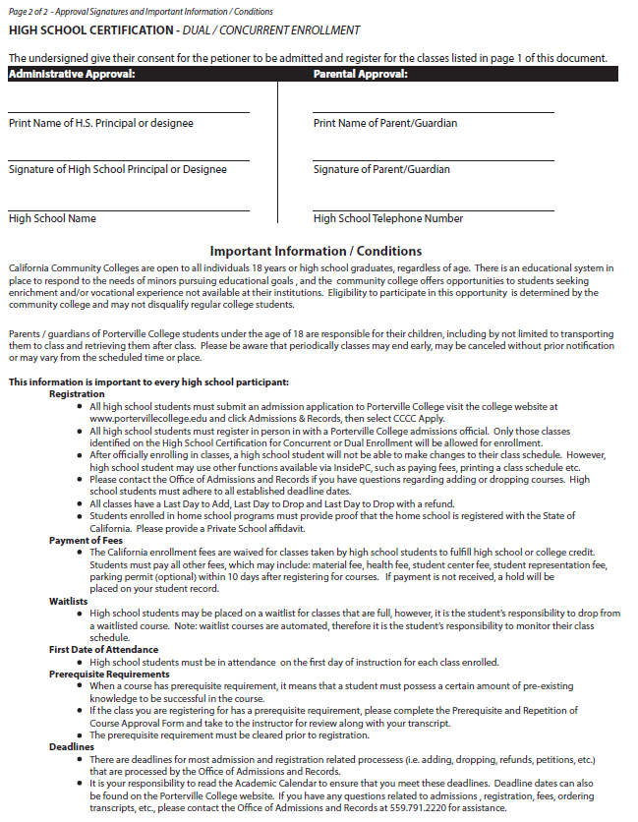

Slide 14
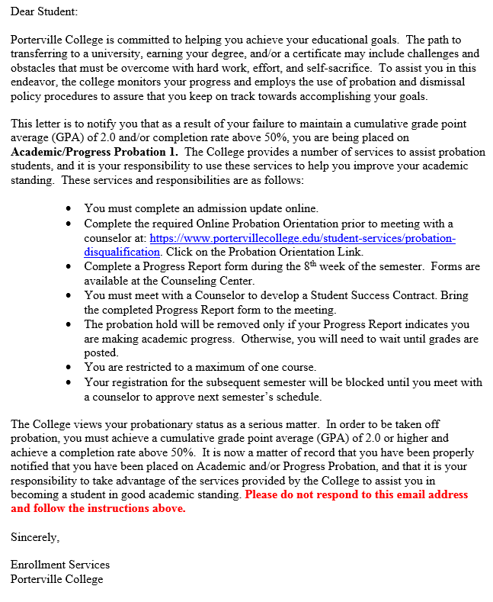

Slide 15
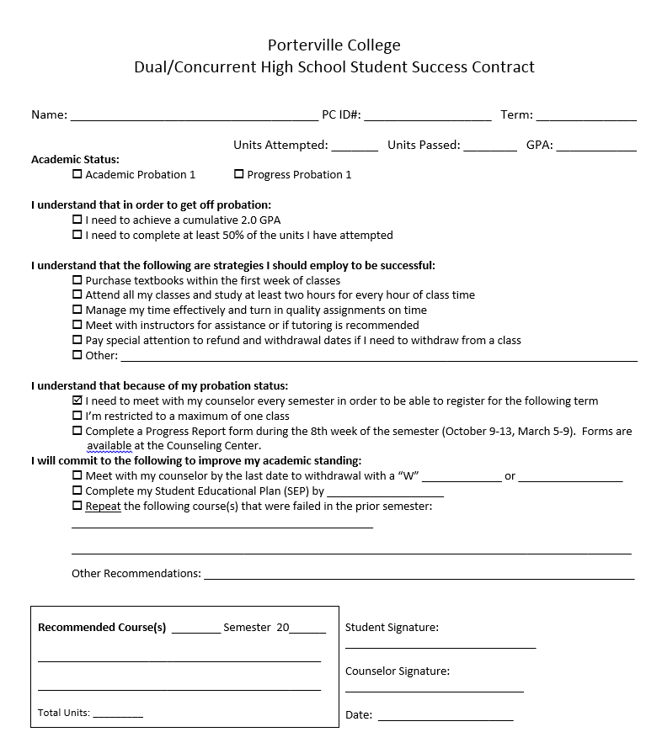

Slide 16
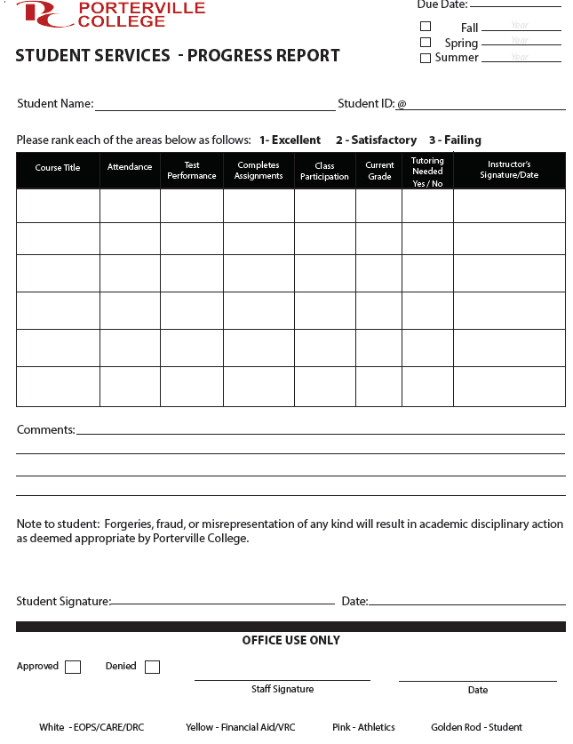

Slide 17
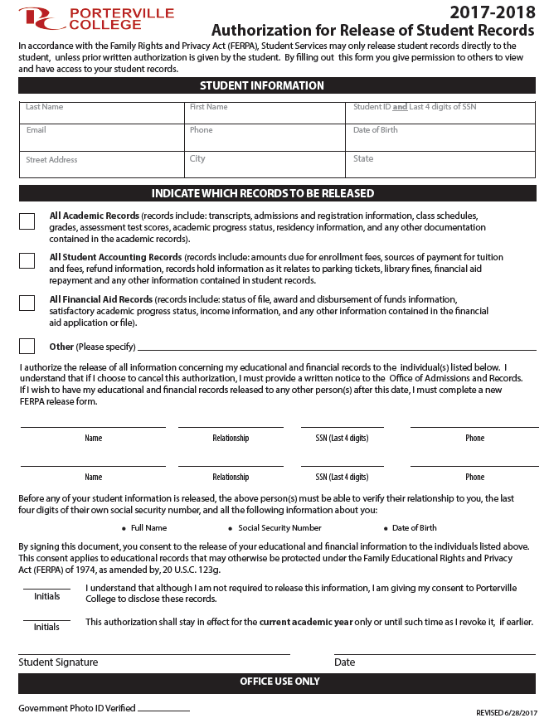

Slide 18


Slide 19
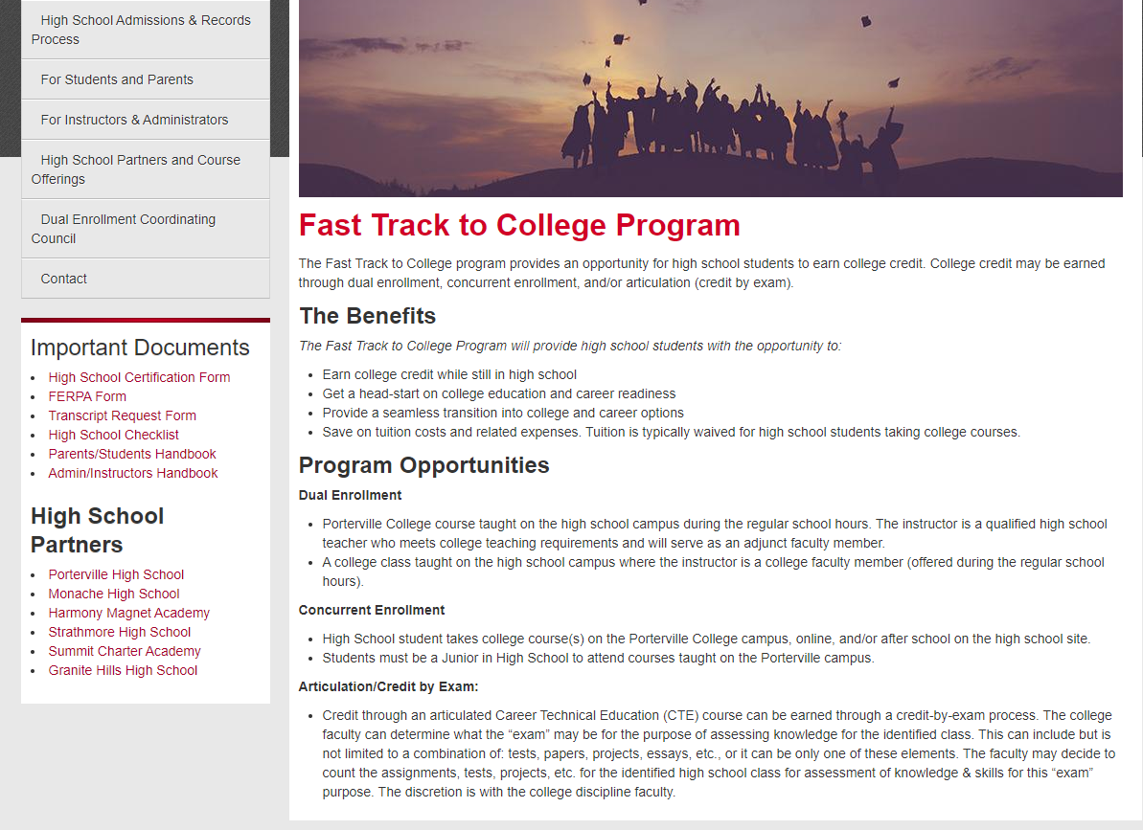
https://www.portervillecollege.edu/fast-track-college/fast-track-college-program

Slide 20
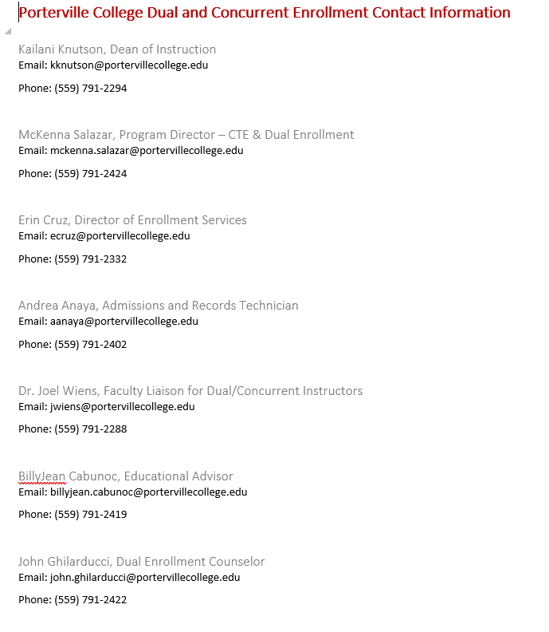

Slide 21
College of the canyons special admits
Non-CCAP: College Now! (Concurrent Enrollment); 11-12 graders only
  Students register themselves
  Enrollment fees waived
CCAP: Dual Enrollment, 9-12 graders
  Batch registration in A&R
  Enrollment and Student fees waived

Slide 24
Registration process
Application (online), modifications
Orientation (online and/or in-person)
Registration
  Special Admit form, student type, HS ID number, rate table modification
  Block registration
Data share between districts

Slide 25
Questions?

