Slide 1
Student Centered Funding Formula Contracted District Audits
Chancellor’s Office
New Admissions and Records Directors Training
California Association of Community College Registrars and Admissions Officers (CACCRAO)
September 17-18, 2018
Sacramento

Slide 2
The Student Centered Funding Formula (SCFF) and You
A. Never heard of it
B. Some knowledge
C. Expert – could explain it to another person

Slide 3
While the system has made significant strides improving student success, serious challenges remain.
Most students who enter a community college never complete a degree or certificate or transfer.
Achievement gaps persist across student groups and across regions.
Students who do reach an educational goal take a long time to do so.

Slide 4
Discussions about a new funding formula began more than a year ago, given concerns among system stakeholders that enrollment—the traditional driver of funding—has been stagnant in many districts.
Enrollment

Slide 5
In reforming funding for community college districts, we aim to do the following:
Provide groups of students that have faced barriers to success with additional support to meet our goals.
Encourage progress toward the Vision for Success adopted by the Board of Governors.
Make resources most useful to community college districts by making them stable, predictable, and flexible.

Slide 6
We want community college finance to further the activities the Chancellor’s Office is undertaking through the Guided Pathways framework.
Associate Degree for Transfer
Associate Degree
Regional Living Wage
Baccalaureate Degree
Completion of nine or more CTE# Units
Credit Certificates
Transfer to Four-Year University
Transfer-Level Math and English

Slide 7
State Budget Process

Slide 8
Apportionments 101
Local Property Tax
Student Enrollment Fees
+ State General Apportionment (Prop 98)
Total Computational Revenue

Slide 9
Ye Olde Funding Formula (1996 – 2018)
District size (number and size of colleges and centers)
Each student (FTES) funded at same rate
for Credit, Noncredit, and CDCP

Slide 10
Milestone
“…California’s state leaders have truly delivered on a promise to put students first and set an example for the rest of the nation by adopting a new funding formula that incentivizes student success…”
–Chancellor Eloy Ortiz Oakley

Slide 11
Student Centered Funding Formula
The new formula calculates apportionments generally using three allocations:
Base Allocation—Current factors (primarily credit FTES).
Supplemental Allocation—Counts of low-income students.
Student Success Allocation—Counts of outcomes related to the Vision for Success, with “premiums” for outcomes of low-income students.
Noncredit FTES (and some other FTES) would be funded at current rates.
The rates are calculated to provide a three-year transition.

Slide 12
Ye Olde funding formula | SCFF

Slide 13
Supplemental Allocation
Districts would receive one “point” based on prior year data:
Pell Grant recipients.
California College Promise Grant recipients.
AB 540 students.

Slide 14
Student Success Allocation
Student Success Allocation—Measures | All Students | Promise Grant Premium | Pell Grant Premium
Associate degrees for transfer granted | 4 | 4 | 6
Associate degrees granted (excluding ADTs) | 3 | 3 | 4.5
Baccalaureate degree granted | 3 | 3 | 4.5
Credit certificates (16 units or more) granted | 2 | 2 | 3
Completion of transfer-level mathematics and English courses within first academic year of enrollment | 2 | 2 | 3
Successful transfer to four-year university | 1.5 | 1.5 | 2.25
Completion of nine or more CTE units | 1 | 1 | 1.5
Attainment of regional living wage | 1 | 1 | 1.5

Slide 15
Point Values
 |  | 2018-19 | 2019-20* | 2020-21*
1. Base Allocation
 | Dollars per Credit FTES | $ 3,727 | $ 3,387 | $ 3,046
 | Basic Allocation | See Note | See Note | See Note
2. Supplemental Allocation - Dollars per Point |  | $ 919 | $ 919 | $ 919
3. Student Success Allocation - Dollars per Point
 | All Students | $ 440 | $ 660 | $ 880
 | Equity Allocation (Pell Grant and Promise Grant Recipients) | $ 111 | $ 167 | $ 222
*Adjusted for COLA in those years.
Note: Calculated based on the numbers of colleges and comprehensive centers consistent with the current formula.

Slide 16
Example 1
Allocations | Dollars
Base Allocation | $3,727
Supplemental Allocation | n/a
Student Success Allocation Completion of transfer-level mathematics and English courses within first academic year of enrollment (2 points * $440) | 880
Total for 1 FTE | $4,607

Slide 17
Example 2
Allocations | Dollars
Base Allocation | $3,727
Supplemental Allocation College Promise & Pell Recipient (2 points * $919) | 1,838
Student Success Allocation Completion of transfer-level mathematics and English courses within first academic year of enrollment (2 points * $440) + (5 points * $111) | 1,435
Total for 1 FTE | $7,000

Slide 18
Hold Harmless Provision
In 2018-19, 2019-20, and 2020-21, a district would receive the greater of the formula total or the amount the district received in 2017-18, adjusted by the changes in the cost-of-living.
The formula includes a “stability” provision that delays any decreases in revenues by one year.

Slide 19
SCFF Oversight Committee
The Legislature established the committee for the purpose of continuously evaluating and reviewing the implementation of the SCFF. The committee consists of 12 members:
Four members appointed by the Senate Committee on Rules with at least one of these members employed by a community college district in a classified position.
Four members appointed by the Speaker of the Assembly with at least one of these members being a faculty member from a community college district.
Four members appointed by the Governor serving a four-year term with at least one being a community college administrator.

Slide 20
Implementation Team
Board of Governors
Chancellor’s Office Implementation Team
Legislature
Governor
Oversight Committee
Advisory Groups

Slide 21
Goals of Implementation Team
To communicate how the implementation of the Student Centered Funding Formula (SCFF) advances the Vision for Success under the Guided Pathways framework.
To apportion funds consistent with the statutes related to the SCFF.
To support community colleges in implementing these policies by providing professional development and technical assistance.
To align system policies, practices, and systems with these changes.
To maintain stability in in the policy environment by building coalitions and making decisions transparently.

Slide 22
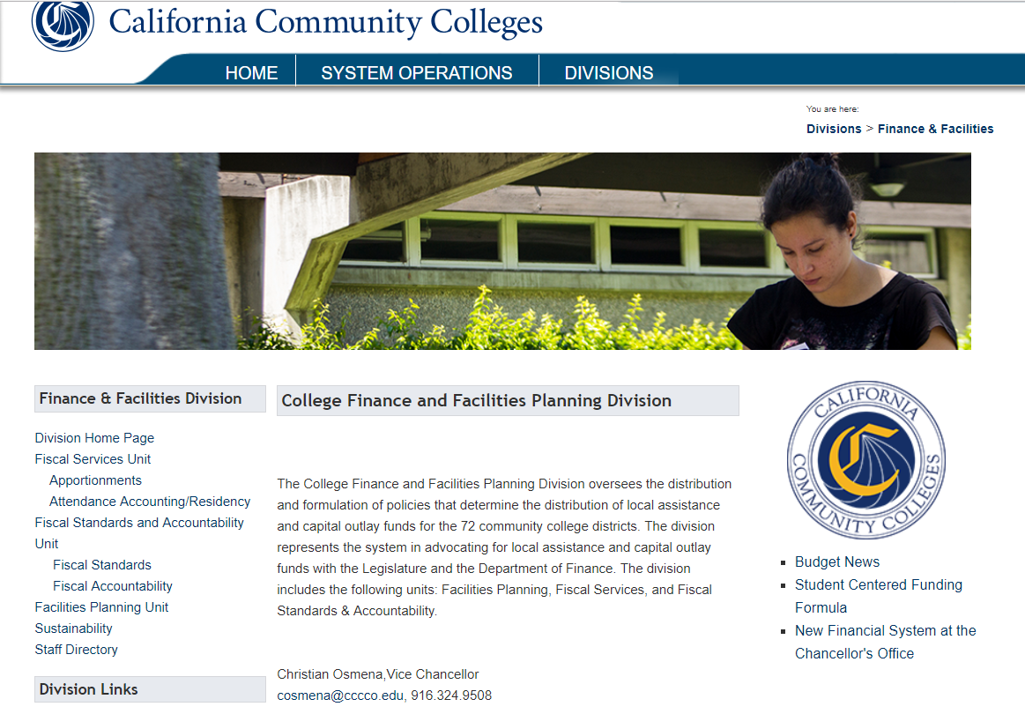
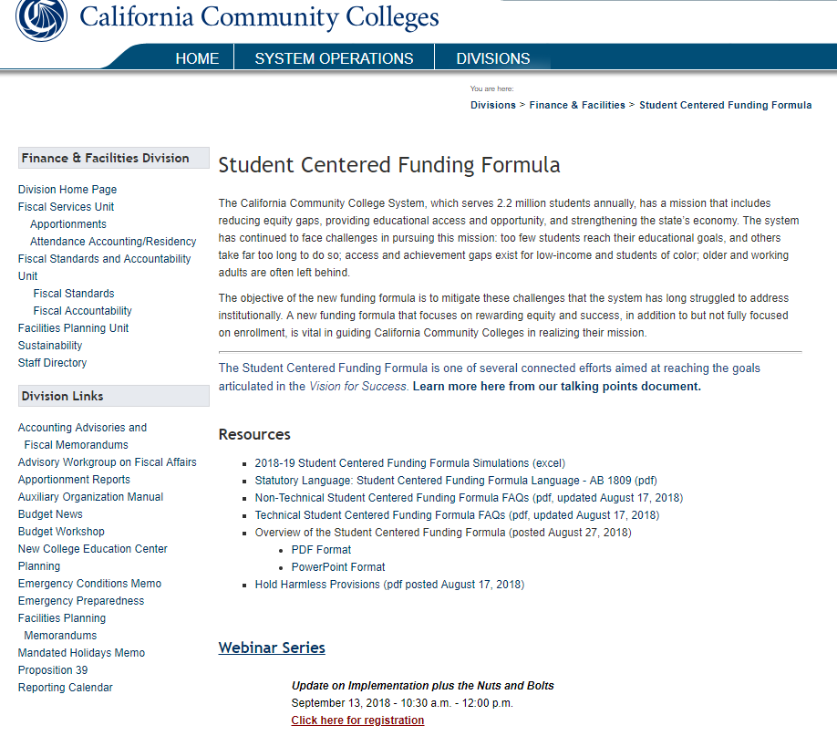
Email Address
Website URL
scff@cccco.edu
http://extranet.cccco.edu/Divisions/FinanceFacilities/StudentCenteredFundingFormula.aspx

Slide 23
Other Support
We have scheduled three SCFF webinars:
September 13—Nuts and Bolts of the SCFF missed it
October 9, 2:00-3:00 —Deep Dive into Data
November 5, 2:00-3:00 —Seeing the Vision in SCFF Implementation

Slide 24
SCFF Questions?

Slide 25
Annual Financial and Compliance Audit
Community college districts are required to have an annual audit conducted by a CPA firm (EC § 84040.5)
The Contracted District Audit Manual (CDAM) prescribes the requirements and procedures for the annual audit
New CDAM issued each Fiscal Year
Section 400 of CDAM -State Compliance Tests (15 tests in 2018-19)
Of the 15 State tests, 7 directly relate to verifying FTES eligibility for State general apportionment. Findings in these areas could result in an apportionment adjustment.
Notes:
25

Slide 26
Audit Tests Related to FTES
Instructional Services Agreement’s – ISA’s (423)
General Apportionment Funding System (424)
Residency (425)
Students Actively Enrolled (426)
Dual Enrollment (427)
Open Enrollment (435)
Apprenticeship RSI (444)
To Be Arranged Hours – TBA (479)
Notes:
26

Slide 27
Why Audit FTES?
Ensure adequacy of governing board-approved procedures, retention of supporting documentation, and independent verification of claimed FTES (§§ 58004, 58030)
To ensure that state aid is apportioned according to the same standards to all districts (§ 58052)
To ensure that the state, districts, and students receive a reasonable return for monies expended (§ 58052)

Slide 28
Common State Compliance Audit Findings
Incorrect application of Attendance Accounting Procedures (T5 §§ 58000 et seq.)
Common deficiencies:
Example 1: Credit course does not meet the same amount of hours per week, so Weekly Census procedure incorrectly applied
Example 2: Support records for positive attendance hours generated did not agree with hours claimed
Example 3: Claiming students that were required to be removed from census roster
Example 4: Apportionment claimed for cancelled “census-based” classes. For cancelled courses, the following rules apply:
Positive Attendance courses – Apportionment can be claimed for actual student contact hours generated by the student up to their drop.
Census-based classes (weekly or daily) cancelled before or after census, apportionment cannot be claimed for the entire course because it ceases to be regularly scheduled.
Notes:
28

Slide 29
FY 18-19 CDAM – Revisions/Updates
Section 424 – State General Apportionment Funding System
The background and criteria sections now reflect the newly enacted Student Centered Funding Formula (SCFF).
In addition, some apprenticeship programs are now eligible to claim full-time equivalent students for apportionment purposes.

Slide 30
FY 18-19 CDAM – Revisions/Updates
Section 425 – Residency
The audit procedures have been updated to reflect recent legislation related to the residency determination for students cross enrolled through the online course exchange of the Online Education Initiative Consortium.
The residency determination of the student’s home college is accepted if the teaching college possesses a signed consortium reciprocity agreement.

Slide 31
FY 18-19 CDAM – Revisions/Updates
Section 427 – Dual Enrollment
Recent legislation now allows :
CCAP agreements with charter schools
Closed courses for eligible high school students in person or using an online platform
In addition, the CCAP annual report must include the total number of FTES generated by online CCAP participants.

Slide 32
Questions?
Wrenna Finche, CPA
Director of Fiscal Standards and Accountability
Division of College Finance and Facilities Planning
wfinche@cccco.edu

