Slide 1
A Transfer Discussion
New CCC Admissions Directors Training
September 2018
Bob Quinn
Notes:
Thank you for the invitation to be here to talk with you about transfer.
My name is Bob Quinn, I began at the CCC in 2005 after 15 years in the private sector. In 2007 I transferred to student services and have been doing T&A ever since.

Slide 2
This Hour…
Role of the Transfer & Articulation Unit
Vision for Success - Transfer
New and Not So New Transfer-Related Initiatives
My unsolicited opinions...
Leave better informed regarding local transfer-related challenges

Slide 3
Transfer & Articulation Unit
“…develop and maintain relationships with colleagues at the CCC, UC, CSU and AICCU systems to allow us all to work cooperatively in a way that ensures transfer intended students have pathways and the necessary support to achieve their academic goals.”
Represent the CO on statewide policy development related to T&A;
Provide leadership on statewide, intersegmental projects;
Promote two-way communication on T&A issues between the colleges and the CO;
Administer technical assistance to the colleges. (AOs & TCDs primarily)
And other duties as assigned…
Notes:
And other duties as assigned – eg: currently writing an RFA for Dual Enrollment

Slide 4





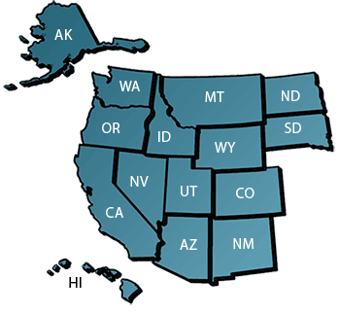
Strong Partnerships
CSU
UC
AICCU
HBCU
Out-of-state
Notes:
The success of my work is dependent on relationships with other segments to further the cause and work out state & local issues as they arise
More about these institutions in a minute.
Wiche by the way would like a statewide exchange agreement, but it has been difficult to reach any mutual agreement (displaces resident students, not all CCCs need enrollment, tuition already low)

Slide 5
Vision for Success - Transfer
#2 - Over five years, increase by 35 percent the number of CCC
students system-wide transferring annually to a UC or CSU*
Notes:
Chancellor’s Goal #2 of 6 by 2022.
May be a tough go given enrollment numbers. Isn’t enrollment flat or decreasing? You know better than me!
My two cents, I would like to see rate based, and even better intersegmental metrics such as yield…pie in sky – regional yield
In 2016-17 79,707 transfers to UC (17,836) and CSU (61,871)

Slide 6


Transfer Pathways
Associate Degree for Transfer
  CSU priority admission
  60 units to BA/BS
HBCU Guaranteed Transfer Agreement
  ADT with 2.5 GPA or at least 30 transfer units
  37 HBCUs as of Sept 2018
Western Governors University
  ADT and admission guarantee, 100% online
UC “Transfer Planner” road maps and now MOU
  Single set of courses to transfer by major
  Admission Guarantee for Fall 2019 term on the horizon
  Recent MOU
AICCU
  Recent MOU
  36 prospective AICCUs so far
  ADT emphasis, Guaranteed Admission, up to 128 units
Notes:
Pathways seems to be the word of the year.
ADT – enacted 2010. More on that in the next slide.
HBCUs were my first attempt to use the ADT as the template for articulation with other segments. Began in 2015 with 9 HBCUs, a GPA of 2.5 or higher and and IGETC/CSU GE, will be guaranteed admission with junior standing.
Then came the WGU. In 2017 WGU signed an agreement with the CCC, recognizing ADT major and GE course fulfilment. Over 5,000 students enrolled, most in health and nursing.
More on the UC one later. Up to 21 popular majors, currently a curriculum fulfillment program, not admissions priority.
AICCU – an agreement with the CCC July 2018, 36 prospective AICCUs, accepts ADTs and 128 unit guarantee. No E-verify plans to date!

Slide 7
Assoc. Degrees for Transfer
Origins – Excess units at CCC & CSU: last minute curric. reqmnts, repeats, inconsistency
2,497 degrees to choose from across 38 majors, ~ 4.5 fewer units, 1.6 fewer terms
Students are younger, slightly more likely to be Hispanic, slightly less likely to be Black, and slightly less likely to be female.
CSU 2017 Overall - Apps (107,779) Adm (83,033) Enr (51,373)
CSU 2017 ADT – Apps (34,004) Adm (33,202) Enr (18,031) 52% on path
Redirects – 839 (2.5% of Apps) of which 18% enrolled, of which 2.5% of those stayed on path
Notes:
Graph numbers are all understated (Wheelhouse Institute UCD), but the point is made.
Only 2.5% of total ADT unduplicated applications were redirected, per CSU. Of those only 18% enrolled, of those 2.5% stayed on path.
Is redirection is fake news?
Is a lot of time being done for verification with for little benefit?

Slide 8
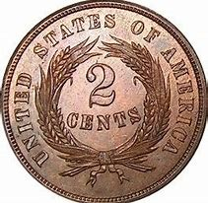

My Two Cents…
Disclaimer: The comments you are about to hear are Bob’s and not those of the Chancellor’s Office…
Promising initiatives in the works
Segment collaboration positive
But Please Do Not Forget About…
We accept the top 100% of all applicants!
Articulation – 82% of CSU transfers (with or without ADTs) need articulation
Regional Impaction vs. student mobility
Implementation details
Notes:
A leader recently asked me if we need ASSIST
The need to measure what is happening at the regional level, and Through the Gate is a promising study in the works.
Program fatigue, all too often the meetings stop prematurely. Details matter!

Slide 9
Other Initiatives…
Common Course Identification (C-ID)
New ASSIST
UC Transfer Pathways
Notes:
I would like to touch briefly on the following three programs

Slide 10
What is C-ID?
A Course Identification Numbering System
Products
  Course descriptors (eg: Math 110 Intro to Stats)
Processes
  Convening of intersegmental faculty for descriptor development
  Statewide vetting of draft descriptors
  Submission of CCC course outlines for review
  Course outline review process and C-ID Number award
Outcomes
  One to many articulation, high data value
  Quality control for ADT Transfer Model Curriculum (TMC) Templates

Slide 11
Why is C-ID Important?
Outcomes
  One to many articulation, filling gaps
  Like ASSIST, a very high data value for other initiatives
  Quality control for ADT Transfer Model Curriculum (TMC) Templates

Slide 12
C-ID By The Numbers
397 Descriptors to choose from in 47 disciplines
18,136 CCC courses have received a C-ID designation
1,290 CSU articulations based on C-ID, with 16 CSUs participating
CTE curricula is the current focus
Notes:
Quite detailed---much more so than CAN was; represent the minimum included in a course.

Slide 13
Articulation System Stimulating Interinstitutional
Student Transfer
Student-Transfer Information System

Slide 14
ASSIST Facts
Partnership between 114 CCCs, 23 CSUs, and 9 UCs
Equally funded by the CCC, CSU, and UC
Over 400,000 transfer course agreements plus GE lists
ASSIST generated over 16 million articulation agreements and transferability lists for over 1 million unique users in 2017
Notes:
ASSIST is a computerized student-transfer information system that can be accessed over the World Wide Web. It displays reports of how course credits earned at one California college or university can be applied when transferred to another. ASSIST is the official repository of articulation for California’s colleges and universities and therefore provides the most accurate and up-to-date information available about student transfer in California.

Slide 15
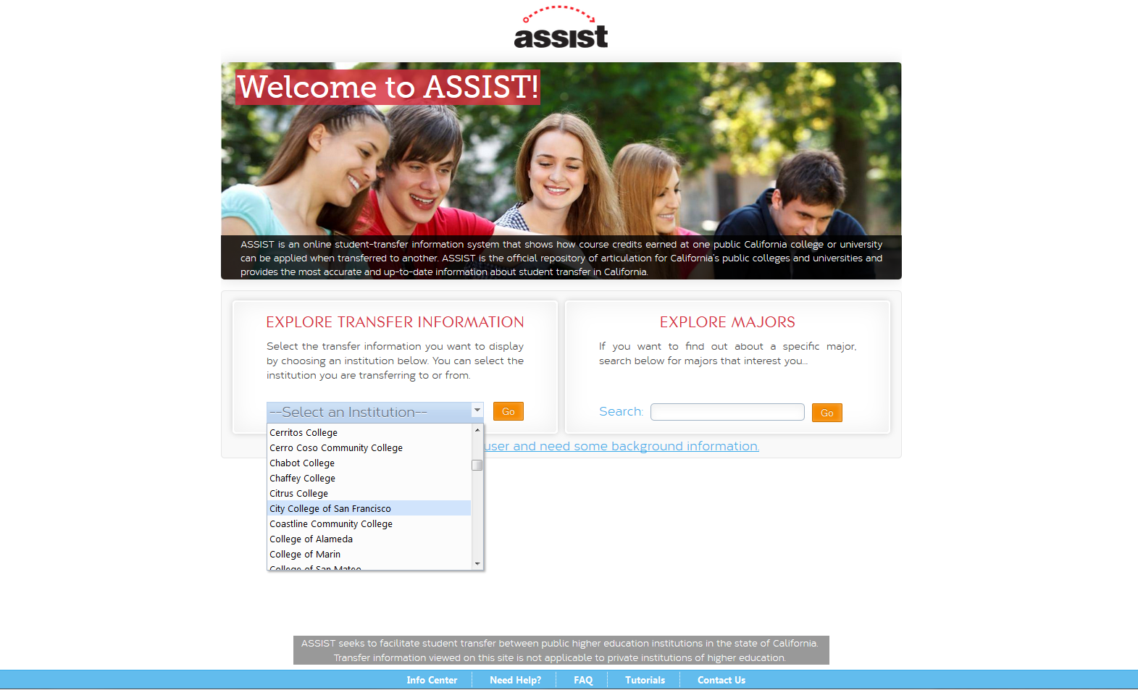
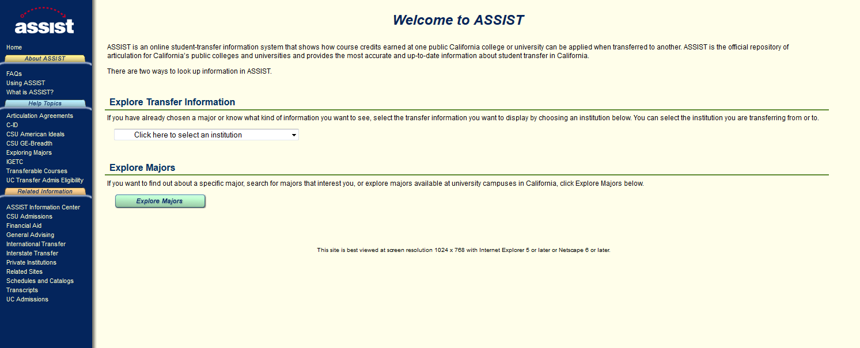
New ASSIST
Legacy ASSIST Home Page:
ASSIST Next Gen Home Page:

Slide 16
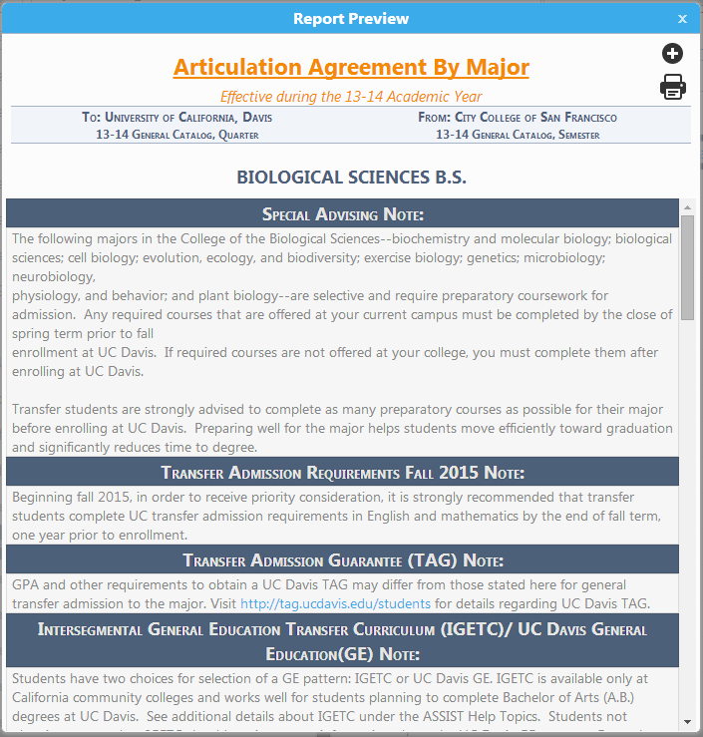
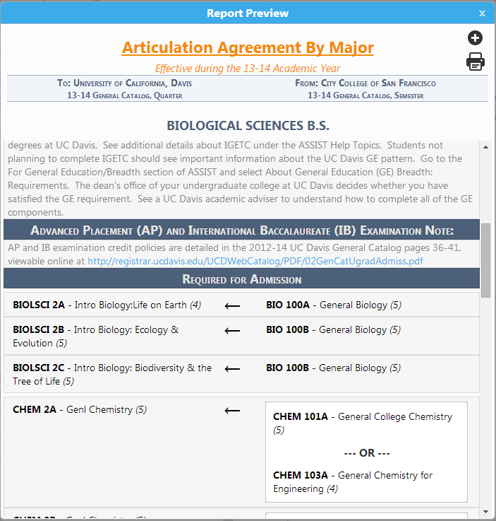
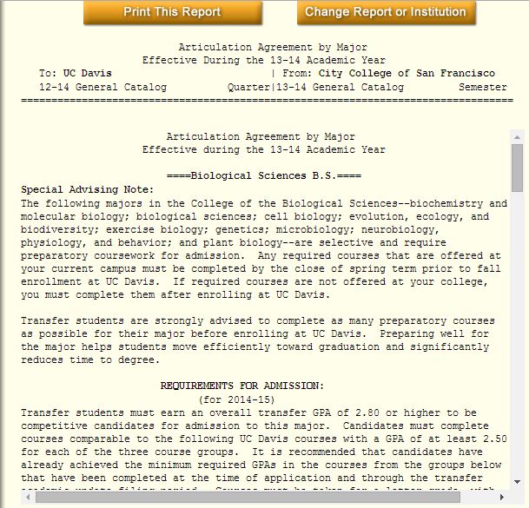
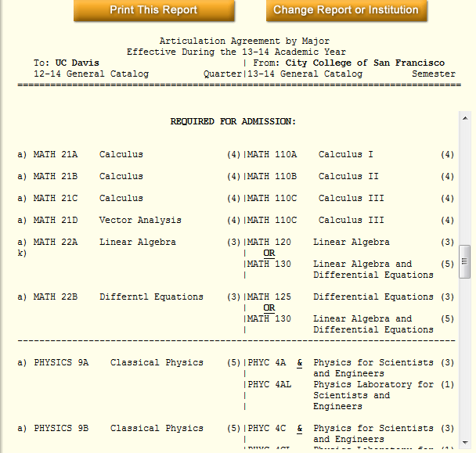
Updates to ASSIST
Legacy ASSIST Transfer Agreement:
ASSIST Next Gen Transfer Agreement:

Slide 17
New ASSIST Update
Initial vendor failure, new vendor 2017
Message to link to temporary CSU and UC sites with current articulation and transferability
Summer 2019 launch with minimally viable product (MVP)

Slide 18
New ASSIST Update
Worth the wait…
“Data-fied” to better support other initiatives
  Online course search engines, audit and planning tools
Enhanced data delivery methods (web services)
Updated look with new features
  One to many college/university articulation views
  Pin it
  Ad hoc reporting feature
  Accessibility compliance
Streamlined backend module for AOs and System Offices

Slide 19
PATHWAYS TO UCs
UC Transfer Initiative

Slide 20

UC Transfer Diversity
Most UC Transfers come from relatively few CCCs:
25% of CCC transfers come from 7 CCCs
50% of CCC transfers come from 19 CCCs
75% of CCC transfers come from 41 CCCs
All 114 CCCs sent at least 1 student to UC

Slide 21
UC Transfer Initiative
A 2014 Transfer Action Team Recommendation;
21 Majors To Date;
Provides a Clear Roadmap to Prepare for a Major that is Acceptable at ANY of the Nine UC Undergraduate Campuses;
Allows Students to Make Themselves Competitive Across the UC system;
  Via LD curriculum fulfillment, not admission guarantee/priority
Work In Progress – Building out the Articulation
Foundation for future admission guarantees

Slide 22
Questions or Comments?
Bob Quinn bquinn@cccco.edu

