Slide 1
CCC Systemwide Initiatives
Education Planning Initiative
CCCCO Admission and Records
New Director’s Briefing
Presented by:
Victor DeVore, San Diego Community College District
Sept 20, 2017

Slide 2
Introductions
  Victor DeVore
    EPI Steering Committee Co-Chair – Year five of operations, Oversee 8 steering committees
    Day Job: San Diego CCD, Student Services Analyst
    CACCRAO Technology Officer
Notes:
Introduction, talk briefly about the Education Planning Initiative. Initiatives include: CCCApply, Student Portal, e-Transcripts, Articulation, Curriculum Programs, works with other two major technology intiatives – Common Assessment Initiative and Online Education Initiative

Slide 3
Learning Objectives
What problems are we solving?
  Common view of challenges facing students on their educational journey
How are we solving these problems?
  Availability of supportive technology toolsets and programs to promote student success

Slide 4

Education Planning Initiative
Student Success Task Force found problems with support provided to students
Recommendation 2.2
  Students must develop an education plan, new modes of service delivery needed
Recommendation 2.3
  Centralized and integrated technologies to better guide and support students needed

Slide 5
Guided Pathways - 2017
Student-centered approach towards students completing educational goals/objectives.
Ambitious goals, with seven core commitments
Integration of funding silos:
  SSSP
  Basic Skills
  Equity
  Strong Workforce Program
  California College Promise

Slide 6

I can’t go to school today because my babysitter is sick!
The course was full or not available!
I took classes I didn’t need!
I can’t ever get time with my counselor or instructor!
I changed my major – now major problems!
Finish?
No idea!
Student-centric Problem Solving…

Slide 7
EPI Toolsets – Key Features
Transform business processes, remove barriers, with integrated statewide toolsets:
Student Portal: SSO, predictive analytics, rules engine
Career Exploration: Cultivate compelling goals
Application: Student profile
Assessment: Integration with CCCAssess
Orientation: On-ramp to success
Education Planning: Tied to timely Degree Audit
Early Alert: Awareness and collaboration
Back-end: eTranscripts, Curriculum

Slide 8
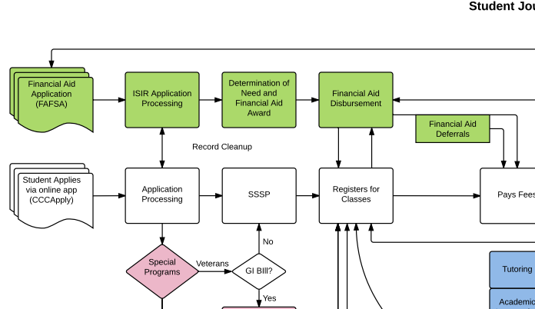
Supporting the Student Journey
Student and Counselor driven tools support the educational Journey

Slide 9
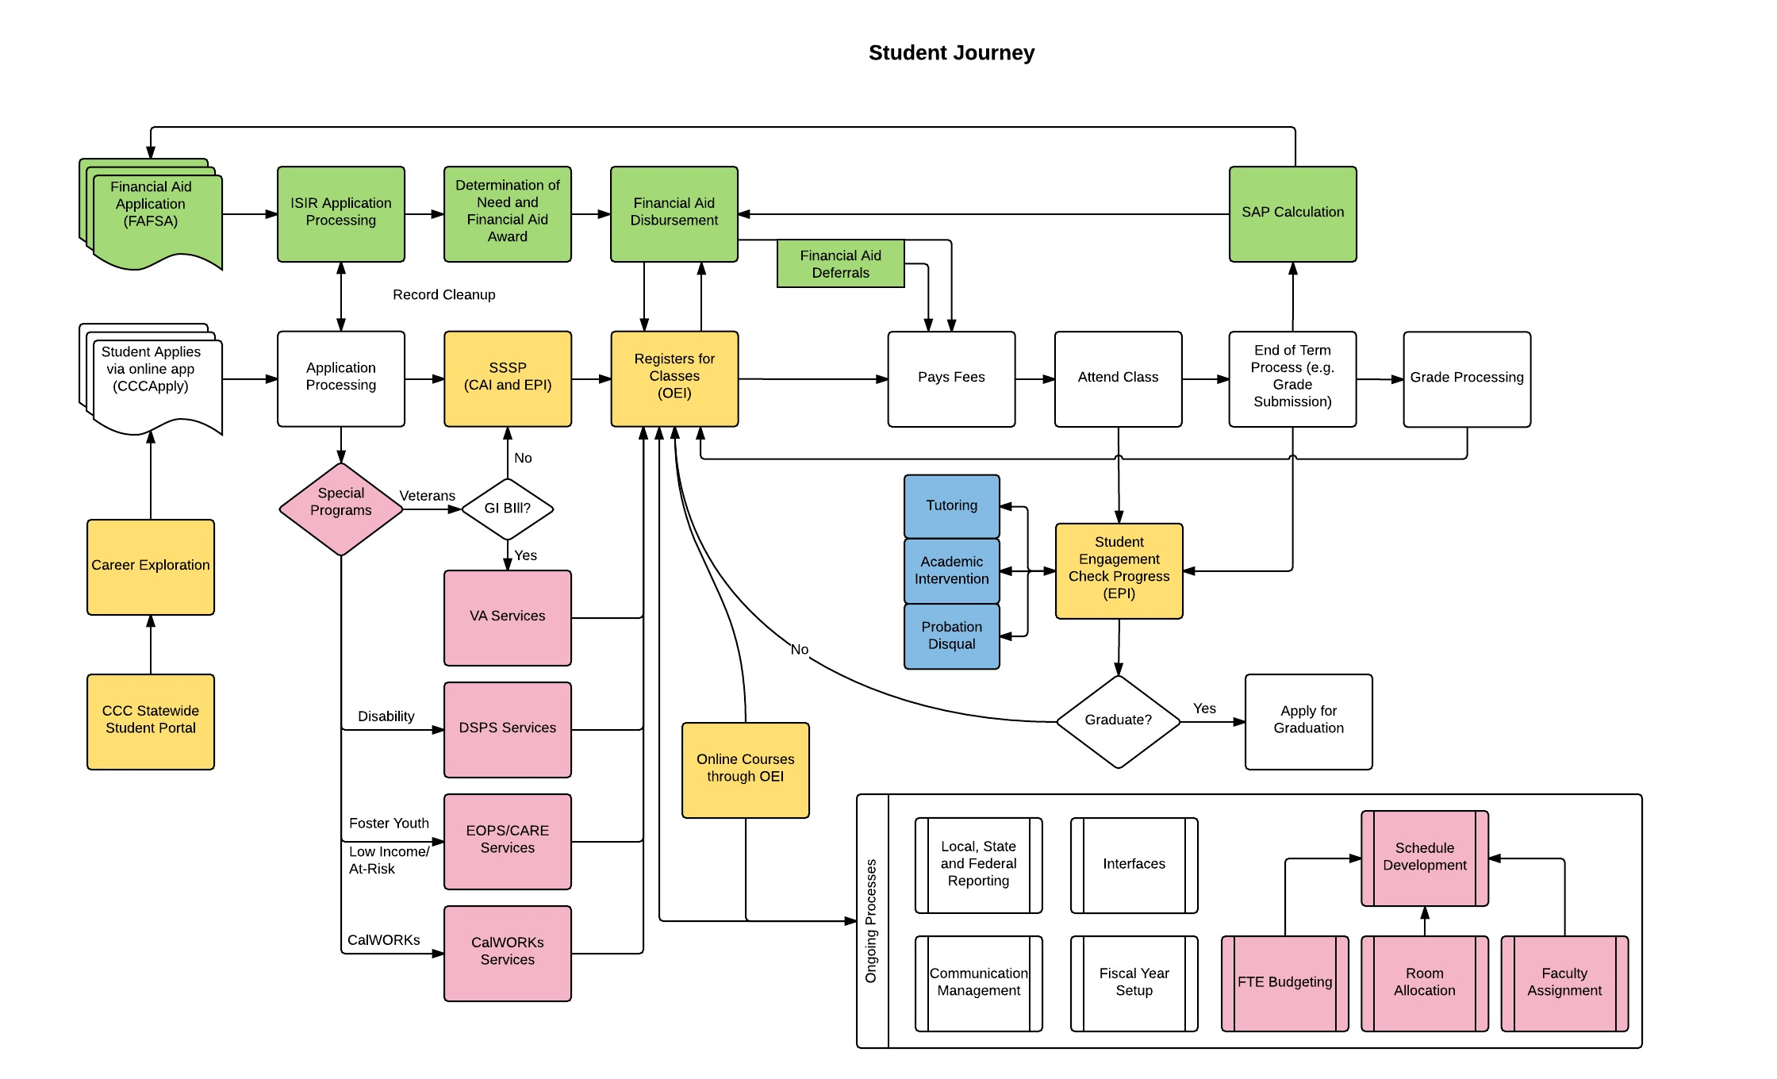

Slide 10
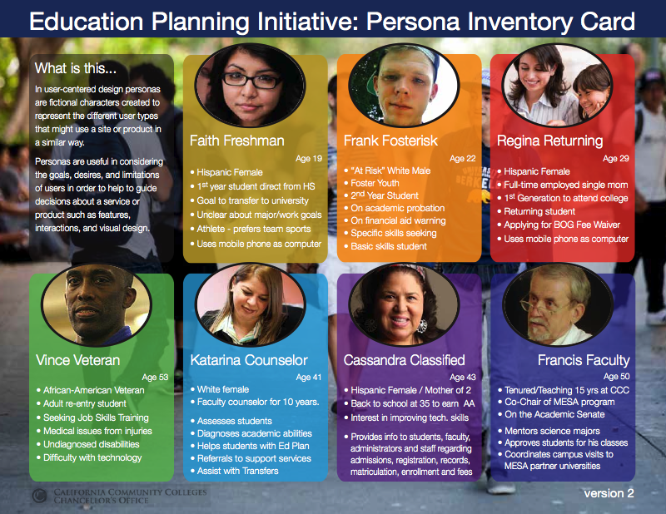
Structured pathways that support planning and progress

Slide 11
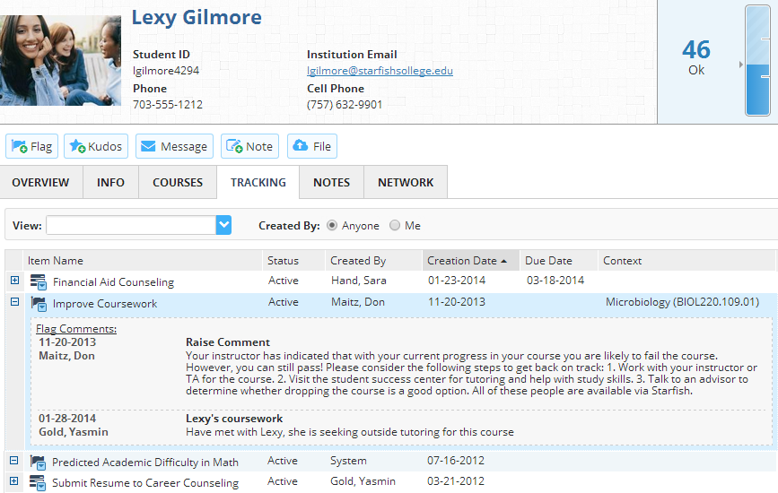

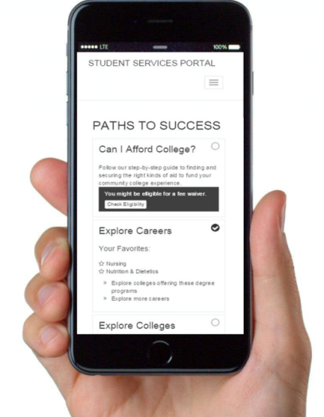
CCC Technology Center Support
Implementation
Integration
Professional Development
User Communities
Help Desk
Ongoing Product Management
Notes:
Information on how the CCC Technology center supports colleges with implementing the new initiatives. Helps demonstrate that there is support, common best practices and working with practioners

Slide 12













With many thanks to our EPI pilot colleges…

Slide 13
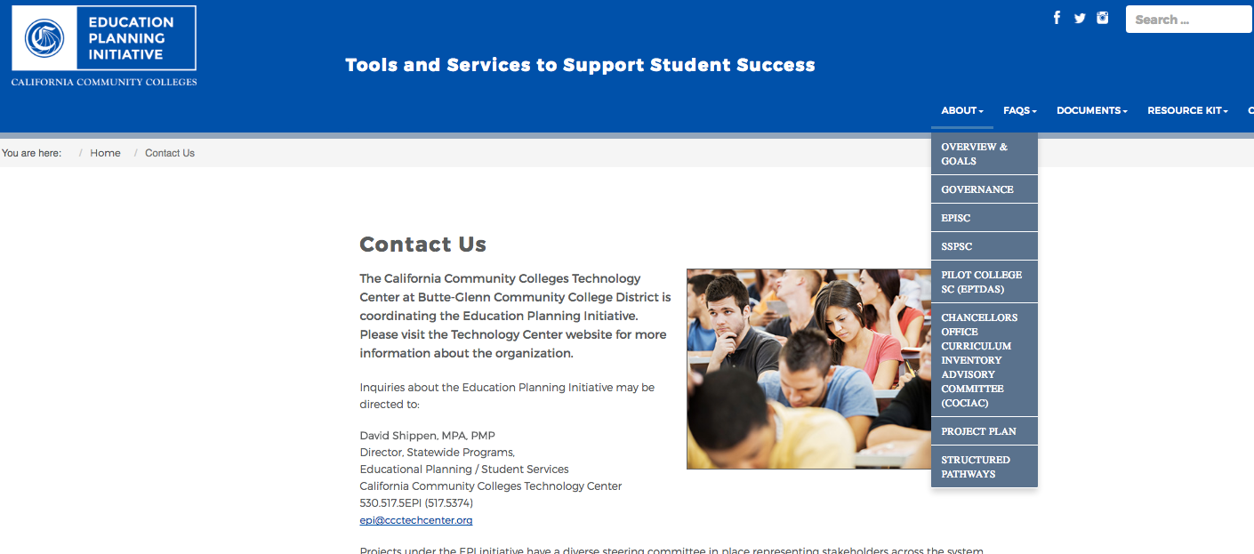
Online Resources
cccedplan.org

Slide 14
Questions?
Thank you for your support!
cccedplan.org

